Slide 1
The Bible The Origin, Inspiration, and Translation
Lesson # 6
Translation & Interpretation

Slide 2
You Can’t Trust
The Bible Because There Are
Mistakes In It

Slide 3
There Are Mistakes (Variations) In Our Translations
Acts 9:5; 26:14
NASB, NIV, "And he said, 'Who art Thou, Lord?' And He said, 'I am Jesus whom you are persecuting'."
KJV, "And he said, Who art thou, Lord? And the Lord said, I am Jesus whom thou persecutest: it is hard for thee to kick against the pricks."

Slide 4
Do These Mistakes Make The Bible Not Trustworthy?
These are human mistakes, not divine mistakes.
Most are non-intentional changes.
Even the intentional changes are not to change the text, but to improve it.
Don't ignore the obvious!

Slide 5
Textual Variants
When you look at the different copies or translations you will see variations or differences.
Unintentional Mistakes
Copying the wrong letter or word.
Leaving a word out or copying a word twice.
Easily discovered and fixed.

Slide 6
Textual Variants
Intentional Mistakes
The adding of a word, words, or sentences.
This was not done to deceive and change the text, but rather to explain, interpret, or parallel a passage.

Slide 7
Matt. 11:19 & Luke 7:35
Matt. 11:19 (NASB)
"The Son of Man came eating and drinking, and they say, 'Behold, a gluttonous man and a drunkard, a friend of tax-gatherers and sinners!' Yet wisdom is vindicated by her deeds."
Matt. 11:19 (KJV)
"The Son of man came eating and drinking, and they say, Behold a man gluttonous, and a winebibber, a friend of publicans and sinners. But wisdom is justified of her children."

Slide 8
Col. 1:14 & Eph. 1:7
Col. 1:14 (NASB)
"in whom we have redemption, the forgiveness of sins."
Col. 1:14 (KJV)
"In whom we have redemption through his blood, even the forgiveness of sins."

Slide 9
More Difficult Passages
1 John 5:7 - The "Trinity"
Mark 16:9-20 - The "Long Ending"
Even if we took these out, what they say and teach are found in other passages. Their exclusion would not change the teaching of the Bible.

Slide 10
Textual Criticism
This is the science or area of study where "experts" try to accurately restore or determine the original text.
The very first textual critics seemed to be honest in their pursuits, but, as time went on, more liberal critics came on the scene.

Slide 11
Rules of Textual Criticism
Manuscript evidence is better than version evidence.
The earlier manuscript is preferred over the later manuscript.
The variant with the most evidence is to be preferred, but quality in manuscripts outweighs quantity.

Slide 12
Rules of Textual Criticism
The shorter variant is to be preferred.
The more difficult variant is to be preferred.

Slide 13
Rules of Interpretation
Hermeneutics - The science of interpretation.
The interpretation that contradicts another passage is wrong.
The interpretation that takes the passage out of context is false.
The context will tell you if a passage is to be taken literally or figuratively.
Simple is almost always preferred.

Slide 14
Copies Of The Old Testament
Why Is The Discovery Of The Dead Sea Scrolls So Significant To Our Understanding Of The Bible?
Up To That Point The Earliest Copies We Had Were Written Even After The New Testament.

Slide 15
Copies Of The Old Testament
The Aleppo Codex – 10th Century Copy
The Leningrad Codex – 11th Century
The British Library Codex Of The Pentateuch – 10th Century
There Are Translations That Are Dated Earlier.

Slide 16
Should Our Faith In The Old Testament Be Shaken?
Jesus Didn’t Have A Problem With It
NO!
The Scribes That Copied The Old Testament Did So With Reverence and Awe.
A Comparison Of The Dead Sea Scroll Texts Shows That There Are No Significant Changes To The Massoretic Text Found In Our Modern Bibles.
Notes:
M

Slide 17
..\..\..\..\lotus\work\flg\herm5.PRZ The Bible Has More Copies
Author | When Written | Earliest Copy | Time Span | # of Copies
Homer (The Iliad) | 900 B.C. | 400 B.C. | 500 years | 643
Sophocles | 496 B.C. | 1000 A.D. | 1,400 years | 193
Demosthenes | 383 B.C. | 1100 A.D. | 1,500 years | 200
Aristophanes | 450 B.C. | 900 A.D. | 1,200 years | 10
Aristotle | 384 B.C. | 1100 A.D. | 1,400 years | 49
Tacitus | 100 A.D. | 1100 A.D. | 1,000 years | 20
The New Testament | 40-100 A.D. | 125 A.D. | 25 years | Over 24,000

Slide 18
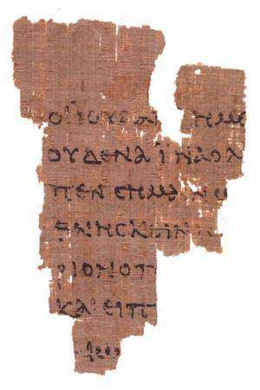
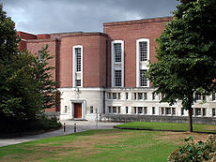
The John Ryland Fragment
A Partial Copy of John’s Gospel
Dated A.D. 125
Less Than 50 Years After The Original
Located At the John Ryland Museum in Manchester, England
Manchester, England
Notes:
M

Slide 19
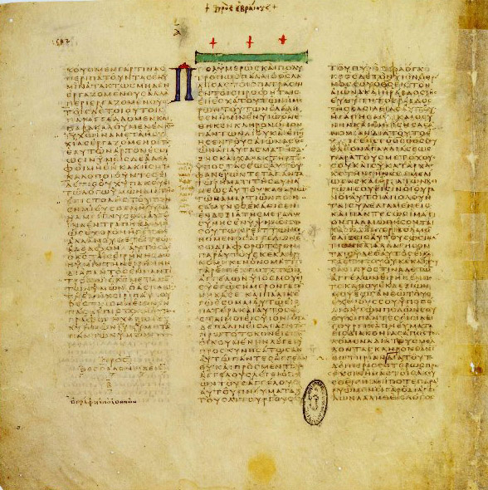
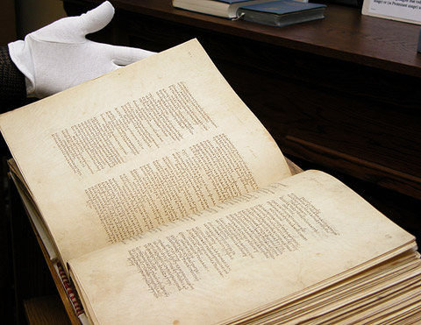
3 Significant Ancient Copies
The Vatican Manuscript (B)
Date = 4thCentury
Location = Vatican
Notes:
M

Slide 20
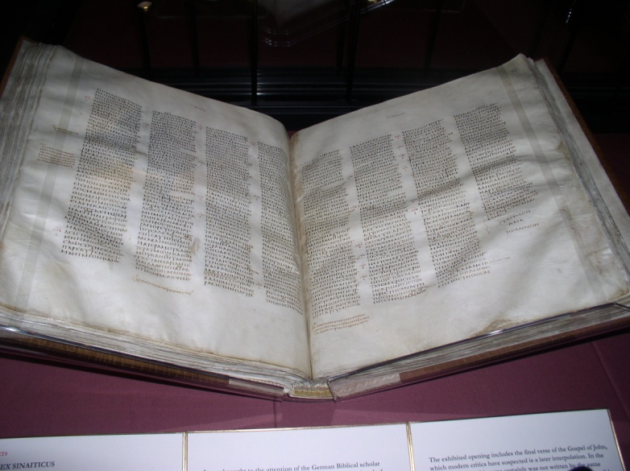
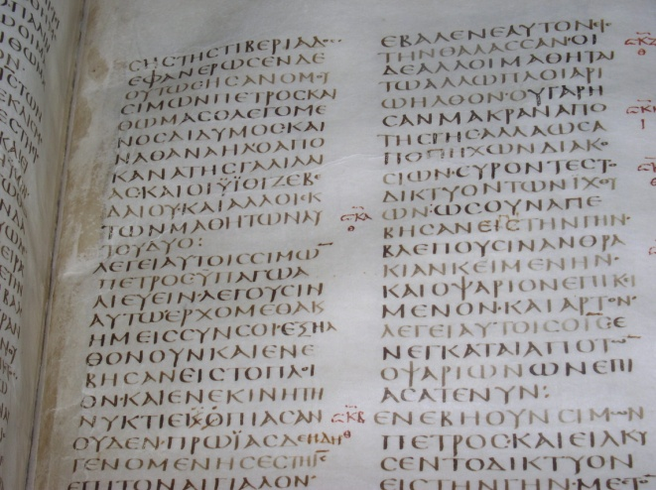
3 Significant Ancient Copies
The Sinaitic Manuscript (Aleph)
Date = 4thCentury
Location = British Library
Find = Great Story
Notes:
M

Slide 22
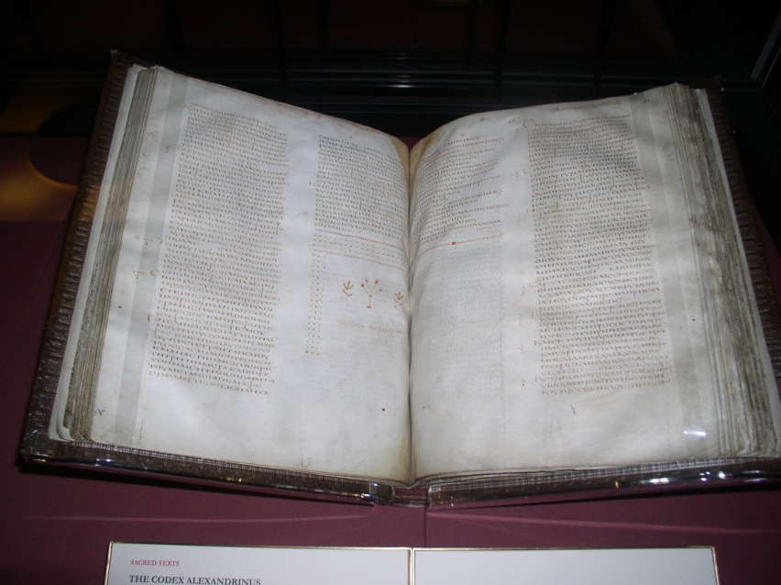
3 Significant Ancient Copies
The Alexandrian Manuscript (A)
Date = 5thCentury
Location = British Library
Notes:
M

Slide 24
2 Tim 3:16-17
“All Scripture is inspired by God and profitable for teaching, for reproof, for correction, for training in righteousness;
¹⁷ that the man of God may be adequate, equipped for every good work.”

