Slide 1
Christian Evidences
Summer 2018
July 1: A study of ancient writings

Slide 2
Purposes of this study
To strengthen our own faith through the examination of evidence.
To equip ourselves with the tools needed to defend our faith.

Slide 3
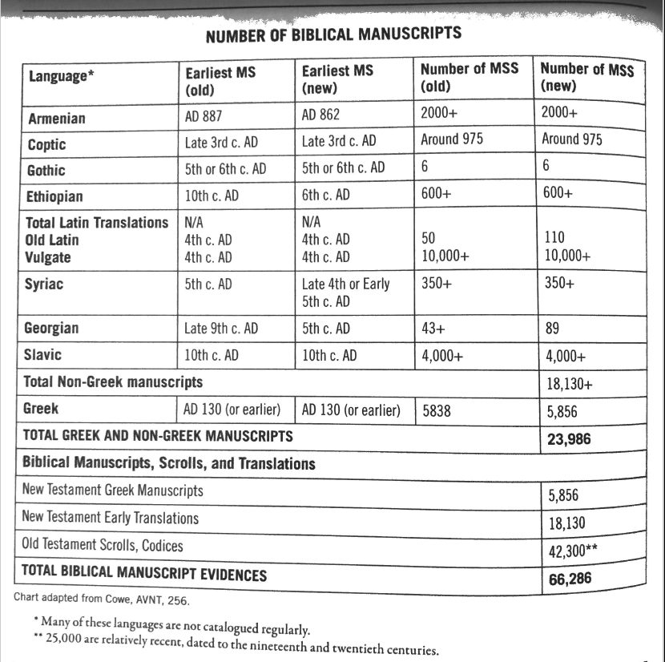

Slide 4
Manuscripts
Important factors
How many?
Are they from many different areas geographically?
How close in age is the manuscript to the original writing?

Slide 5
Original Dates of Composition
Dating Original Writings
Clues outside of the writings that relate to the author or the writing
Expressions that are dated
Events that are mentioned or omitted
Similarities to other texts written in a certain time period

Slide 6
Manuscripts
Dating Manuscripts
Material on which it is written; what kind of ink was used
Compare with other works – general trends
Handwriting – book hand and cursive
Styles of letters – uncials and minuscules
Generally, we get a broad idea of when it was written
plus or minus 20 years or more

Slide 7
P52

Slide 8
Early Manuscripts
P52 – a papyrus fragment from the gospel of John – dated A.D. 100-150
So far, it is the oldest piece of the New Testament ever found.
Chester Beatty Biblical Papyri
#1: portions of the four gospels and Acts – 3rd century
#2: portions of 8 letters of Paul and Hebrews – AD 200
#3: large portion of Revelation – 3rd century

Slide 9
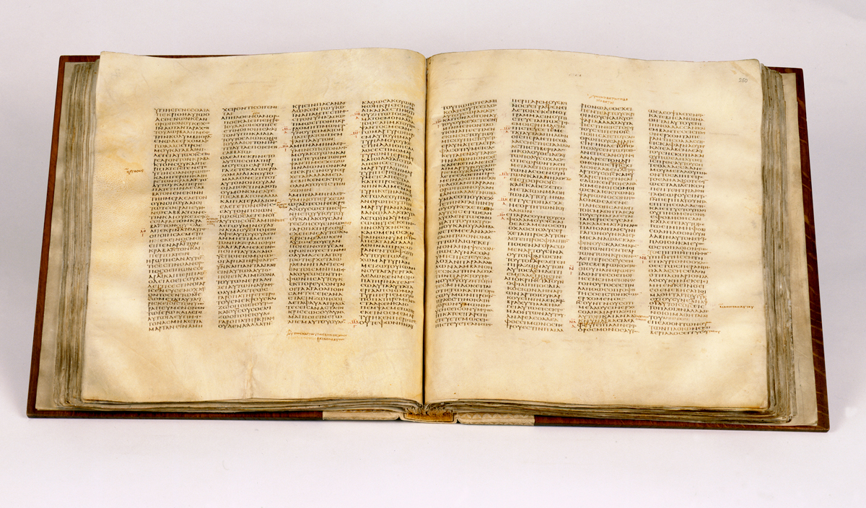
Codex Sinaiticus

Slide 10
Early Manuscripts
Martin Bodmer Papyri
2/3 of the gospel of John
AD 200
Codex Sinaiticus – complete New Testament – AD 350
Codex Vaticanus – almost complete New Testament – AD 350

Slide 11
New Testament Canon
2 Timothy 3:16
All scripture is inspired by God…

Slide 12
New Testament Canon
What is/was the criteria used for determining what is inspired by God?
1. Was the book written by an apostle?
2. Was the writer confirmed by the acts of God? (i.e. miracles)
Did the message tell the truth? (Does it harmonize with apostolic authority?)
4. Was it generally accepted by God’s people, especially those living when the book was written?

Slide 13
New Testament Canon
2 Peter 3:15-16 (AD 67-68)
¹⁵ And count the patience of our Lord as salvation, just as our beloved brother Paul also wrote to you according to the wisdom given him, ¹⁶ as he does in all his letters when he speaks in them of these matters. There are some things in them that are hard to understand, which the ignorant and unstable twist to their own destruction, as they do the other Scriptures.
Letters of Polycarp (AD 115), Clement (AD 200)
refer to Old and New Testament books with the phrase, “as it is said in these scriptures.”

Slide 14
New Testament Canon
Iranaeus (AD 180) (20 books listed)
His writings attest the canonical recognition of the four gospels, Acts, Romans, 1 & 2 Corinthians, Galatians, Ephesians, Philippians, Colossians, 1 & 2 Thessalonians, 1 & 2 Timothy, Titus, 1 Peter, 1 John, and Revelation.
Origen in Homiliae Josuam 7.1
(c. AD 249)
Lists all books except for Revelation.
(Revelation only book missing)

Slide 15
New Testament Canon
By AD 249, all books of the New Testament had been recognized as authoritative and inspired works.
That’s 219 years after Jesus.
Writings of the church fathers referred to the 27 books exclusively with few exceptions.

Slide 16
Other Books
Pseudepigrapha
Writing produced by someone falsely claiming to be someone else.
Gospel of Thomas
Gospel of the Ebionites
Gospel of Peter
Gospel of Mary
Gospel of the Hebrews
Gospel of the Egyptians
Gospel of Philip
Gospel of Judas

Slide 17
Other Books
Apocryphal Writings
Writings that contained much “legendary material.” Some were gnostic with “secret knowledge.”
The “Real” First Corinthians
Ancient Homily (2nd Clement)
Apocalypse (Revelation) of Peter
Acts of Paul and Thecla
Epistle to the Laodiceans
Gospel According to the Hebrews
Shepherd of Hermas

Slide 18
Other Books
Catechetical Writings
Writings that had some value, but were still not considered canonical.
Epistle of Pseudo-Barnabas
Epistle to the Corinthians (Clement)
Shepherd of Hermas
Didache, Teaching of the Twelve
Epistle of Polycarp to the Philippians
The Seven Epistles of Ignatius

Slide 19
Old Testament Canon
As with the New Testament, “no human authority and no council of rabbis ever made the Old Testament authoritative. These books were inspired by God and had His stamp of authority on them from the beginning. Through the long usage in the Jewish community their authority was recognized.”

Slide 20
Old Testament Canon
Council in Jamnia – AD 90
Rabbis merely confirmed the canon which was already in place
Evidence shows that the Hebrew canon was established as early as the fourth century BC and no later than 150 BC.

