Slide 1
Life’s Milestones
Notes:
Milestones – For tonight’s invitation, I want to talk to you about milestones
The original use of milestones is very old, in fact, the use of milestones dates back to around the 3rd century B.C. or about 2,300 years ago.

Slide 2
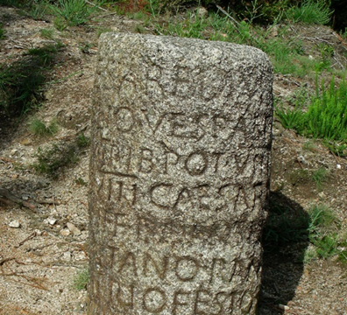
Roman Milestones
Notes:
The original use of milestones is very old, in fact, the use of milestones dates back to around the 3rd century B.C. or about 2,300 years ago.
The Romans had built a huge 53,000 mile network of roads and for every 1,000 paces or approximately 4,800 feet a stone marker was placed.
Mark Progress: Travelers were then able to use these stones placed at such intervals to mark their progress.
Directions and Information: Also, it also helped those who had traveled a particular road give new traveler’s directions and information about their trip on that same road.
About 95 Roman milestones still exist with inscriptions, mostly dedications to the current Emperor at the time of inscription, or distance to a location.
The original use of milestones is very old, in fact, the use of milestones dates back to around the 3rd century B.C. or about 2,300 years ago.

Slide 3
Milestones
Mile Markers: We have continued the practice of milestones even today. We call them mile markers.
Interstate Highways: Next time you travel on an interstate highway, look to the side of the road. Every mile, there will be a little sign with a number on it. It tells you how many miles you have traveled from the beginning of the road.
All the exit signs are numbered according to the nearest mile marker.

Slide 4
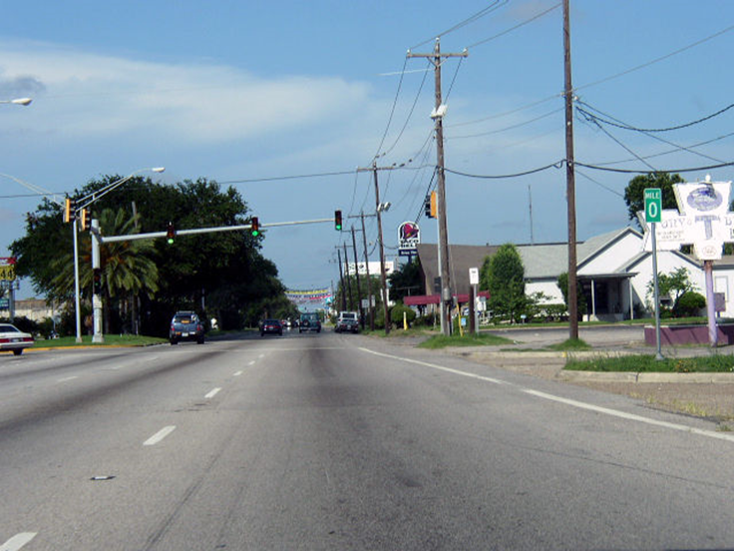
Present Day Use of Milestones Mile Markers and Exist Numbers
Notes:
For example, I-45 has 285 mile-markers.
Mile marker zero is on Galveston Island at the 61st street intersection.

Slide 5
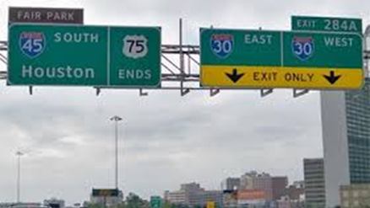
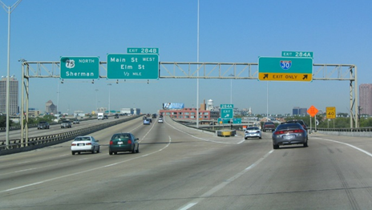
I-45 Mile Marker 285
Notes:
The last I-45 mile marker – mile marker 285 – which is located in Dallas between exits 284 A and B. At that point, the highway turns into I-75.
Therefore, as you are traveling north, exit 284 B denotes the end of I-45 as it changes into I-75.
As you are traveling south, exit 284 A denotes the ending of I-75 as it changes into I-45.
In between, each mile marker tells the traveler where they are at. For example, at I-45 mile marker 263 is Walnut Springs, Texas.

Slide 6
Milestones in Life
Life is a Journey: Like a road leading from birth to death
Milestone Events: Life events that let us know where we are on life’s road – and what to expect when we are there
Notes:
Related to that, the word milestone is more commonly used as reference points in our lives
Milestone Events: Each person’s life is like a journey on a road taking us from birth to death. And like the Roman milestones, various events that take place in our lives serve as milestones which let us know where we are at in our life’s journey.
All milestones of life are permanent life changing events.

Slide 7
Milestones in Life
Life Changing Events
Birthdays
Other Events: Joy, Sorrow, Grief
Notes:
Birthdays: For example, each birthday that we have is a type of milestone that not only tells us where we are on our life’s journey, but informs us of what we can generally expect to experience as we enter each decade. With each passing decade, our lives are permanently changed forever. There is no going back.
Of course, the milestones of life are far more than simply aging and having birthdays. As we travel through life, we will also encounter various life changing events that we also call milestones.
Joy: Many are joyous: Marriage, Birth of a child, strength of young maturity, first job or promotion
Sorrow and Grief: Others are times of extraordinary sorrow and grief. Death of a spouse or child, disabling illness, loss of employment.
Again, each of these events permanently change our lives forever.

Slide 8
Milestones in Life
Rites of Passage
Ecclesiastes 1:9 That which has been is that which will be, And that which has been done is that which will be done. So, there is nothing new under the sun.
Notes:
Rites of Passage: These life changing events – the milestones of our lives - kind of like “rites of passage” which all must experience. The Ecclesiastes writer observed there is nothing new under the sun.
By this passage, we can be sure that the life changing milestone events that are certain to occur in our respective lives has been experienced by countless others. While not every life is identical, taken as a whole, we are simply going through what all must go through – both good or bad.

Slide 9
Milestones in Life
Adversities and Tribulations
Sorrows and Griefs
Fears and Terrors
Pain and Suffering
Disability and Loss
Notes:
Perhaps the milestone events that are the most difficult to contend are those that bring us into the fire of tribulations and adversity.
Deep sorrows and griefs
Witness death of loved ones
Times of fears and even terrors
Times when we suffer disability and the loss of just about everything we ever had. In this regard, I am overwhelmed by what the Mann’s and Kimbrough’s are going through.
I know what sorrows and hardships Deb and I have endured over our life time.
I know what Deb and I are having to endure now.
But we have not had to experience what Mark and Kim and Dan and Janice and their families are having to endure now.

Slide 10
Milestones in Life
Adversities and Tribulations – All must enter:
Matthew 6:34 … Each day has enough trouble of its own.
John 16:33 … In the world you have tribulation,…."
Acts 14:22 … " Through many tribulations we must enter the kingdom of God.“
1 Peter 4:12 Beloved, do not be surprised at the fiery ordeal among you, which comes upon you for your testing, as though some strange thing were happening to you;
Notes:
But this I do know. All of God’s children must enter into sufferings during this physical life.

Slide 11
Question
Joyous Milestones:
Will we abandon God?
Will we forget God?
Suffering Milestones:
Will we remain faithful?
Will we reject God?
Notes:
The question for each of us tonight is how we will respond to milestone events that are certain to occur in our lives.
When we enter into the joyous events of this physical existence, will we abandon God to enjoy the good things this world has to offer? Will we forget God?
When we suffer in this present life, will we remain faithful? Will we reject God?

Slide 12
Nature of this Physical Life
Constant Change – Nothing stays the same
Good things will come:
They are passing
All we obtain we will lose
Life is filled with Difficulties, Sorrows, Pain
But they too are passing
Notes:
In answering these questions, please keep this in mind:
Life is constant change. Nothing stays the same.
The good things of this physical life are temporary and passing. All that we obtain we will lose.
This life is filled with difficulties, sorrows, and pain. But they too are passing.

Slide 13
Nature of God
Constant & Unchanging Presence in our Lives
God will more than restore all that we lose
Eternal Life
Kingdom
Glory
Authority – Reign with Christ
Inherit all that Jesus inherits
Notes:
But God is the one constant and changing presence in our lives. He will more than restore all that we lose in this present life.
He grants to us eternal life as an inheritance
He gives us His kingdom as an inheritance.
He glorifies us and gives us authority.
He will make everything new

Slide 14
My Next Milestones
Most of your approaching milestones are now memories for me
My life is mostly lived.
I have three abiding milestones that remain
Ultimately, they are your milestones also
Notes:
This brings us to me – what are my next milestones?
In many respects, all of your approaching milestones in life are now memories for me.
Education is done and past
I’ve held my jobs and am now retired.
Our children are grown
Deb and I have suffered our sorrows and tragedies. Most are behind us. Some continue. And more will come
My life has been mostly lived – but three milestones remain. And more than that, they remain for you and all the other children of God. They are the constant milestones that remain throughout our entire lives

Slide 15
Three Remaining Milestones
Serve God
1 Corinthians 15:58 Therefore, my beloved brethren, be steadfast, immovable, always abounding in the work of the Lord, knowing that your toil is not in vain in the Lord.
Death
Hebrews 9:27 And inasmuch as it is appointed for men to die once and after this comes judgment,
Glory
2 Timothy 4:8 in the future there is laid up for me the crown of righteousness, which the Lord, the righteous Judge, will award to me on that day; and not only to me, but also to all who have loved His appearing.
Notes:
Serve God:
1 Corinthians 15:58 Therefore, my beloved brethren, be steadfast, immovable, always abounding in the work of the Lord, knowing that your toil is not in vain in the Lord.
No matter what we successes and joys come our way or what sorrows and griefs we suffer, we must faithfully endure to serve God in love.
Death:
Hebrews 9:27 And inasmuch as it is appointed for men to die once and after this comes judgment,
All of our lives’ milestones all point to and prepare us for this final moment certain moment in life. While most men dread this moment in fear and grief, for the Christian, the day and hour of our death will be the best moment of our life in this physical existence. After that, it will only get better.
Glorification:
2 Timothy 4:8 in the future there is laid up for me the crown of righteousness, which the Lord, the righteous Judge, will award to me on that day; and not only to me, but also to all who have loved His appearing.

