Slide 2
Refusing God’s Promise
The Failure at Kadesh-Barnea
Numbers 13-14

Slide 3
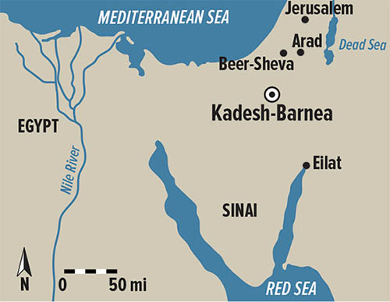
What’s going on?
Delivered from Slavery in Egypt
Covenant with God at Sinai
Approaching Promised Land
Complained at Every Step
Numbers 13-14

Slide 4
Two Reports of the Land
Promised Land
“They are too strong for us”
10
Promised Land
“We will surely overcome it”
2
Numbers 13:25-14:10

Slide 5
Two Responses to Jesus
Promised Life
Broad and easy way
Many
Promised Life
Narrow and difficult way
Few
Matthew 7:13-14

Slide 6
Promised Kingdom
(5:1-12)
Poor in spirit, Meek, Mourn
Promised Kingdom
(5:20-48)
Righteousness beyond Pharisees
Promised Reward
(6:1-18)
Pray, Fast, Give with a pure heart
Matthew 5-7

Slide 7
Learning from the Few
Make God’s glory our ultimate goal.
Take on a “different spirit.”
Numbers 14:11-24

Slide 8
Refusing God’s Promise
”God has Not given us a spirit of Fear, but of Power, Love, and Self-control”
Numbers 13-14

