Slide 1
Moses & The New Moses
Sunday, December 22, 2019

Slide 2
How does the author encourage the readers?
Describing examples of faith from famous Hebrews
Old Testament stories ex: Moses
Validate their faith
Connections between Old Testament and Jesus

Slide 3
What is your favorite story about Moses?
Take a minute to write down which story

Slide 4
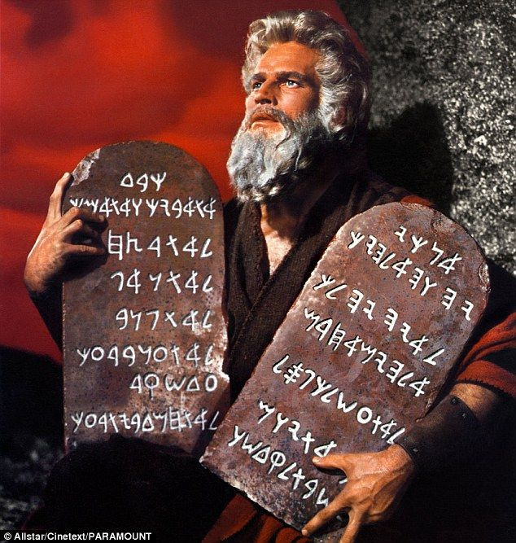
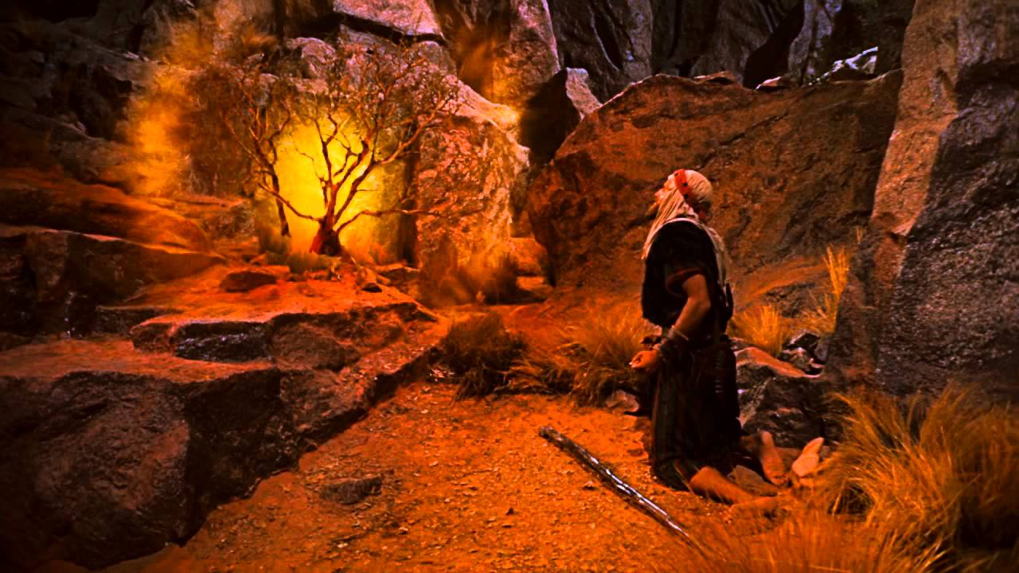
My Favorite Stories

Slide 5
Who is the New Moses?
Deuteronomy 18
15 “The Lord your God will raise up for you a prophet like me from among you, from your brothers—it is to him you shall listen— 16 just as you desired of the Lord your God at Horeb on the day of the assembly, when you said, ‘Let me not hear again the voice of the Lord my God or see this great fire any more, lest I die.’ 17 And the Lord said to me, ‘They are right in what they have spoken. 18 I will raise up for them a prophet like you from among their brothers. And I will put my words in his mouth, and he shall speak to them all that I command him. 19 And whoever will not listen to my words that he shall speak in my name, I myself will require it of him.

Slide 6
Who is the New Moses?
Luke 24
⁴⁴ Then he said to them, “These are my words that I spoke to you while I was still with you, that everything written about me in the Law of Moses and the Prophets and the Psalms must be fulfilled.”

Slide 7
Who is the New Moses?
Acts 7
³⁵ “This Moses, whom they rejected, saying, ‘Who made you a ruler and a judge?’—this man God sent as both ruler and redeemer by the hand of the angel who appeared to him in the bush. ³⁶ This man led them out, performing wonders and signs in Egypt and at the Red Sea and in the wilderness for forty years. ³⁷ This is the Moses who said to the Israelites, ‘God will raise up for you a prophet like me from your brothers.’ ³⁸ This is the one who was in the congregation in the wilderness with the angel who spoke to him at Mount Sinai, and with our fathers. He received living oracles to give to us. ³⁹ Our fathers refused to obey him, but thrust him aside, and in their hearts they turned to Egypt,

Slide 8
By Faith Statement 1/5
Hebrews 11:23
23 By faith Moses, when he was born, was hidden for three months by his parents, because they saw that the child was beautiful, and they were not afraid of the king's edict.

Slide 9
By Faith Statement 1/5
Hebrews 11:23
Questions
23 By faith Moses, when he was born, was hidden for three months by his parents, because they saw that the child was beautiful, and they were not afraid of the king's edict.
Whose Faith?

Slide 10
By Faith Statement 1/5
Hebrews 11:23
Questions
23 By faith Moses, when he was born, was hidden for three months by his parents, because they saw that the child was beautiful, and they were not afraid of the king's edict.
Whose Faith?
Parents of Moses

Slide 11
By Faith Statement 1/5
Hebrews 11:23
Questions
23 By faith Moses, when he was born, was hidden for three months by his parents, because they saw that the child was beautiful, and they were not afraid of the king's edict.
Whose Faith?
Parents of Moses
Are there any similarities between the childhood of Moses and Jesus?

Slide 12
By Faith Statement 2/5
Hebrews 11:24-26
24 By faith Moses, when he was grown up, refused to be called the son of Pharaoh's daughter, 25 choosing rather to be mistreated with the people of God than to enjoy the fleeting pleasures of sin. 26 He considered the reproach of Christ greater wealth than the treasures of Egypt, for he was looking to the reward.

Slide 13
By Faith Statement 2/5
Hebrews 11:24-26
Questions
24 By faith Moses, when he was grown up, refused to be called the son of Pharaoh's daughter, 25 choosing rather to be mistreated with the people of God than to enjoy the fleeting pleasures of sin. 26 He considered the reproach of Christ greater wealth than the treasures of Egypt, for he was looking to the reward.
Whose Faith?

Slide 14
By Faith Statement 2/5
Hebrews 11:24-26
Questions
24 By faith Moses, when he was grown up, refused to be called the son of Pharaoh's daughter, 25 choosing rather to be mistreated with the people of God than to enjoy the fleeting pleasures of sin. 26 He considered the reproach of Christ greater wealth than the treasures of Egypt, for he was looking to the reward.
Whose Faith?
Moses

Slide 15
By Faith Statement 2/5
Hebrews 11:24-26
Questions
24 By faith Moses, when he was grown up, refused to be called the son of Pharaoh's daughter, 25 choosing rather to be mistreated with the people of God than to enjoy the fleeting pleasures of sin. 26 He considered the reproach of Christ greater wealth than the treasures of Egypt, for he was looking to the reward.
Whose Faith?
Moses
What is the “Reproach of Christ”?

Slide 16
By Faith Statement 2/5
Hebrews 11:24-26
Questions
24 By faith Moses, when he was grown up, refused to be called the son of Pharaoh's daughter, 25 choosing rather to be mistreated with the people of God than to enjoy the fleeting pleasures of sin. 26 He considered the reproach of Christ greater wealth than the treasures of Egypt, for he was looking to the reward.
Whose Faith?
Moses
What is the “Reproach of Christ”?
Reproach - disapproval or disappointment in someone
Rebuke, scold, reprimand
Reproach of Christ is a term used to refer to those who suffer because of their faith

Slide 17
By Faith Statement 2/5
Hebrews 11:24-26
Questions
24 By faith Moses, when he was grown up, refused to be called the son of Pharaoh's daughter, 25 choosing rather to be mistreated with the people of God than to enjoy the fleeting pleasures of sin. 26 He considered the reproach of Christ greater wealth than the treasures of Egypt, for he was looking to the reward.
How is the “Reproach of Christ” greater than the “treasures of Egypt”?

Slide 18
By Faith Statement 3/5
Hebrews 11:27
Questions
27 By faith he left Egypt, not being afraid of the anger of the king, for he endured as seeing him who is invisible.
Whose Faith?

Slide 19
By Faith Statement 3/5
Hebrews 11:27
Questions
27 By faith he left Egypt, not being afraid of the anger of the king, for he endured as seeing him who is invisible.
Whose Faith?
Moses

Slide 20
By Faith Statement 3/5
Hebrews 11:27
27 By faith he left Egypt, not being afraid of the anger of the king, for he endured as seeing him who is invisible.
The Invisible God

Slide 21
By Faith Statement 3/5
Hebrews 11:27
27 By faith he left Egypt, not being afraid of the anger of the king, for he endured as seeing him who is invisible.
The Invisible God
Reminds me of Hebrews 11:1 Now faith is the assurance of things hoped for, the conviction of things not seen

Slide 22
The Invisible God
Examples in Hebrew culture
Holy of Holies

Slide 23
The Invisible God
Examples in Hebrew culture
Were Images of God made?

Slide 24
The Visible God

Slide 25
The Visible God
Colossians 1:15
Hebrews 1:3
“He is the image of the invisible God, the firstborn of all creation”
“He is the radiance of the glory of God and the exact imprint of his nature, and he upholds the universe by the word of his power. After making purification for sins, he sat down at the right hand of the Majesty on high”

Slide 26
Movie Trivia
For over 50 years ABC has played the 10 Commandments annually on this day?

Slide 27
Movie Trivia
For over 50 years ABC has played the 10 Commandments annually on this day?
Answer: the night before Easter

Slide 28
Movie Trivia
For over 50 years ABC has played the 10 Commandments annually on this day?
Answer: the night before Easter
Did ABC get this right?

Slide 29
By Faith Statement 4/5
Hebrews 11:28
Questions
28 By faith he kept the Passover and sprinkled the blood, so that the Destroyer of the firstborn might not touch them.
Whose Faith?

Slide 30
By Faith Statement 4/5
Hebrews 11:28
Questions
28 By faith he kept the Passover and sprinkled the blood, so that the Destroyer of the firstborn might not touch them.
Whose Faith?
Moses

Slide 31
What is Passover?
Exodus 13
6 Seven days you shall eat unleavened bread, and on the seventh day there shall be a feast to the Lord.7 Unleavened bread shall be eaten for seven days; no leavened bread shall be seen with you, and no leaven shall be seen with you in all your territory. 8 You shall tell your son on that day, ‘It is because of what the Lord did for me when I came out of Egypt.’ 9 And it shall be to you as a sign on your hand and as a memorial between your eyes, that the law of the Lord may be in your mouth. For with a strong hand the Lord has brought you out of Egypt. 10 You shall therefore keep this statute at its appointed time from year to year.

Slide 32
Elements of Passover

Slide 33
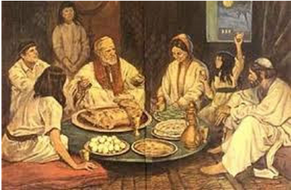
Elements of Passover
The telling of the Passover story
8 You shall tell your son on that day, ‘It is because of what the Lord did for me when I came out of Egypt.’

Slide 34
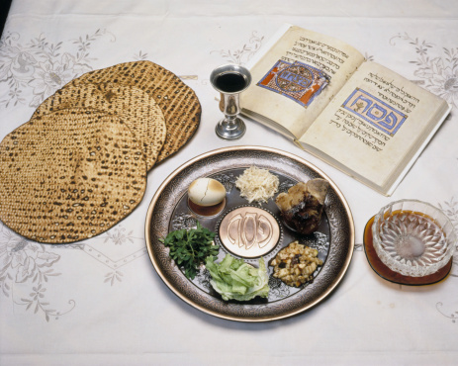
Elements of Passover
The Meal
Lamb
Unleavened bread
Fruit of the vine
Bitter herbs

Slide 35
Significance of Passover
In Jewish Culture
A time set aside annually to remember the story of the Exodus and how God delivered his people from the bondage of Egypt
In Christian Culture
The first Lord’s Supper was the last Passover
A time set aside weekly to remember the story of the death and resurrection of Jesus Christ through who God delivered his people from the bondage of sin

Slide 36
By Faith Statement 5/5
Hebrews 11:29
29 By faith the people crossed the Red Sea as on dry land, but the Egyptians, when they attempted to do the same, were drowned.

Slide 37
By Faith Statement 5/5
Hebrews 11:29
29 By faith the people crossed the Red Sea as on dry land, but the Egyptians, when they attempted to do the same, were drowned.
Whose Faith?
The People (Hebrews)

Slide 38
How did the Jews show their faith by crossing the Red Sea?

Slide 39
Art Trivia
Located in Vatican City this chapel is home to the papal conclave and many famous works of art

Slide 40
Sistine Chapel – Ceiling

Slide 41
Sistine Chapel – Ceiling

Slide 42
Sistine Chapel – Alter Wall
Currently is home to Michelangelo's “the Last Judgement”
Previously hosted artwork depicting the birth and infancy of Moses and Jesus

Slide 43
Sistine Chapel – South Wall (6 stories of Moses)

Slide 44
Sistine Chapel – North Wall (6 stories of Christ)

Slide 45
Sistine Chapel – Entrance Wall
Resurrection of Christ
Dispute over the body of Moses

Slide 46
The New Moses: Deuteronomy 18
15 “The Lord your God will raise up for you a prophet like me from among you, from your brothers—it is to him you shall listen— 16 just as you desired of the Lord your God at Horeb on the day of the assembly, when you said, ‘Let me not hear again the voice of the Lord my God or see this great fire any more, lest I die.’ 17 And the Lord said to me, ‘They are right in what they have spoken. 18 I will raise up for them a prophet like you from among their brothers. And I will put my words in his mouth, and he shall speak to them all that I command him. 19 And whoever will not listen to my words that he shall speak in my name, I myself will require it of him.

Slide 47
“A prophet like me”
Deuteronomy 18:15
John 1:21,23
“The Lord your God will raise up for you a prophet like me from among you, from your brothers—it is to him you shall listen”
21 And they asked him, “What then? Are you Elijah?” He said, “I am not.” “Are you the Prophet?” And he answered, “No.”
23 He said, “I am the voice of one crying out in the wilderness, ‘Make straight the way of the Lord,’ as the prophet Isaiah said.”

Slide 48
“at Horeb on the day of the assembly”
Deuteronomy 18:16
John 1:17
“just as you desired of the Lord your God at Horeb on the day of the assembly, when you said, ‘Let me not hear again the voice of the Lord my God or see this great fire any more, lest I die.”
17 For the law was given through Moses; grace and truth came through Jesus Christ

Slide 49
“a prophet like you”
Deuteronomy 18:18
Acts 7:37-39
I will raise up for them a prophet like you from among their brothers. And I will put my words in his mouth, and he shall speak to them all that I command him.
³⁷ This is the Moses who said to the Israelites, ‘God will raise up for you a prophet like me from your brothers.’ ³⁸ This is the one who was in the congregation in the wilderness with the angel who spoke to him at Mount Sinai, and with our fathers. He received living oracles to give to us. ³⁹ Our fathers refused to obey him, but thrust him aside, and in their hearts they turned to Egypt,

Slide 50
“he shall speak to them all that I command him”
Deuteronomy 18:18
John 4:25-26
I will raise up for them a prophet like you from among their brothers. And I will put my words in his mouth, and he shall speak to them all that I command him.
25 The woman said to him, “I know that Messiah is coming (he who is called Christ). When he comes, he will tell us all things.” 26 Jesus said to her, “I who speak to you am he.”

Slide 51
“I myself will require it of him”
Deuteronomy 18:19
Acts 3:22-26
“And whoever will not listen to my words that he shall speak in my name, I myself will require it of him.”
22 Moses said, ‘The Lord God will raise up for you a prophet like me from your brothers. You shall listen to him in whatever he tells you. 23 And it shall be that every soul who does not listen to that prophet shall be destroyed from the people.’ 24 And all the prophets who have spoken, from Samuel and those who came after him, also proclaimed these days. 25 You are the sons of the prophets and of the covenant that God made with your fathers, saying to Abraham, ‘And in your offspring shall all the families of the earth be blessed.’ 26 God, having raised up his servant, sent him to you first, to bless you by turning every one of you from your wickedness.”

Slide 52
Why did the author include Moses in Ch.11?

