Slide 1
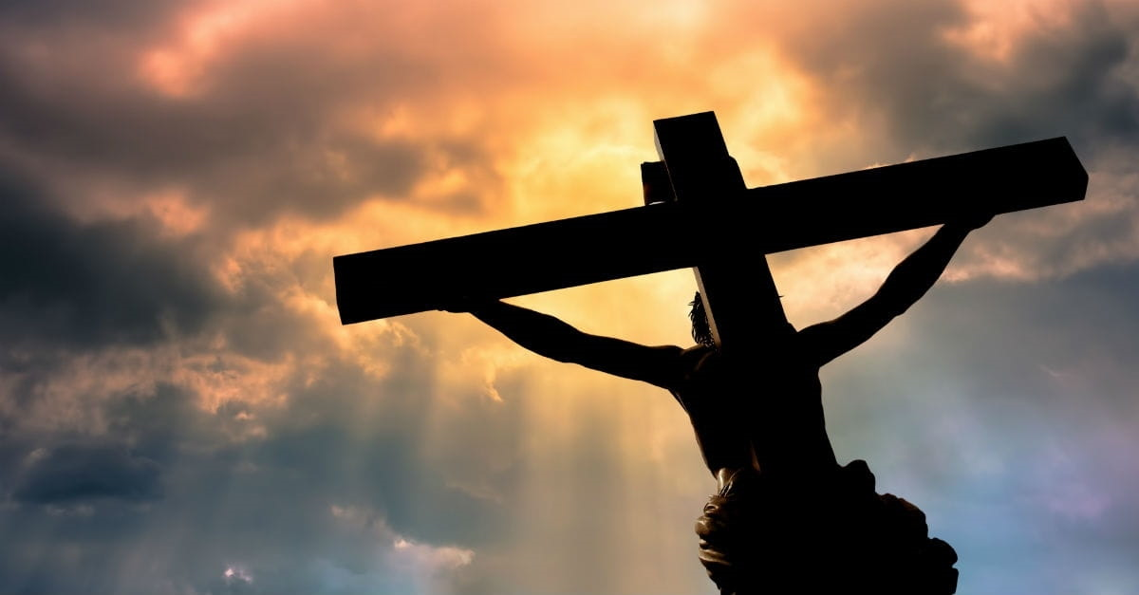
Overcoming Spiritual Discouragement
1
For By grace you have been saved by faith … It is the gift of God. Ephesians 2:8

Slide 2
Spiritual Discouragements
2
Temptation and Sin
Paradox – Who bears the greater guilt
Spiritual Progress

Slide 3
3
Romans 7:24 Wretched man that I am! Who will set me free from the body of this death?

Slide 4
4
Question: What Hope Do We have
Answer: Much
Right to have Confidence in Our Salvation
How is that Possible in Light of Sin?

Slide 5
5
Romans 7:24 Wretched man that I am! Who will set me free from the body of this death?
Romans 8:1 Therefore there is now no condemnation for those who are in Christ Jesus.

Slide 6
“In Christ”
6
Not a Figurative nor a Metaphorical Term – Literal
Baptized into Christ
Sins Washed Away - United to Christ - Sons of God
Free Gift of Eternal Life
Saved by God’s Grace and Not our Works
Where Sin Increases – God’s Grace Abounds More

Slide 7
Can We Sin with Impunity?
7
Romans 6:1-2 What shall we say then? Are we to continue in sin so that grace may increase? ² May it never be!
Galatians 2:17 "But if, while seeking to be justified in Christ, we ourselves have also been found sinners, is Christ then a minister of sin? May it never be!
Hebrews 10:26 For if we go on sinning willfully after receiving the knowledge of the truth, there no longer remains a sacrifice for sins,

Slide 8
Delimma
8
What Good is Grace if it No Longer Covers Our Sins?

Slide 9
Understanding God’s Grace
9
Satan is at War with the Children of God
God Knows We Will Suffer Temptations and Sin
Therefore, God Lavishes His Grace on Us
Purpose of Grace is not Enable More Sin
Purpose of Grace is to Protect us from Sin

Slide 10
When the Christian Sins
10
We are not to Give Up in Discouragement and Surrender
Instead, We are to Continue to Fight the Good Fight of Faith
But How?

Slide 11
When the Christian Sins
11
We will suffer sorrow, shame, guilt, and pain
Why? We see Sin as God sees Sin
Therefore, Sin Hurts
That Pain is what Motivates us to Repent

Slide 12
Strength to Persevere
12
Confidence in Salvation
Confidence in God’s Saving Grace
God’s Grace gives us a Fresh Start
Acts 3:19 "Therefore repent and return, so that your sins may be wiped away….

Slide 13
Purpose of God’s Grace – Fresh Start
13
1 Corinthians 15:10 But by the grace of God I am what I am, and His grace toward me did not prove vain; but I labored even more ….

Slide 14
When to Repent?
14
2 Corinthians 6:2 …" Behold, now is "THE ACCEPTABLE TIME," behold, now is "THE DAY OF SALVATION"—

