Slide 1
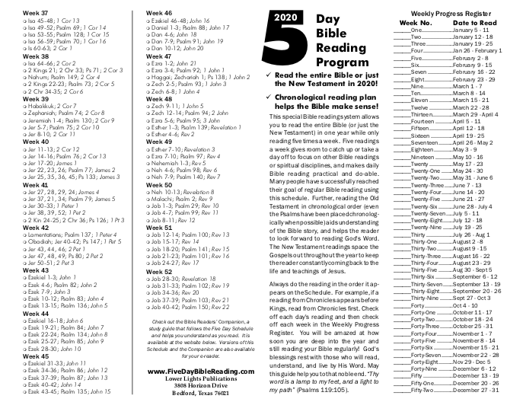

Slide 2
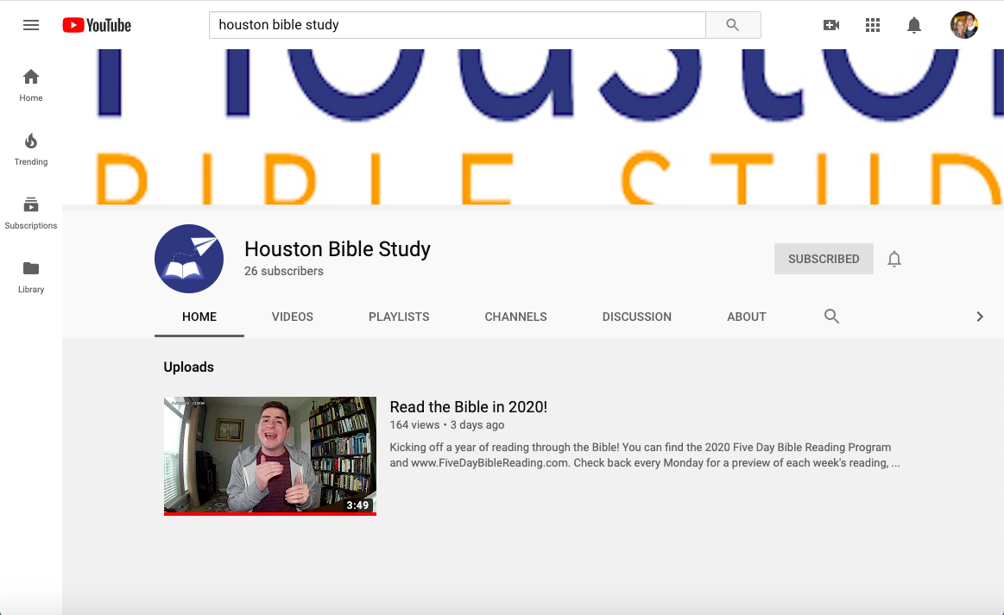

Slide 3
“There is a flow to history and culture. This flow is rooted in what people think. And what they think will determine how they act.”
Francis Schaeffer, How Should We Then Live? (1976)

Slide 4
Divided Truth?
Values
Private
Facts
Public
Faith
Heart
Reason
Brain

Slide 5
Divided Truth?
Is Christianity only a Sunday thing?
Do we have our ‘spiritual life’ and the other part of our life?
Are there areas of life that we think God’s truth has no bearing on?

Slide 6
Solution? A Biblical Worldview
“The term literally means a view of the world, a biblically informed perspective on all of reality. A worldview is like a mental map that tells us how to navigate the world effectively.”
Nancy Pearcey, Total Truth (2004)

Slide 7
20/20 Vision
Developing a Biblical Worldview

Slide 8
“Hear, O Israel: The Lord our God, the Lord is one. You shall love the Lord your God with all your heart and with all your soul and with all your might. And these words that I command you today shall be on your heart. You shall teach them diligently to your children, and shall talk of them when you sit in your house, and when you walk by the way, and when you lie down, and when you rise. You shall bind them as a sign on your hand, and they shall be as frontlets between your eyes. You shall write them on the doorposts of your house and on your gates.”
Deuteronomy 6:4-9

Slide 9
“And all that generation also were gathered to their fathers. And there arose another generation after them who did not know the Lord or the work that he had done for Israel. And the people of Israel did what was evil in the sight of the Lord and served the Baals.”
Judges 2:10-11
“In those days there was no king in Israel. Everyone did what was right in his own eyes.”
Judges 21:25

Slide 10
“Let those of us who are mature think this way, and if in anything you think otherwise, God will reveal that also to you. Only let us hold true to what we have attained. Brothers, join in imitating me, and keep your eyes on those who walk according to the example you have in us. For many, of whom I have often told you and now tell you even with tears, walk as enemies of the cross of Christ. Their end is destruction, their god is their belly, and they glory in their shame, with minds set on earthly things.”
Philippians 3:15-19

Slide 11
“The eye is the lamp of the body. So, if your eye is healthy, your whole body will be full of light, but if your eye is bad, your whole body will be full of darkness. If then the light in you is darkness, how great is the darkness!”
Matthew 6:22-23

Slide 12
What’s in a Worldview?
How did everything get here? Is there a higher power? Who am I?
Why is there evil in the world? How did everything go so wrong?
What is the solution? What is my role in that? What does the future hold?
Creation
Fall
Redemption

Slide 13
Pillars of a Biblical Worldview
Creation
God created all things good.
Man created in God’s image.
Fall
Man rebelled against God.
Sin and death into the world.
World under sway of the evil one.
Redemption
Jesus lived, died, and resurrected.
We are called to be transformed.
He will return to set all things right.
If true, how would I…
Relate to nature?
Treat other people?
Treat my body?
Do my job?
Raise my kids?
Spend free time?
Entertain myself?
Involve with religion?
Involve with politics?
Act toward gov’t?

Slide 14
Alternate Worldviews?
Creation
Everything came about by chance.
Humans are biological machines.
Fall
Humans are inherently good.
Cultural/political systems are to blame.
Inevitable evil force in the universe.
Redemption
Government can fix the problems.
There is no solution, only despair.
Goal is to be happy while life exists.
If true, how would I…
Relate to nature?
Treat other people?
Treat my body?
Do my job?
Raise my kids?
Spend free time?
Entertain myself?
Involve with religion?
Involve with politics?
Act toward gov’t?

Slide 15
“For though we walk in the flesh, we are not waging war according to the flesh. For the weapons of our warfare are not of the flesh but have divine power to destroy strongholds. We destroy arguments and every lofty opinion raised against the knowledge of God, and take every thought captive to obey Christ…”
2 Corinthians 10:3-5

Slide 16
20/20 Vision
“If your eye is healthy, your whole body will be full of light.”

