Slide 1
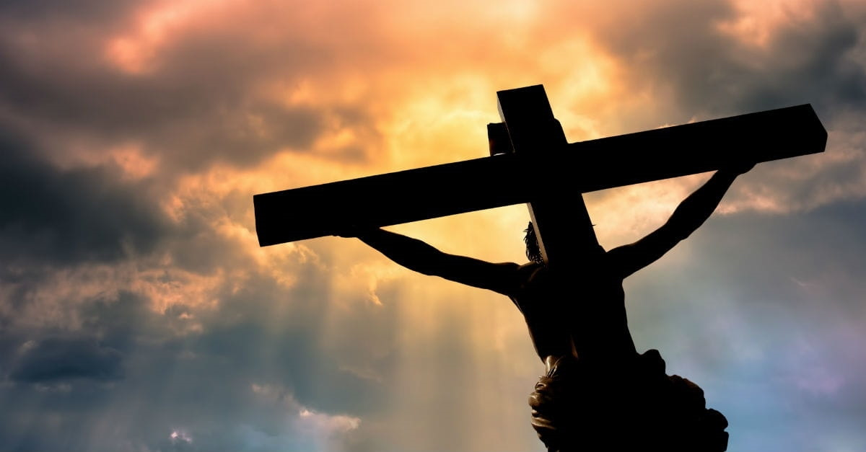
Death – Burial and Resurrection of Christ
Beauty – Majesty - Magnitude

Slide 2
Death – Burial - Resurrection
Eternal Life
Revealed throughout All Scripture
Origin before Eternity & Foundation of the World
Epochal Event

Slide 3
Death – Burial - Resurrection
Why?
Why Did Jesus Have to Suffer and Die for our Transgressions?

Slide 4
Attributes of God
God is Omnipotent – Infinitely Powerful
God is Omniscience – Infinitely All Knowing
God is Omnipresent – Infinitely Exists Everywhere

Slide 5
Nature of God
God is Light - 1 John 1: 5
God is Love – 1 John 4:8
God is Holy and Righteous – Revelation 4:8

Slide 6
God is Holy and Just
Holy – (adjective) Perfectly Pure and Righteous
Just – (Adjective) That which is holy, pure, innocent of wrong doing

Slide 7
Justice
God is a God of Justice- Isaiah 30:18
Justice – Root Word is Just (Righteous, Holy, Pure)
Noun used in context of an outcome
Judicial Proceeding – Righteous Judge impartially renders a verdict that is moral, accurate, and equitable according to law

Slide 8
Justice
God’s justice means He will judge all men impartially according to God’s law
Each who obeys the law is impartially rewarded according to the law
Each who disobeys the law is impartially punished according to the same law.

Slide 9
God’s Law Concerning Sin - Death
Genesis 2:17 … you will surely die."
Ezekiel 18:20 "The person who sins will die….
Romans 6:23 For the wages of sin is death….

Slide 10
Why Does God’s Law Demand Death?
Death means separation - It is not a cessation of existence. Thus, physical death is separation of the spirit from the body. Genesis 35:18; James 2:26
Life means union. God unites eternal spirits to the earthly elements, these elements become living breathing flesh and blood bodies. Genesis 2:7; Zechariah 12:1; Luke 8:53-55

Slide 11
Spiritual death is the separation from God
Isaiah 59:2 But your iniquities have made a separation between you and your God….
2 Thessalonians 1:8-9 to those who do not obey the gospel of our Lord Jesus. ⁹ These will pay the penalty of eternal destruction, away from the presence of the Lord ….
Ezekiel 18:20 "The person who sins will die….
Romans 6:23 For the wages of sin is death….

Slide 12
Eternal Life
Spiritual Eternal Life is the Union of our Eternal Spirit to God because of Perfect and Infinite Holiness, Purity, and Righteousness
Perfect and Infinite Sinlessness

Slide 13
Justice
God Cannot and Will Not Relent
Justice Demands Death
If God Does Not Require Death (separation) – Will Allow Every Evil Person into Heaven (Murderers, Liars, Thieves, Covetous, Assaulters, Rapists, etc.)
Will Even Allow Satan and His Demons to Re-Enter Heaven

Slide 14
Problem: All Men Have Sinned
Psalm 14:3 … There is none righteous, not even one.
Romans 3:23 for all have sinned and fall short of the glory of God
Romans 5:12 …. and so death spread to all men, because all sinned—
Romans 7:24 Wretched man that I am! Who will set me free from the body of this death?

Slide 15
God is Love
God is Love – 1 John 4:8
God’s Love Surpasses Understanding - Ephesians 3:19
Nothing can Separate us from God’s Love – Romans 8:38-39

Slide 16
Compassion, Mercy, and Grace
God is Compassionate, gracious, and abounding in lovingkindness (goodness, kindness, grace). They never cease nor ever fail. Psalm 103:8-12; Lamentations 3:22-23
Rich in Mercy (Compassionate and Forgiving towards one who is in God’s power to punish) – Ephesians 1:7-14
Filled with Grace (Favor) – Thus we are saved by God’s grace
Ephesians 2:8For by grace you have been saved through faith; and that not of yourselves, it is the gift of God

Slide 17
God’s Son’s Not Slated for Death
1 Thessalonians 5:9 For God has not destined us for wrath, but for obtaining salvation through our Lord Jesus Christ, ¹⁰ who died for us….

Slide 18
But How?
God Cannot and Will Not Change His Law
He Who Sins Shall Surely Die
All Men Have Sinned – Including God’s Children

Slide 19
Beauty – Majesty - Magnitude
God’s Plan of Salvation
Must satisfy the requirements of His law demanding the death of those who sin and, at the same time,
Show mercy and compassion upon His children who are also guilty of sin to save us from the penalty of death

Slide 20
Beauty – Majesty - Magnitude
God sent His Son, Jesus Christ into the world to suffer our penalty of death in our stead. Romans 5:6, 8, 10
Justice requires the penalty of sin to be paid and Jesus paid it for us.
But … Jesus’s supreme act of love on our behalf, as great as it is, is not enough to save us. Jesus did even more. Why?

Slide 21
Beauty – Majesty - Magnitude
Guilty sinners cannot enter into God’s presence.
It is sin that eternally separate us from God. Only the perfectly holy, righteous, and sinless can enter into God’s presence
In order to be fully saved from death, God must give us eternal life.
Eternal life (union with God) requires the cleansing of our sins to become perfectly holy and blameless.

Slide 22
Cleansing & Forgiveness – Shed Blood
Because the life of the flesh is in the blood, God gives the blood of the sacrificed innocent life to the guilty sinner to make atonement (cover, propitiation, forgiveness) for sin. It is the blood by reason of the life that makes atonement.’ Leviticus 17:11
Therefore, according to God’s Law, all things are cleansed with blood, and without shedding of blood there is no forgiveness. Hebrews 9:22

Slide 23
Christ Shed His Blood for Forgiveness Of Sins
Roman scourging shredded our Lord’s flesh down to the bone
Jesus head was pierced with a crown of thorns
Jesus’s hands and feet were pierced through with nails.
Jesus’s side, lungs, and his heart were pierced through with a Roman spear.

Slide 24
Christ Shed His Blood for Forgiveness
Matthew 26:28 for this is My blood of the covenant, which is poured out for many for forgiveness of sins.
Ephesians 1:7-8 In Him we have redemption through His blood, the forgiveness of our trespasses
1 John 1:7 … the blood of Jesus His Son cleanses us from all sin

Slide 25
Christ Shed His Blood for Forgiveness
At Baptism, Cleansed with Christ’s Blood, Union with Christ (Eternal Life) and become the beloved sons of God
Acts 22:16 … be baptized, and wash away your sins, calling on His name.'
1 John 1:7 … the blood of Jesus His Son cleanses us from all sin.
Galatians 3:26-27 For you are all sons of God through faith in Christ Jesus. ²⁷ For all of you who were baptized into Christ have clothed yourselves with Christ.

Slide 26
 | Jesus – Son of God | Saints - Sons of God
Son of God | Romans 1:4 | Romans 8:16; Hebrews 2:10
Son of Man | Matthew 9:6 | Hebrews 2:6
Son of Abraham | Matthew 1:1 | Galatians 3:7, 29
Holy | John 6:69; 1 John 3:5 | Ephesians 1:4
Name Above All Names | Mark 8:29; Philippians 2:9 | Acts 15:17; 11:26
Anointed | Luke 4:18 | 2 Corinthians 1:21
Deity | John 20:28, Colossians 2:9 | 2 Peter 1:4
Priests | Hebrews 9:11 | 1 Peter 2:9
Image of God | Hebrews 1:2 | 1 John 3:2
Exaltation | Philippians 2:9 | James 4:10
Glorified | Hebrews 2:9 | 2 Thessalonians 2:14
Power | Eph 1:21; 2 Ptr 1:6; Rev 5:12 | 1 Corinthians 15:42-43, 50
Kingdom | John 18:36; Colossians 1:13 | Dan 7:18, Mt 25:34; Luke 12:32
Throne | Revelation 3:21 | Rev 3:21
Authority | Ephesians 1:20-21 | Rev 2:26
Reign Forever | Rev 11:15 | Rev 22:5
Heirs of God | Hebrews 1:2 | Romans 8:16-17

Slide 27
 | Jesus – The Son of God | Saints - Sons of God
Son of Man | Matthew 9:6 | Hebrews 2:6
Dwelt in the Flesh | Hebrews 2:14 | Hebrews 2:14
Suffer in the Flesh | Isaiah 53:3 | John 16:33; Acts 14:22; Rom 8:17
Perfected in Suffering | Hebrews 2:10 | James 1:2-4
Baptized | Matthew 3:13-17 | Acts 2:38
Persecution | John 15:20 | John 15:20
In – not of – the world | John 17:14-16 | John 15:19, 17:14-16
Tempted | Hebrews 2:18; 4:15 | 1 Corinthians 10:13, James 1:14
Sin | Isaiah 53:11-12, 1 Peter 2:24 | Romans 3:23
Physically Die | Romans 5:6-8 | Romans 5:12; Hebrews 9:27
Spiritually Died | Psalm 22:1; Mt 27:46 | Romans 6:23
Spiritually Resurrected | Luke 23:43 | Luke 23:43; Romans 6:4-5
Physically Resurrected | Acts 4:10 | 1 Corinthians 15:52, 1 Thess 4:16
Ascend into Heaven | John 20:17; Acts 1:9-11 | 1 Thessalonians 4:17, Mt 25:34
Crucified Death | 1 Corinthians 15:3-4 | Romans 6:3-5; Colossians 2:12

Slide 28
Death Burial and Resurrection
Romans 6:3-11 … all of us who have been baptized into Christ Jesus have been baptized into His death? ⁴ Therefore we have been buried with Him through baptism into death, so that as Christ was raised from the dead through the glory of the Father, so we too might walk in newness of life. ⁵ For if we have become united with Him in the likeness of His death, certainly we shall also be (united) in the likeness of His resurrection, ⁶ knowing this, that our old self was crucified with Him, in order that our body of sin might be done away with, so that we would no longer be slaves to sin; ⁷ for he who has died is freed from sin. ⁸ Now if we have died with Christ, we believe that we shall also live with Him

Slide 29
Death Burial and Resurrection
Galatians 2:20 "I have been crucified with Christ; and it is no longer I who live, but Christ lives in me; and the life which I now live in the flesh I live by faith in the Son of God, who loved me and gave Himself up for me.
Died (Separated) from the flesh and its evil lusts. Romans 7:5, Galatians 5:24; Colossians 2:11-15
Died (Separated) from the world and its allurements that tempt us to satisfy our fleshly desires. Galatians 6:14
Died (Separated) from Sin – no longer to be sins slave. Romans 6:16-22

Slide 30
Death Burial and Resurrection of Christ
As we prepare our minds to remember Christ’s Death, Burial, and Resurrection
Give thanks for the profound beauty, majesty, and magnitude of what Christ suffered and what He accomplished – Penalty – Cleansed of Sin - Eternal Life – Sons of God – Obtain all the spiritual blessings in Christ reserved only for the sons of God.
And know that the very death that we are remembering today is the exact same death that all the sons of God share in common – both Jesus and us.

