Slide 1
The Sacrifice of Our Savior

Slide 2
The Sacrifice of Our Savior
Sin – Mankind’s Predicament and God’s Solution
Savior – Jesus’ Suffering and Sacrifice for Us
Salvation – Jesus’ Resurrection and Promise to Us

Slide 3
The Necessity of the Cross - Sin

Slide 4
Sin and Its Problem
1 John 3:4 – Sin is lawlessness
2 John 9 – Sin is transgressing God’s law
Romans 3:23 – All have sinned
Gen 3:1-5, 13-24 – Sin introduced to the world, but its solution is foretold as well
1 John 1:8-10 – We have all sinned
Gal 5:19-21 – Sin shows up in various ways

Slide 5
Solution to Sin
Exodus 12:3-14 – Passover - saving of God’s people
Hebrews 9:22 – Sacrifice and blood is required
John 1:1-16 – Jesus is the Christ, who came to earth
John 1:29-32 – Jesus, the Lamb of God
John 3:15-16 – God loves us; gave Christ as our sacrifice
Romans 5:6-8 – While we were sinners, Christ died for us

Slide 6
The Suffering on the Cross - Savior

Slide 7
The Sacrifice of Our Savior
Thursday Night
The Last Supper
Mt. of Olives
Garden of Gethsemane
Friday
Betrayal and Arrest
Trial 1 – Annas
Trial 2 - Caiaphas
Trial 3 – Sanhedrin
Trial 4 – Pilate
Trial 5 – Herod
Trial 6 – Pilate
Beaten
Crucifixion
On the Cross / Death
Burial
Sunday – Resurrection!

Slide 8
The Last Supper
Thursday
6:30-11:30 PM

Slide 9
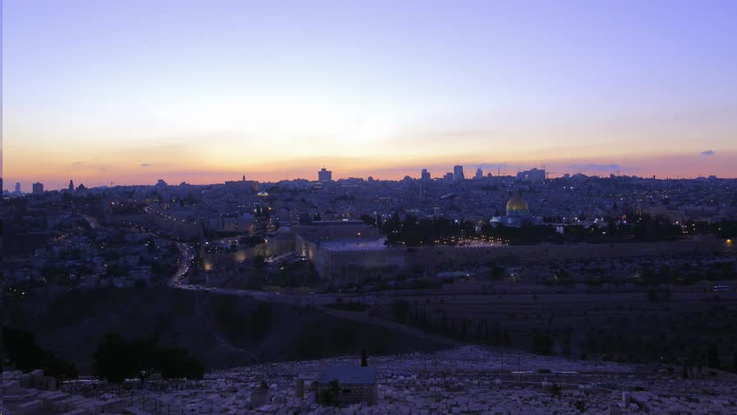
Mount of Olives
Thursday
11:30 PM – 12:00 AM

Slide 10
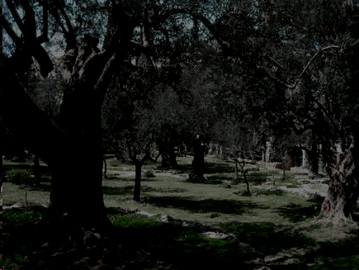
Garden of Gethsemane
Friday
12-2:00 AM
Prayer
Forsaken by Disciples (Sleeping)
Betrayed by Friend
Arrested

Slide 11
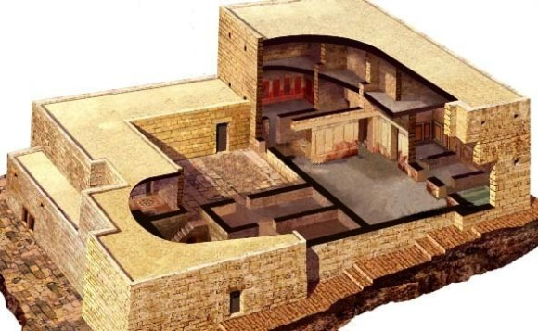
House of Annas (former High Priest)
Friday
2-3:00 AM
Trial 1
Before Annas

Slide 12
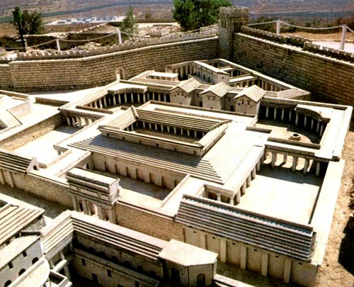
House of Caiaphas (current High Priest)
Friday
3-5:00 AM
Trial 2
With the Sanhedrin Court
Peter Denies Christ - 3x
Imprison-ment

Slide 13
House of Caiaphas (current High Priest)
Friday
5-6:00 AM
Trial 3
Whole Sanhedrin,
Elders,
Chief Priests,
Scribes
Judas kills himself

Slide 14
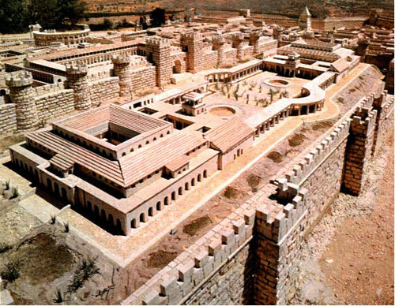
Praetorium - (Home of Pilate – part of Herod’s Palace)
Friday
6-7:00 AM
Trial 4
Before Pilate the Roman Governor
1st time

Slide 15
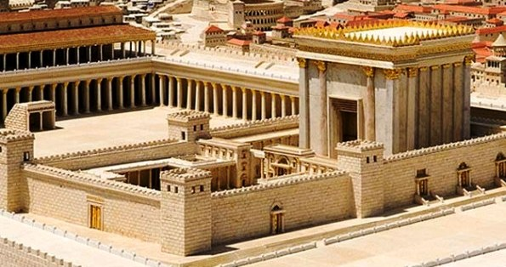
Herod Antipas (Roman Governor of Galilee)
Friday
7-7:30 AM
Trial 5
Herod

Slide 16
Pilate’s House (Roman Governor of Galilee)
Friday
7:30-8:30 AM
Trial 6
Final Trial
Chief Priests,
Rulers
Jesus is Tortured

Slide 17
Praetorium
Friday
8:30-9:30 AM
Jesus is
Beaten
Mocked & Tortured
Crown of Thorns

Slide 18
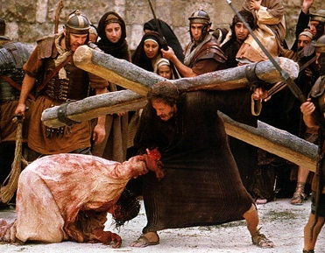
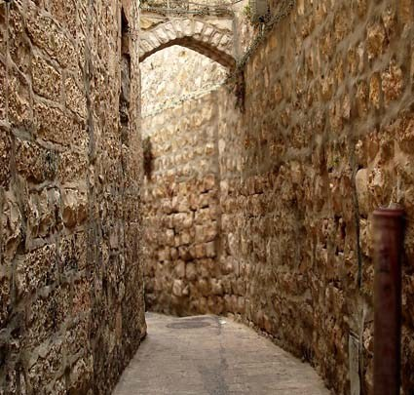
Travel to Golgotha (through Jerusalem)
Friday
9:30 AM - Noon
Jesus is
Forced to carry His cross
Simon of Cyrene also carries Jesus Cross
Two robbers also taken

Slide 19
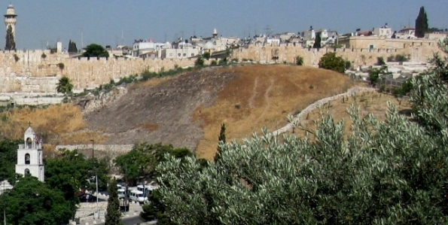
Golgotha (the Place of the Skull)
Friday
Noon – 3 PM
Jesus is Crucified
Jesus on the Cross
Darkness over the land

Slide 20
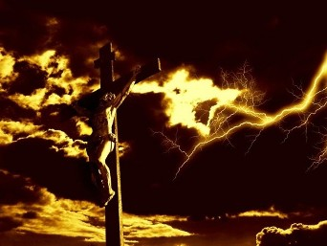
Golgotha (the Place of the Skull)
Friday
About 3 PM
Jesus Dies
It is finished

Slide 21
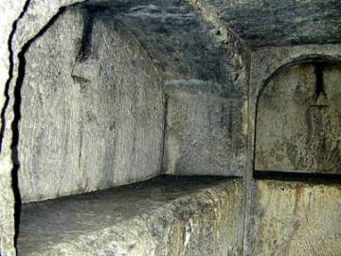
Jesus is Buried
Friday
3-6 PM
Jesus is Buried
Guards are placed

Slide 22
The Resurrection from the Dead – Salvation

Slide 23
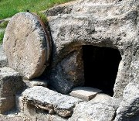
Alive!
Jesus is Resurrected
Angels were met
Jesus appears to Mary
Many saw Jesus alive!

Slide 24
Resurrected!
Matthew 28:1-8
Stone is rolled away
Jesus is gone
Angels greet Mary, Mary Magdalene, Salome
John 20:2-10 – Peter and John see for themselves
John 20:11-18 – Jesus appears to Mary

Slide 25
We Too Have Hope!
1 Peter 1:18-21 – Redeemed by Jesus blood
Romans 6:3-5 – Baptized into His death, likewise raised like His resurrection
1 Corinthians 15:1-12 – the Gospel message

