Slide 1
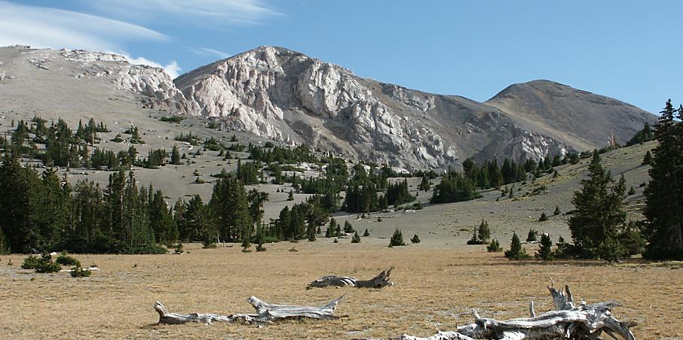
A Sacrifice On The Mountain

Slide 2
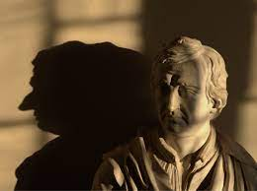


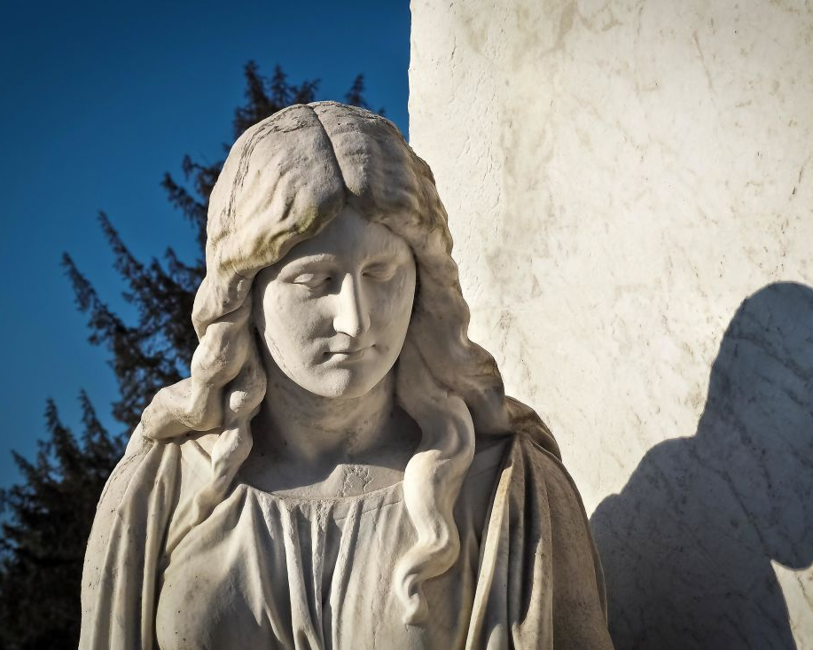
Shadows
Col 2 ¹⁷ These are a shadow of the things to come, but the substance belongs to Christ
Heb 10 The law is only a shadow of the good things that are coming—not the realities themselves. For this reason, it can never, by the same sacrifices repeated endlessly year after year, make perfect those who draw near to worship.

Slide 3
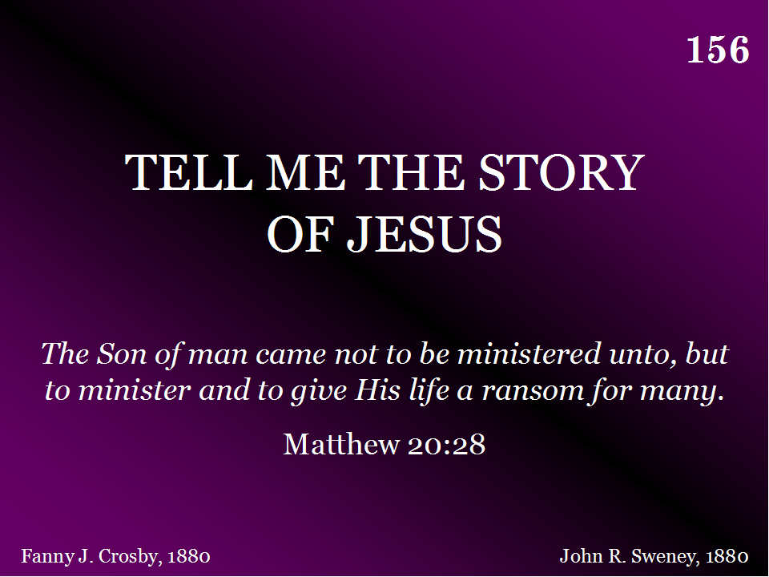
156 - Tell Me The Story Of Jesus - Title

Slide 4

Christ’s Life
But when the fullness of time had come, God sent forth his Son, born of woman, born under the law, to redeem those who were under the law, so that we might receive adoption as sons.

Slide 5
Behold the Lamb
Song – 2 verses
Dottie Rambo
1979

Slide 6
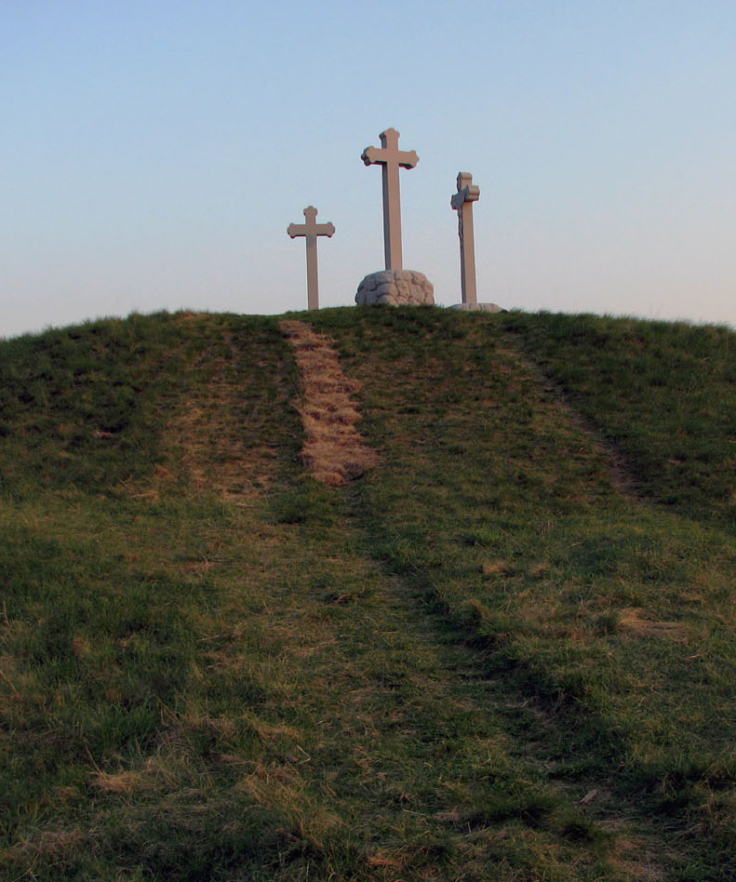
Christ’s Death
The next day he saw Jesus coming toward him, and said, “Behold, the Lamb of God, who takes away the sin of the world!

Slide 7
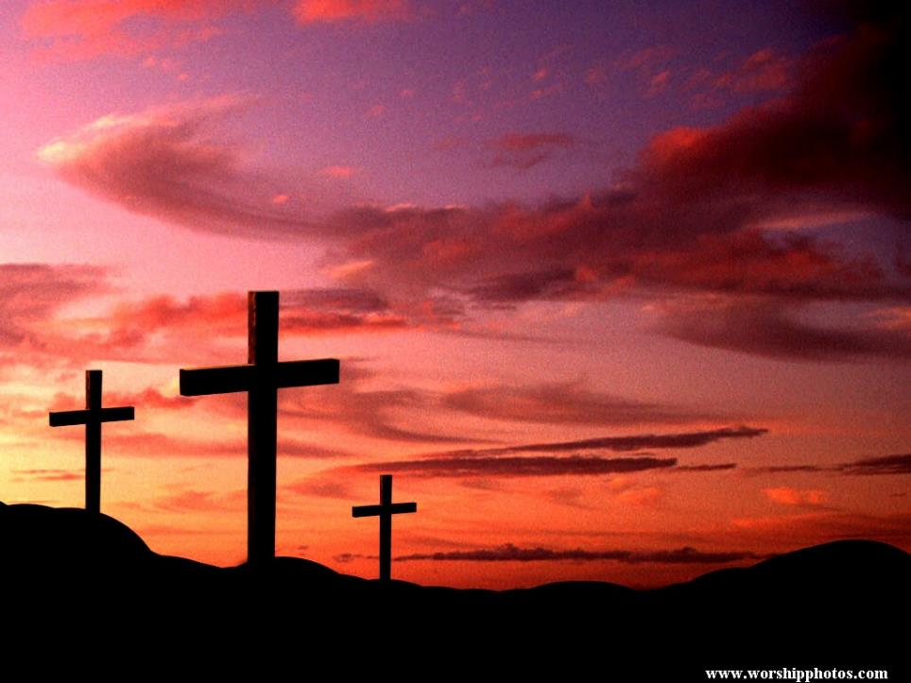
“But God shows His love for us in that while we were still sinners, Christ died for us.”
Romans 5:8

Slide 8
More Precious Than Silver
Song – 1 verse – 2 times through
Lynn DeShazo
1982

Slide 9

Giving to the Lord
“Each one must give as he has decided in his heart, not reluctantly or under compulsion, for God loves a cheerful giver.”
2 Corinthians 9:7

Slide 10
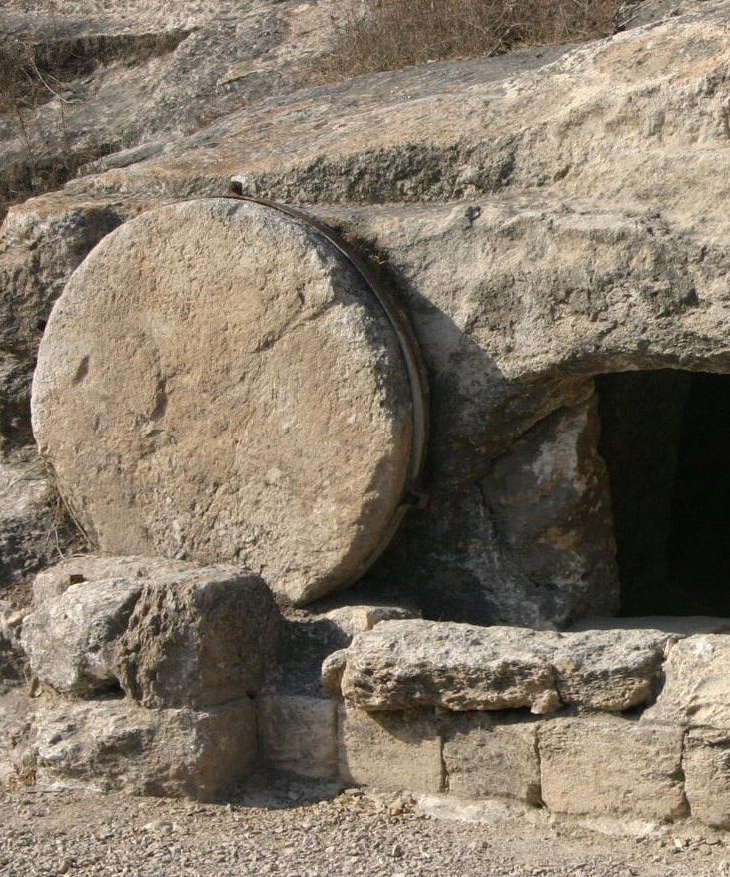
Christ’s Glorification
Christ Jesus is the one who died—more than that, who was raised—who is at the right hand of God, who indeed is interceding for us.

