Slide 1
Singing and Invitation are About to Begin

Slide 3
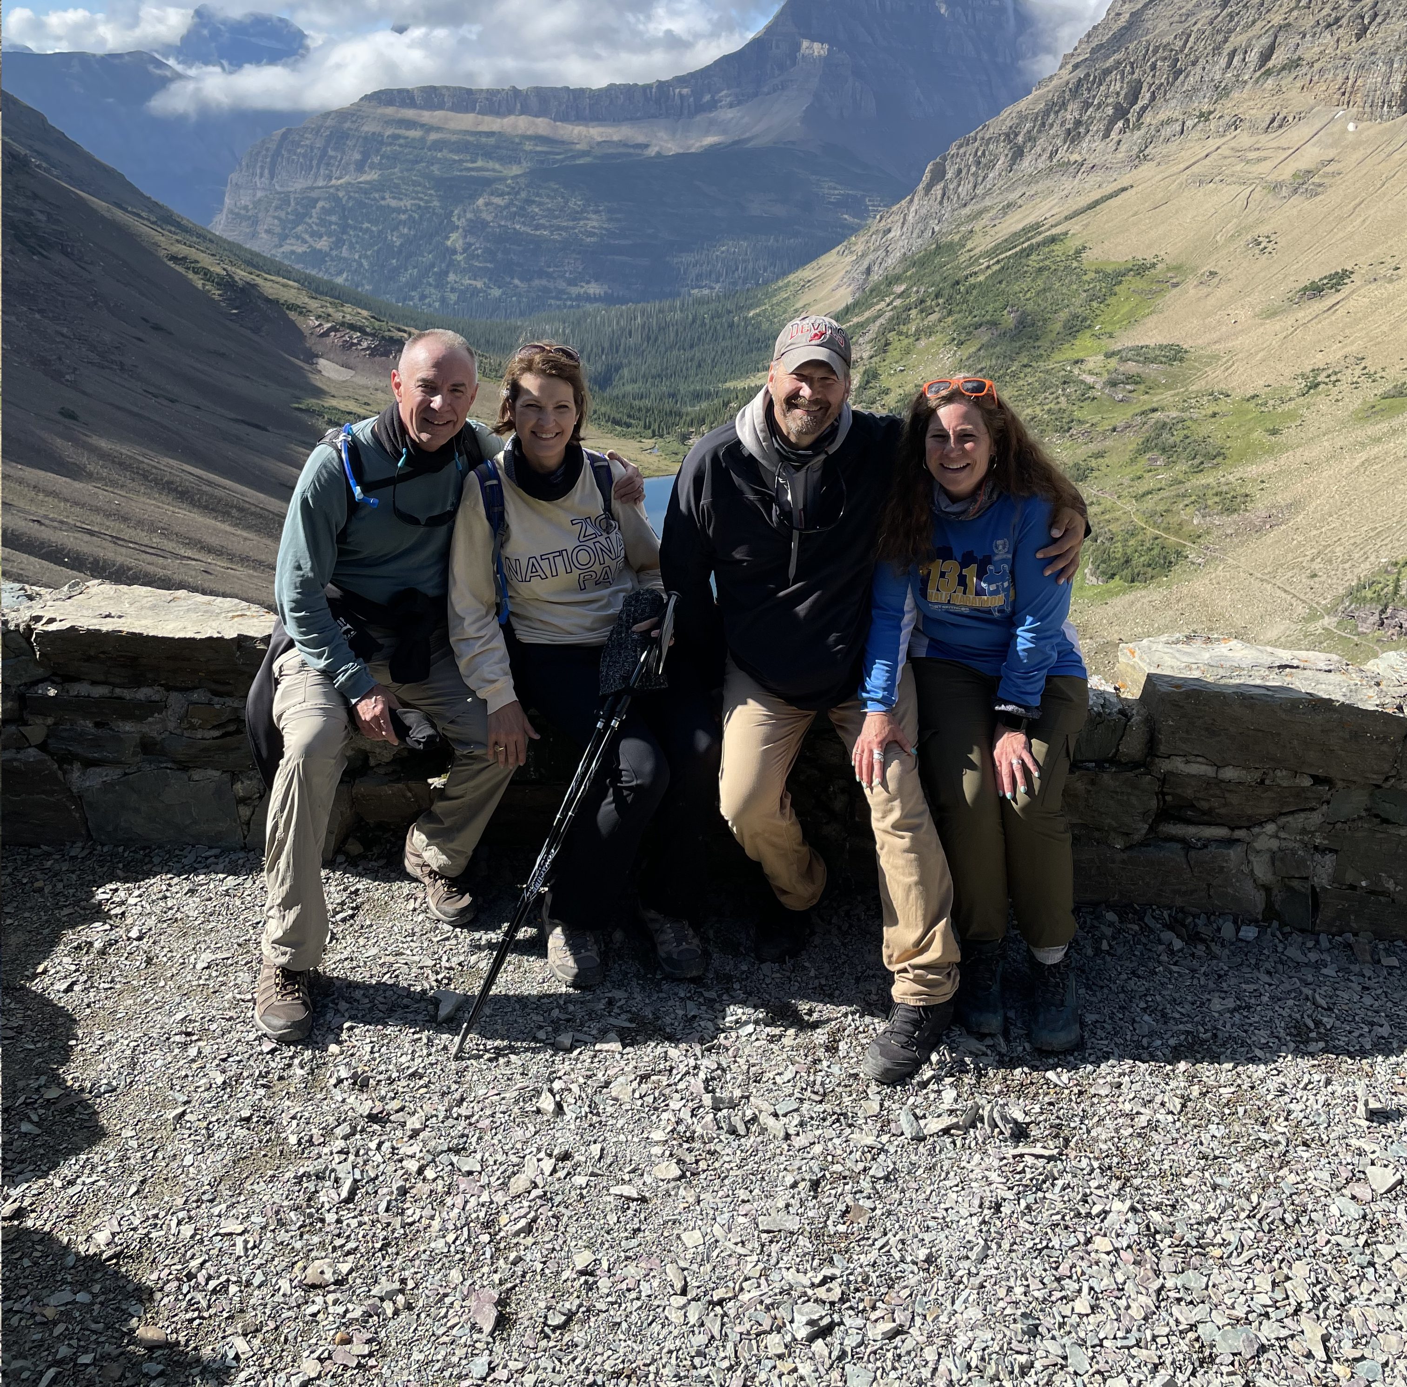

Slide 4
Announcements & Closing Prayer
“My house shall be a house of prayer” John 2:14

