Slide 1
Paul’s Second Letter to the Corinthians
Bellaire Auditorium
Wednesday Nights, Fall 2021

Slide 2
Overview of 2 Corinthians
1-7: Paul describes his __________
1-7: Paul’s ministry
1:1-11 - Thanksgiving
1:12 - 2:13 – Travel Report
2:14 - 7:4 – Gospel Ministry
7:5-16 – Travel Report
ministry
8-9: Paul encourages the __________
contribution
10-13: Paul addresses his __________
opponents

Slide 3
Encouragement to Give (ch.8)
Example of the Macedonians (1-5)
Demonstration of their love (7-8)
Emulation of the gospel (9)
From potential to reality (6,10-12)
Equality among Christians (13-15)
Honorable handling of $$ (16-24)

Slide 4
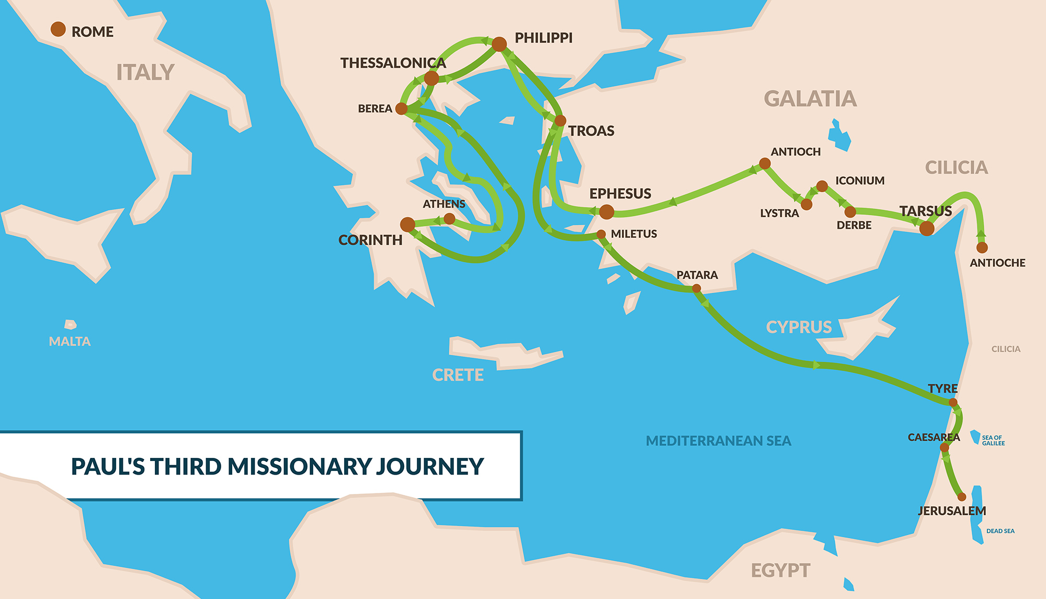

Slide 5
2 Corinthians 9 - Observation
Who?
What?
Where?
When?
Why?
Repeated words?
Questions?
What do you see?

Slide 6
2 Corinthians 9 - Interpretation
Main points? Summary?
Connections within the passage?
Connection to chapters 1-7?
Connection to 1 Corinthians?
Connection to Scripture?
Answers to our questions?

Slide 7
¹ Praise the Lord! How blessed is the man who fears the Lord, Who greatly delights in His commandments. ² His descendants will be mighty on earth; The generation of the upright will be blessed. ³ Wealth and riches are in his house, And his righteousness endures forever. ⁴ Light arises in the darkness for the upright; He is gracious and compassionate and righteous. ⁵ It is well with the man who is gracious and lends; He will maintain his cause in judgment. ⁶ For he will never be shaken; The righteous will be remembered forever.
⁷ He will not fear evil tidings; His heart is steadfast, trusting in the Lord. ⁸ His heart is upheld, he will not fear, Until he looks with satisfaction on his adversaries. ⁹ He has given freely to the poor, His righteousness endures forever; His horn will be exalted in honor.
¹⁰ The wicked will see it and be vexed, He will gnash his teeth and melt away; The desire of the wicked will perish.
Psalm 112
Quoted in 2 Cor. 9:9

Slide 8
²² For this reason I have often been prevented from coming to
you; ²³ but now, with no further place for me in these regions,
and since I have had for many years a longing to come to you
²⁴ whenever I go to Spain—for I hope to see you in passing, and
to be helped on my way there by you, when I have first enjoyed
your company for a while— ²⁵ but now, I am going to Jerusalem
serving the saints. ²⁶ For Macedonia and Achaia have been pleased to make a contribution for the poor among the saints in Jerusalem. ²⁷ Yes, they were pleased to do so, and they are indebted to them. For if the Gentiles have shared in their spiritual things, they are indebted to minister to them also in material things. ²⁸ Therefore, when I have finished this, and have put my seal on this fruit of theirs, I will go on by way of you to Spain. ²⁹ I know that when I come to you, I will come in the fullness of the blessing of Christ. ³⁰ Now I urge you, brethren, by our Lord Jesus Christ and by the love of the Spirit, to strive together with me in your prayers to God for me, ³¹ that I may be rescued from those who are disobedient in Judea, and that my service for Jerusalem may prove acceptable to the saints; ³² so that I may come to you in joy by the will of God and find refreshing rest in your company. ³³ Now the God of peace be with you all. Amen.
Romans 15

Slide 9
2 Corinthians 9 - Application
So what? How do I respond?
What do I learn about God?
What do I learn about the gospel?
What convicts me?
Change my thinking?
Change my relationships?
Change my actions?

Slide 10
Paul’s Second Letter to the Corinthians
Homework for Wednesday:
2 Corinthians 10 (pages 18-19)

