Slide 1
Q?
What kind of homes do our children
need?

Slide 2
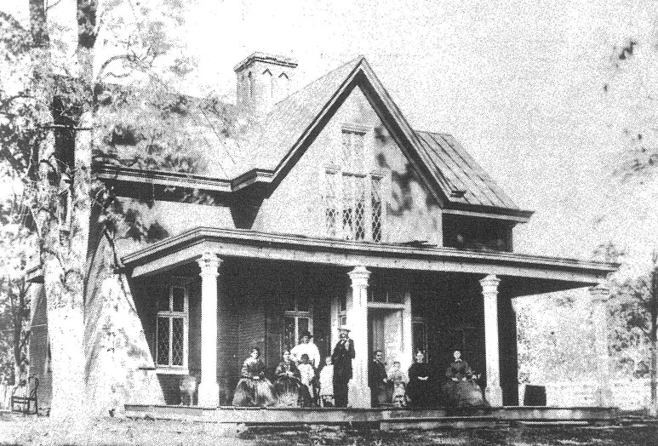
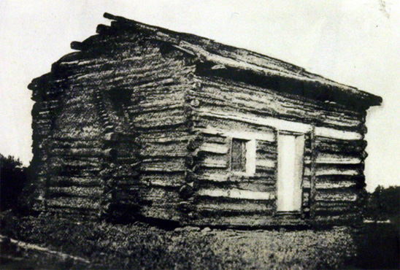

Slide 3
The crying need in our culture is not better houses… it’s better homes.

Slide 4
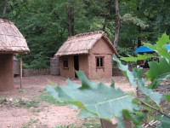
2 Ptr. 3 “seeing that all these things shall be dissolved…”

Slide 5
2 Ptr. 3 “seeing that all these things shall be dissolved…”

Slide 6
Proverbs
15:16-17
&
17:1

Slide 7
what children do need:
Titus 2.4
DT. 6.7
PR.
13.24
PR. 1.8; 13.24; 22.6
JOSH.
24.15

Slide 8
CHILD TRAINING
Proverbs 22.6 “Train up a child in the way he should go, even when he is old, he will not depart from it”
or Judith Harris:“Do Parents really matter?”
Time issues:
a garden

Slide 9
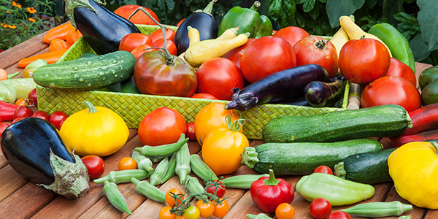
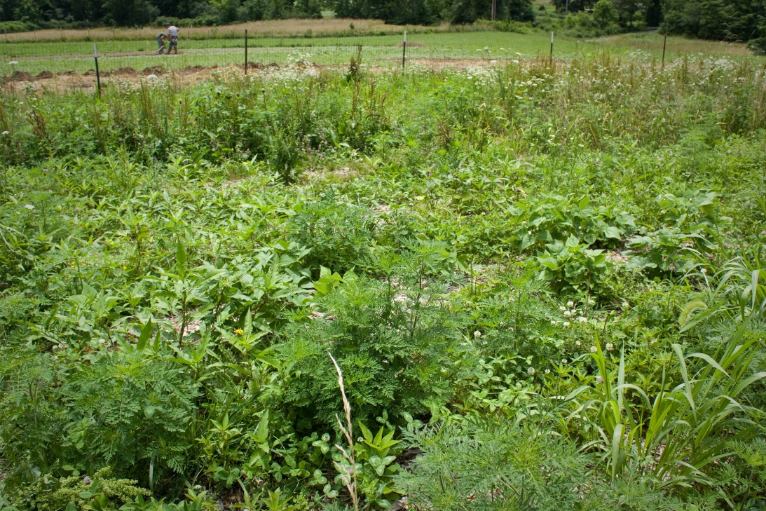

Slide 10
PARENTS
Proverbs 22.6 “Train up a child in the way he should go, even when he is old, he will not depart from it”
or Judith Harris:“Do Parents really matter?”
Time issues:
a garden
cat, bird
Deut. 6.7; Eph.6.4
the importance of starting early
(robins): It takes the babies about 2 weeks to leave the nest, or "fledge," and then they usually stay with their parents for two or three weeks after that. https://journeynorth.org/tm/robin/ExpertAnswer09.html
10 to 12 weeks

Slide 11
CHILD TRAINING

Slide 12
Prov. 29:15 NET
A rod and reproof impart wisdom, but a child who is unrestrained brings shame to his mother.

Slide 13
Proverbs 22.6 ESV
“Train up a child in the way he should go,
Even when he is old, he will not depart from it”

Slide 14
EARLY TRAINING & “NO”
The importance of “no” [cf. Gen.2; Ex. 20]
respect & compliance for the prohibitory “no”
if you don’t mean it, don’t say it, and if you do mean it, enforce it - Mt.5.37

Slide 15
early child training

Slide 16
LESSON # 1: basic vocabulary:
No
No

Slide 17
VOCABULARY TEST:
What does “no” mean to my child?
Tantrum
time
No
The defense attorney may now cross examine
No
No
Don’t do it while Mom or Dad are watching
No
No

Slide 18
RESPECT
FOR AUTHORITY
I WON’T ALWAYS GET MY WAY
BEHAVIOR IS MORE IMPORANT THAN DESIRE
SELF DENIAL
/ SELF CONTROL
No
No

Slide 19
EARLY TRAINING & “NO”
important foundation: learning to submit to an earthly father prepares the child for submission to a far more important Father.

Slide 20
EARLY TRAINING & “NO”
respect & compliance for prohibitory “no”
zero tolerance for defiant & rebellious “no”

