Slide 1

HEB.13:4
Let marriage be had in honor among all

Slide 2
1 Cor.
7.7&32

Slide 3
THIS is under attack:
Gen.
2:24

Slide 4
For this reason a man shall leave his father and mother and cleave to his wife and the two shall become one flesh….
And what God joined together, let no one separate

Slide 5
me too movement?

Slide 6
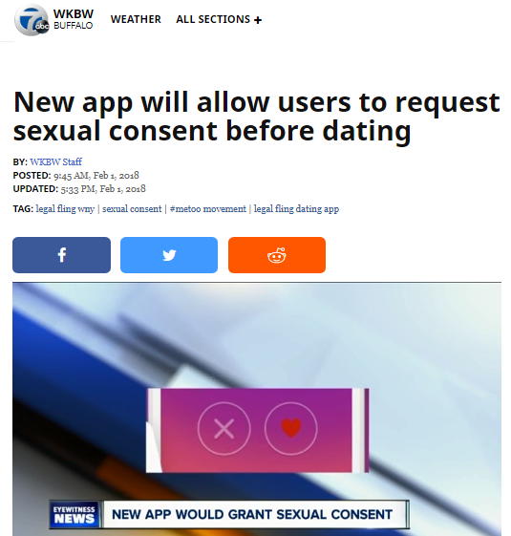
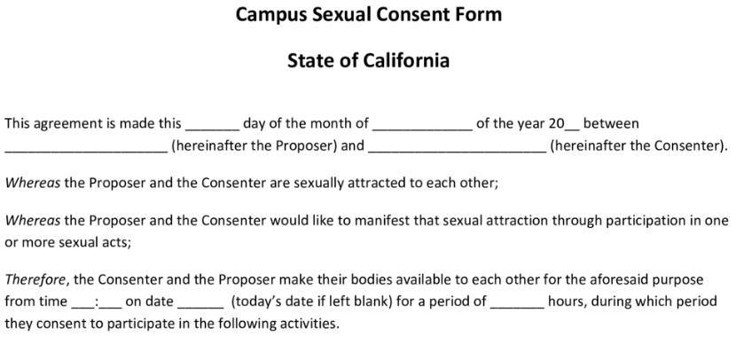
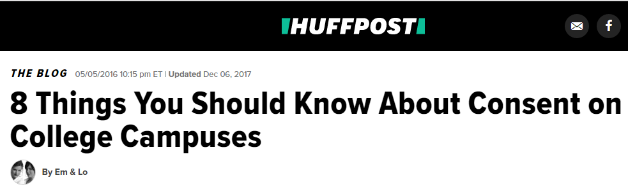
a recurring defense:
“consensual”

Slide 7
Here’s a much
better consensual
agreement:

Slide 8

Do you take this
woman / man
to be your lawfully wedded
wife /husband?
To have and to hold, and to keep yourself to
her/ him alone?
So long as you both shall live?
I do.
I do.

Slide 9

BUILD,
MAINTAIN
&
PROTECT
YOUR
HOME

Slide 10
Gen. 2.18, 24 -leave & cleave
Gen.3.13-19
  provide for physical needs
Deut.6.1-9; Eph.6.4
  provide spiritual leadership
Eph. 5.25, 28-29
  provide leadership generally
  a sacrificial & serving leader : Eph. 5.25
husbands

Slide 11
Eph 5:25, 28-31, 33 ESV
25 Husbands, love your wives, as Christ loved the church and gave himself up for her, ...
28-31 In the same way husbands should love their wives as their own bodies. He who loves his wife loves himself. For no one ever hated his own flesh, but nourishes and cherishes it, just as Christ does the church, because we are members of his body.
31 "Therefore a man shall leave his father and mother and hold fast to his wife, and the two shall become one flesh." ... 33 However, let each one of you love his wife as himself, and let the wife see that she respects her husband.
husbands

Slide 12
Eph 5:25, 28-31, 33 ESV
25 Husbands, love your wives, as Christ loved the church and gave himself up for her, ...
28-31 In the same way husbands should love their wives as their own bodies. He who loves his wife loves himself. For no one ever hated his own flesh, but nourishes and cherishes it, just as Christ does the church, because we are members of his body.
31 "Therefore a man shall leave his father and mother and hold fast to his wife, and the two shall become one flesh." ... 33 However, let each one of you love his wife as himself, and let the wife see that she respects her husband.
husbands

Slide 13
Eph 5:25, 28-31, 33 ESV
25 Husbands, love your wives, as Christ loved the church and gave himself up for her, ...
28-31 In the same way husbands should love their wives as their own bodies. He who loves his wife loves himself. For no one ever hated his own flesh, but nourishes and cherishes it, just as Christ does the church, because we are members of his body.
31 "Therefore a man shall leave his father and mother and hold fast to his wife, and the two shall become one flesh." ... 33 However, let each one of you love his wife as himself, and let the wife see that she respects her husband.
husbands

Slide 14
(other points made else where) but in Eph. 5 to the to the wife: husband: wife: LOVE HER FOLLOW HIM

Slide 15
REMEMBERING YOUR VOWS:
“love and cherish” Eph.5.28-29
“honor” 1Ptr.3.7
“to her and her alone” Job.31.1; Pr.5; Mt.5
husbands

Slide 16
Thou shalt have no other gods before me.
Thou shalt not make
a graven image
Thou shalt not take the name of the LORD thy God in vain
Remember the sabbath
Honour thy father and thy mother
Thou shalt not
kill.
Thou shalt not commit adultery
Thou shalt not
steal.
Thou shalt not
bear false witness
Thou shalt not
covet
pornography
Matt. 5.27-30

Slide 17
a Healthy marriage:
involves so much much more than
“don’t commit Adultery”
a Healthy
body:
Involves so much more than
“don’t commit suicide”

Slide 18
Gen.
2:24
“Let marriage be had in honor among all” Heb.13:4

Slide 19
“disposable-marriage” in a disposable culture
“I think God wants me to be happy”
“I thought things would be different”
“I want to do what I want to do”
“It’s not good for the kids to see us unhappy”
“I’m not in love anymore”
Luke 16.18; Mark 10; Matt. 19
1 Cor. 7; Malachi 2:13-16

Slide 20
“Being frustrated with your spouse
is no more a good reason to get divorced
anymore than
being frustrated with your children
is a good reason to put them up for adoption.”
-Dave Willis
davewillis.com

Slide 21


a lesson from cuban cars
By Zahav511 - Own work, CC BY-SA 3.0, https://commons.wikimedia.org/w/index.php?curid=23452995
CC BY-SA 3.0, https://commons.wikimedia.org/w/index.php?curid=1042507
By MiltonPoint - Own work, CC BY-SA 4.0, https://commons.wikimedia.org/w/index.php?curid=38351278

Slide 22
Pr. 18.22
“He who finds a wife finds a good thing”

Slide 23
Gen.
2:24
“Let marriage be had in honor among all” Heb.13:4

Slide 24
husband & wife
1Cor.7.
defraud not one another
husband
wife
“one flesh” God’s plan / fund. & beneficial
considerate (1 Cor.7; Mt. 7.12; Php.2 )
secure (Pr.31 / Pr.5-7)
impassioned (Prov.5)
loving (Eph.5/ Titus 2)

Slide 25
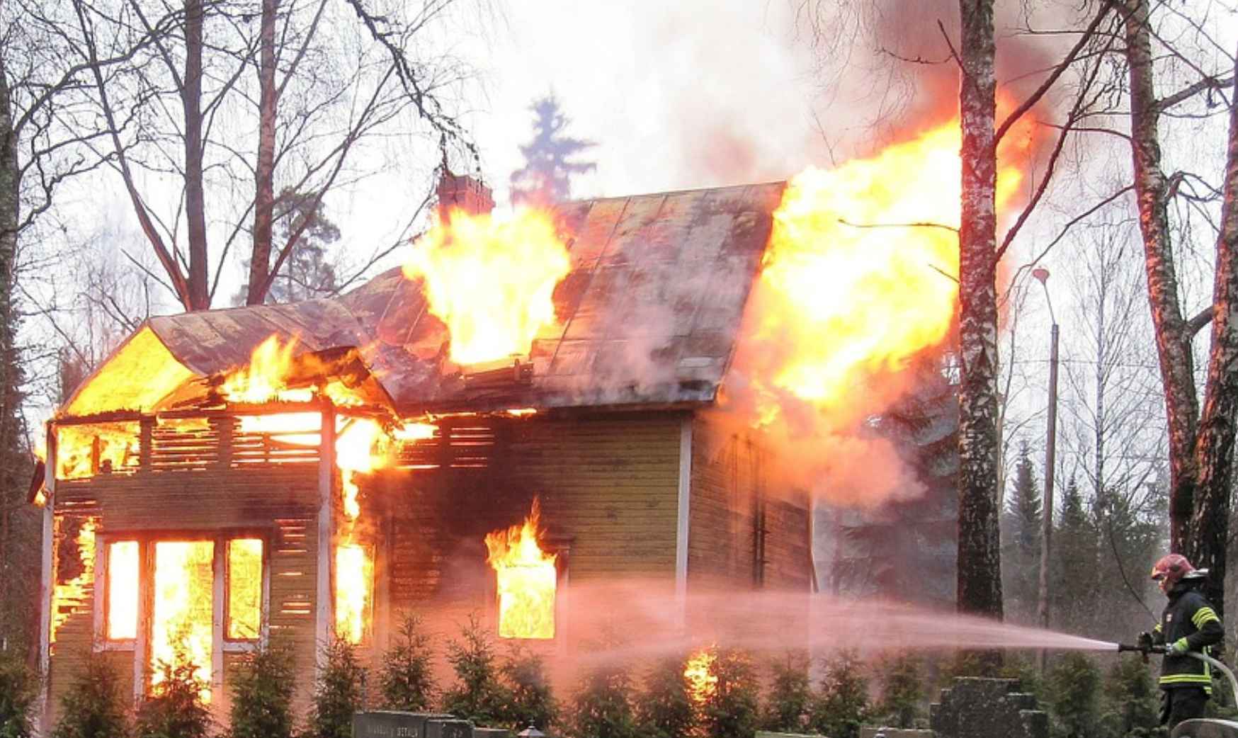


Slide 26
PROTECT
YOUR
MARRIAGE

Slide 27
RESPECTING
BOUNDARIES
clothing
communication
compliments
contact
companionship
closeness
imagination
intimacy
love
desire
loyalty

Slide 28
1. You’re having conversations you wouldn’t want your spouse to see.
If you’re ever in a position where you think, “I’m glad my husband/wife isn’t seeing this,” then you’re already out of bounds...
2. You’re dressing to impress a specific individual other than your spouse.
When we’re trying to be visually attractive for an individual other than our spouse, we’re opening a very dangerous door.
3. You try to create opportunities to be alone with someone other than your spouse.
If you’re going out of your way to “run into” someone so you can have one-on-one conversations, that’s a huge red flag.
4. You delete text messages or emails from someone, because you don’t want your spouse to see them.
If you’re ever hiding messages, texts or calls, then you’ve crossed an obvious line..
5. You’re having consistent romantic and/or sexual fantasies about someone other than your spouse.
Affairs don’t start in the bedroom, they always start in the mind!
6. You’re constantly comparing your spouse to this other individual.
…the mental tendency is to see this new person as nearly flawless and, by comparison, your spouse’s flaws become much more obvious. If you’re more critical of your spouse while mentally comparing them to this other person, you’re falling into a toxic trap.
7. You’re planning a new life together with this other person.
Once you start planning and romanticizing a new life with this other person, you’re in a very dangerous place...
7 SIGNS YOU’RE HAVING AN EMOTIONAL AFFAIR: patheos.com / Dave Willis
Read more at http://www.patheos.com/blogs/davewillis/7-signs-youre-having-an-emotional-affair/#dpbyiHYp7bXGRMGT.99

Slide 29
HEB.13:4
Let marriage be had in honor among all

Slide 30
Proverbs
5
6
7

Slide 31
a Healthy marriage:
involves so much much more than
“don’t commit Adultery”
a Healthy
body:
Involves so much more than
“don’t commit suicide”

Slide 32
STRESS
STRAIN
&
STRIFE

Slide 33
communication
communication
Col.
3.19
Prov. 21.9
27.15

Slide 34
speaking with kindness
Eph. 4.15 speaking the truth in love
Prov.25:15 a soft tongue breaks the bone
Prov.15:1 A soft answer turneth away wrath: but grievous words stir up anger
Prov. 31:26
Col. 3:19
Mt. 7:12
PROVERBS 18:21

Slide 35
tension,
frustration,
irritableness
effectiveness

Slide 36
“Let no corrupt speech proceed out of your mouth, but such as is good for edifying as the need may be, that it may give grace to them that hear.”
Eph.4:29 asv

Slide 37
throwing jabs
“My mistake. I should have learned by now not to expect too much.”
“I shouldn’t blame you. You get it honestly enough from your [Dad/Mom/brother/sister].”
“I should have listened to my mother when she warned me about you.”
Prov.12:18 nasb
“There is one who speaks rashly
like the thrusts of a sword,
But the tongue of the wise brings healing.”

Slide 38
Prov. 14.1 nasb
The wise woman builds her house, But the foolish tears it down with her own hands.
Prov. 21:9 & 19

Slide 39
specific area …
“sorry apologies“ vs. sorrow & apology

Slide 40
apologies
Perhaps I made a mistake
the minimizing apology
the accusation apology
the “hypothetical” apology
the “I’m sorry, but…” apology
the angry apology
Maybe my reaction wasn’t the best
Well, no one’s perfect after all
i.o.w.:
NO BIG DEAL. MAYBE I WASN’T PERFECT.

Slide 41
apologies
I’m sorry you got so upset over that
the minimizing apology
the accusation apology
the “hypothetical” apology
the “I’m sorry, but…” apology
the angry apology
I’m sorry you were so bothered by that
I’m sorry you took it the wrong way
i.o.w.: HERE’S YOUR APOLOGY: SORRY YOU MESSED UP, BUT IT’S YOUR FAULT

Slide 42
apologies
If I may have made a mistake
the minimizing apology
the accusation apology
the “hypothetical” apology
the “I’m sorry, but…” apology
the angry apology
If I did anything that may have appeared to be wrong
i.o.w.: I’M ADMITTING NOTHING (and likely did nothing). BUT SUPPOSING EVEN IF I DID, LET’S CONSIDER IT APOLOGIZED FOR

Slide 43
apologies
Well I’m sorry, BUT IF YOU HADN’T…
the minimizing apology
the accusation apology
the “hypothetical” apology
the “I’m sorry, but…” apology
the angry apology
I’m sorry, BUT YOU WERE THE ONE…
I’m sorry, BUT I ONLY
REACTED THAT WAY
BECAUSE YOU…
i.o.w.: OK, there’s your apology. NOW TO THE REAL PROBLEM: YOU.

Slide 44
apologies
So I’m sorry,
OK???
the minimizing apology
the accusation apology
the “hypothetical” apology
the “I’m sorry, but…” apology
the angry apology
FINE! I’m sorry then. Are you satisfied?
i.o.w.:
Ok- I said the words. Now get off my back!

Slide 45
apologies
the minimizing apology
the accusation apology
the “hypothetical” apology
the “I’m sorry, but…” apology
the angry apology
the apology of the prodigal son
Lk.15:21

Slide 46

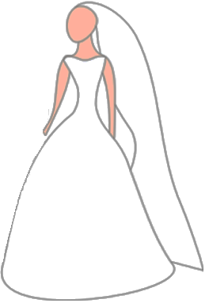

Slide 48

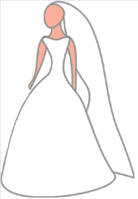


PhP.
2.1-8

Slide 51
Nurture? Or Neglect?
Build up? Or tear down?
Grow together? Or grow cold?

