Slide 1
Reflections on the Lord Supper

Slide 3
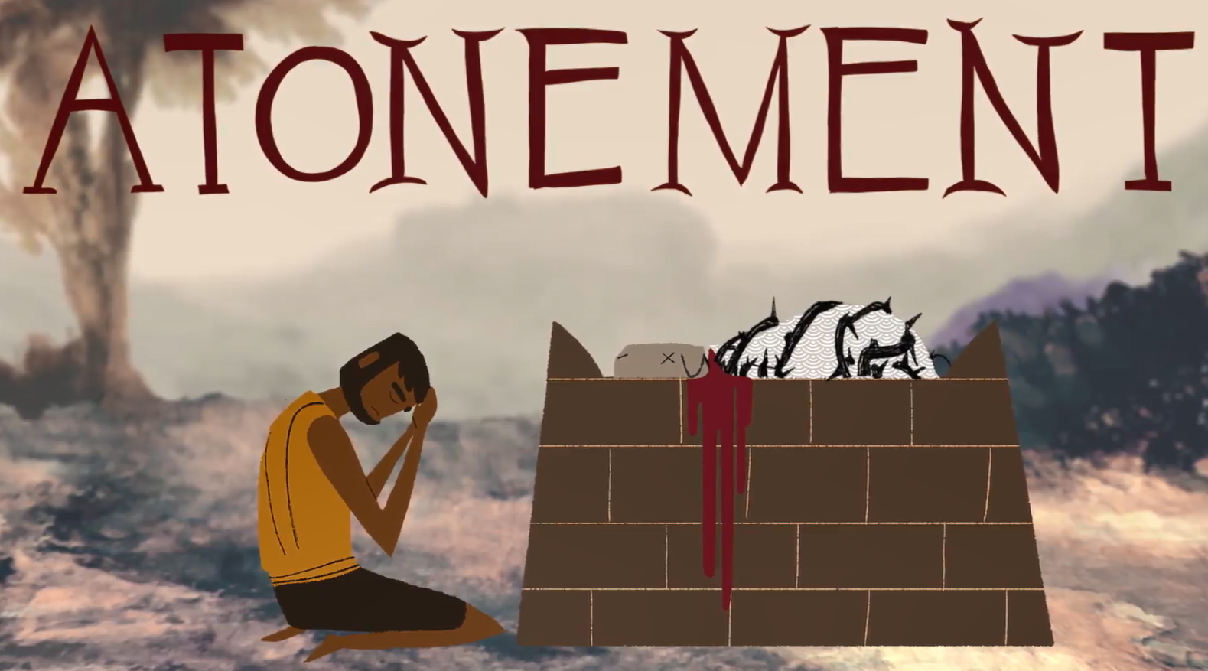

Slide 4
[Lev 17:11 NKJV] 11 'For the life of the flesh [is] in the blood, and I have given it to you upon the altar to make atonement for your souls; for it [is] the blood [that] makes atonement for the soul.'

Slide 5
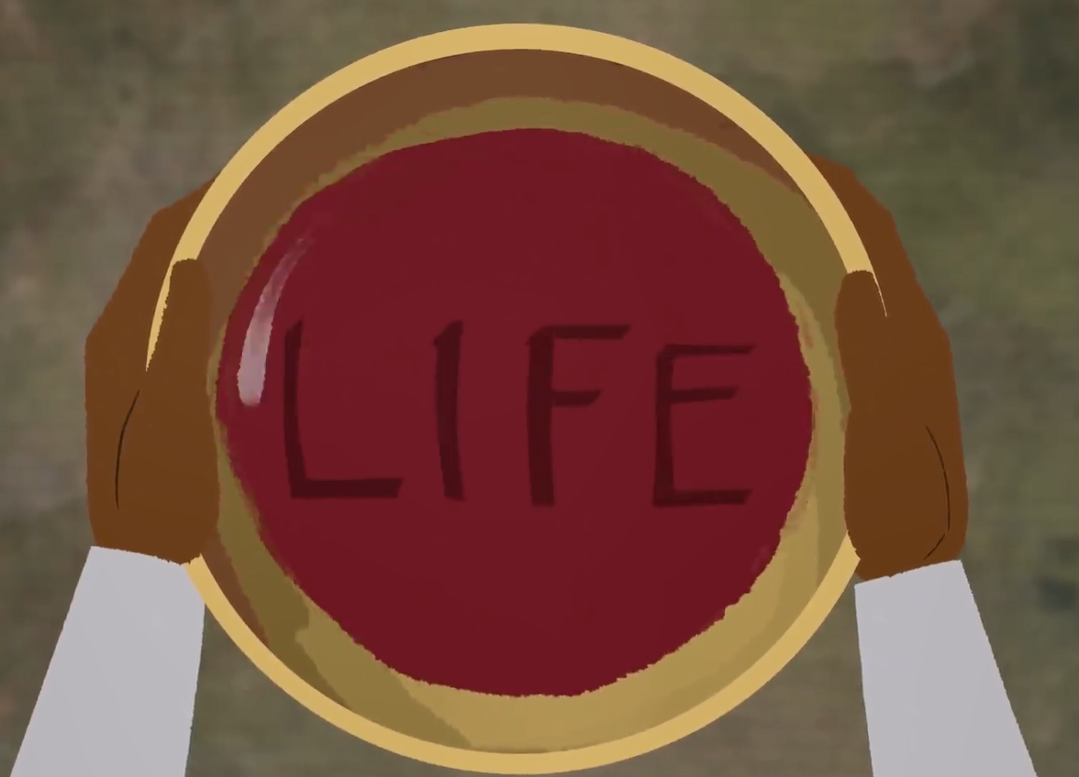

Slide 7
[1Co 10:18 NKJV] 18 Observe Israel after the flesh: Are not those who eat of the sacrifices partakers of the altar?

Slide 8
[Deu 12:5-7 NKJV] 5 "But you shall seek the place where the LORD your God chooses, out of all your tribes, to put His name for His dwelling place; and there you shall go. 6 "There you shall take your burnt offerings, your sacrifices, your tithes, the heave offerings of your hand, your vowed offerings, your freewill offerings, and the firstborn of your herds and flocks. 7 "And there you shall eat before the LORD your God, and you shall rejoice in all to which you have put your hand, you and your households, in which the LORD your God has blessed you.

Slide 9
[Exo 19:12 NKJV]. 12 "You shall set bounds for the people all around, saying, 'Take heed to yourselves [that] you do [not] go up to the mountain or touch its base. Whoever touches the mountain shall surely be put to death.

Slide 10
[Exo 20:24 NKJV] 24 'An altar of earth you shall make for Me, and you shall sacrifice on it your burnt offerings and your peace offerings, your sheep and your oxen. In every place where I record My name I will come to you, and I will bless you.

Slide 11
[Exo 24:1-11 NKJV] 1 Now He said to Moses, "Come up to the LORD, you and Aaron, Nadab and Abihu, and seventy of the elders of Israel, and worship from afar. 2 "And Moses alone shall come near the LORD, but they shall not come near; nor shall the people go up with him." 3 So Moses came and told the people all the words of the LORD and all the judgments. And all the people answered with one voice and said, "All the words which the LORD has said we will do." 4 And Moses wrote all the words of the LORD. And he rose early in the morning, and built an altar at the foot of the mountain, and twelve pillars according to the twelve tribes of Israel. 5 Then he sent young men of the children of Israel, who offered burnt offerings and sacrificed peace offerings of oxen to the LORD. 6 And Moses took half the blood and put [it] in basins, and half the blood he sprinkled on the altar.

Slide 12
7 Then he took the Book of the Covenant and read in the hearing of the people. And they said, "All that the LORD has said we will do, and be obedient." 8 And Moses took the blood, sprinkled [it] on the people, and said, "This is the blood of the covenant which the LORD has made with you according to all these words." 9 Then Moses went up, also Aaron, Nadab, and Abihu, and seventy of the elders of Israel, 10 and they saw the God of Israel. And [there was] under His feet as it were a paved work of sapphire stone, and it was like the very heavens in [its] clarity. 11 But on the nobles of the children of Israel He did not lay His hand. So they saw God, and they ate and drank.

Slide 13
[1Co 10:16 NKJV] 16 The cup of blessing which we bless, is it not the communion of the blood of Christ? The bread which we break, is it not the communion of the body of Christ?

Slide 14
[Mat 26:29 NKJV] 29 "But I say to you, I will not drink of this fruit of the vine from now on until that day when I drink it new with you in My Father's kingdom.“
[Luk 22:16 NKJV] 16 "for I say to you, I will no longer eat of it until it is fulfilled in the kingdom of God."

