Slide 1
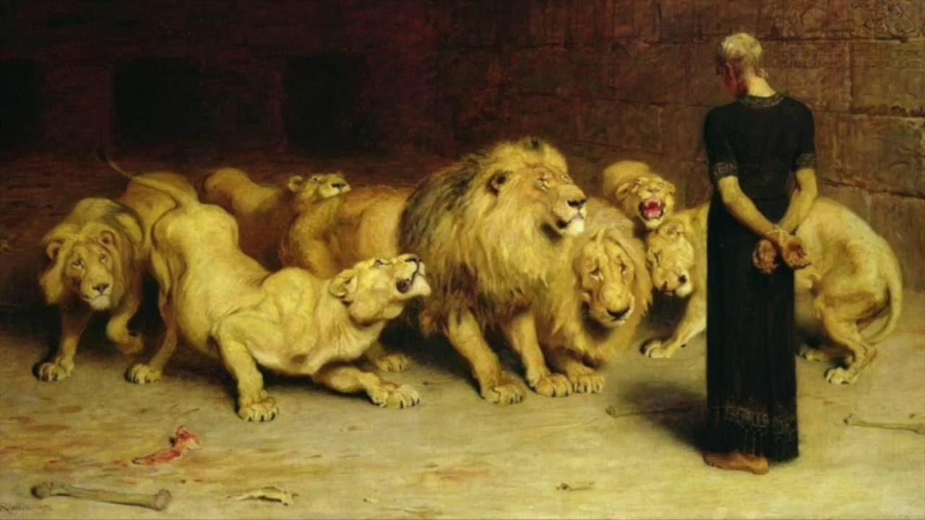
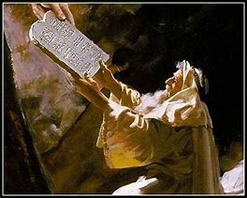
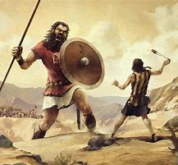
Old Testament Survey
Lesson 7: The United Kingdom – Saul, David, and Solomon
“….our tutor to bring us to Christ” (Gal 3:24)

Slide 2
Structure of the Old Testament
Section | Key Topics
Genesis - Deuteronomy | Creation through the exodus Books of the law
Joshua - Ruth | Conquest of Canaan through the time of the judges
1 Samuel – 2 Chronicles | The time of the kings, the divided kingdom, and the captivity
Ezra - Esther | The return to Judah
Psalms – Song of Solomon | Books of poetry and wisdom
Isaiah - Daniel | Major prophets
Hosea - Malachi | Minor prophets

Slide 3
Summary of OT Bible Chronology (In Round Numbers)
Event | Approximate Date
Creation | ~4,200 BC
Noah / The Flood | ~2,600 BC
Joseph / Israel to Egypt | ~2,000 BC
Moses / Exodus from Egypt
Reign of Solomon | 970 BC
The Babylonian captivity | ~606 BC
Return to Judah | ~436 BC
Birth of Christ | ~3 BC
~1,500 BC

Slide 4
Outline of the United Kingdom
1 Samuel
Samuel, Saul (1050 – 1010 BC)
Reigned for 40 years (per Acts)
2 Samuel
David (1010 – 970 BC)
Reigned for 40 years
Age 30 - 70
1 Kings 1-11
Solomon (970 - 930 BC)
Reigned for 40 years
Starting in 970 BC per Egyptian and Assyrian records for Rehoboam, plus Solomon’s 40-year reign
1 Chronicles 1-9
Names and genealogies
1 Chronicles 10
Death of Saul
1 Chronicles 11-29
David
2 Chronicles 1-9
Solomon

Slide 5
Key Personalities
Samuel
Saul
David
Solomon

Slide 6
Samuel
Positives
Served God from childhood
“Speak, for your servant hears”
Stature and favor before God and men
Known as a seer and man of God
Judged Israel
Defrauded no man
“I will pray for you”
“I will teach you the good and right way”
Advised against having a king
Spoke truth to the people and the king
Rebuked both the people and the king
Fulfilled God’s command for Agag and the Amalekites
Negatives
Sons did not follow God
Looked for physical appearance and stature as the requirements for a king

Slide 7
The Coming King – Per Moses
The people will ask for a king: “like all the nations around me”
“the Lord your God chooses” the king
He shall be a brother, not a foreigner
He shall not:
Multiply horses, wives, or silver and gold
Return to Egypt
He shall have a copy of the law
Read it, fear the Lord, and observe all the law, so that:
His heart is not lifted above his brethren
He does not turn aside from the commandments
He prolongs the days of his kingdom

Slide 8
The Coming King – Per Samuel
The people demand:
“make use a king to judge us like all the nations”
God said:
“they have rejected Me, that I should reign over them”
Samuel says the king will:
Take your sons
Servants, an army, farmers, making weapons
Take your daughters
Perfumers, cooks, bakers
Take the best of your fields
Take a tenth of your produce and your sheep
Take your servants, young men, and donkeys for his work
Make you his servants, and you will cry out
The Lord will not hear you
The people reply:
We will have a king, that we may be like all the nations

Slide 9
Saul 1 Samuel 9-31; 1 Chron 10
Positives
Tall, choice, and handsome
Initially modest
Selected by God as the first king of Israel
Spirit of the Lord falls on him
Negatives
Unlawful sacrifice
“I felt compelled”
Rejected from being king
Spares Agag, king of the Amalekites, against God’s commands
Again rejected from being king
“I feared the people and obeyed their voice”
“rejected the word of the Lord”
The Spirit of God departed from him
Persecutes David
Consults a medium

Slide 10
David 2 Samuel 1 – 1 Kings 2; 1 Chron 11-29
Positives
Walked in integrity of heart and uprightness
A man after God’s heart
Repentant
Trusted in God
Had mercy on Saul (twice)
The Spirit of God spoke by him
1 Chron 28:19. "All this," said David, "the Lord made me understand in writing, by His hand upon me, all the works of these plans."
Many Psalms
Desired to build a dwelling place for God
Left full instructions for Solomon
Offers himself for the people
“Gold standard” for the following kings
Negatives
Aligned with dubious groups when needed
Adultery with Bathsheba
Murdered Uriah
Sons are a mess
Conducts a census of Israel
Shed much blood, made great wars
Not permitted to build the temple of God

Slide 11
Solomon 1 Kings 1-11; 2 Chron 1-9
Positives
Asked for wisdom
Granted wisdom above all men
Wisdom writings
God appears to him twice
Initially served God
1 Kings 4:20, 25
Judah and Israel were as numerous as the sand by the sea in multitude, eating and drinking and rejoicing.
Judah and Israel dwelt safely
Negatives
Loved many foreign wives
Turned away his heart after other gods
Worked and taxed the people excessively
Not loyal to God
Loses the kingdom
Adversaries and internal rebellion

Slide 12
Results After 3 Kings
Only 1 of 3 fully served the Lord
1 Sam 17:25
“[If someone will kill Goliath, the king will] give his father's house exemption from taxes in Israel
1 Kings 12:3-4
Jeroboam and the whole assembly of Israel: "Your father made our yoke heavy"
1 Kings 7
Solomon built his house, the House of the Forest of Lebanon, the Hall of Pillars, a hall for the throne, the Hall of Judgement, a house for Pharaoh’s daughter…..
Told you so…..

Slide 13
Leading Us to Christ
The lineage and kingship of David leads to Jesus
1 Chron 17:14
And I will establish him in My house and in My kingdom forever; and his throne shall be established forever.

Slide 14
Date | Lesson Topic | Class Leader
Dec 1 (W) | Why study the OT? Theme of the OT. OT Summary. | Rick
Dec 5 (S) | Genesis (part 1) | Jordan
Dec 8 (W) | Genesis (part 2) | Jordan
Dec 12 (S) | The Exodus (Egypt to Canaan) | Rick
Dec 15 (W) | The Law | Rick
Dec 19 (S) | Joshua and Judges | Jordan
Dec 22 (W) | The United Kingdom: Saul, David, and Solomon | Rick
Dec 26 (S) | The Divided Kingdom: Israel | Jordan
Jan 2 (S) | The Divided Kingdom: Judah | Rick
Jan 5 (W) | Books of Poetry and Wisdom | Jordan
Jan 9 (S) | Major Prophets: Isaiah, Jeremiah, Ezekiel, Daniel | Rick
Jan 12 (W) | Old Testament Review | Jordan & Rick
Jan 16 (S) | Between the Testaments | Jordan

Slide 15
Thanks

Slide 16
Backup Material

Slide 17
Date | Lesson Topic | Class Leader
Dec 1 (W) | Why study the OT? Theme of the OT. OT Summary. | Rick
Dec 5 (S) | Genesis (part 1) | Jordan
Dec 8 (W) | Genesis (part 2) | Jordan
Dec 12 (S) | The Exodus (Egypt to Canaan) | Rick
Dec 15 (W) | The Law | Rick
Dec 19 (S) | Joshua and Judges | Jordan
Dec 22 (W) | The United Kingdom: Saul, David, and Solomon | Rick
Dec 26 (S) | The Divided Kingdom: Israel | Jordan
Jan 2 (S) | The Divided Kingdom: Judah | Rick
Jan 5 (W) | Books of Poetry and Wisdom | Jordan
Jan 9 (S) | Major Prophets: Isaiah, Jeremiah, Ezekiel, Daniel | Rick
Jan 12 (W) | Old Testament Review | Jordan & Rick
Jan 16 (S) | Between the Testaments | Jordan

