Slide 1
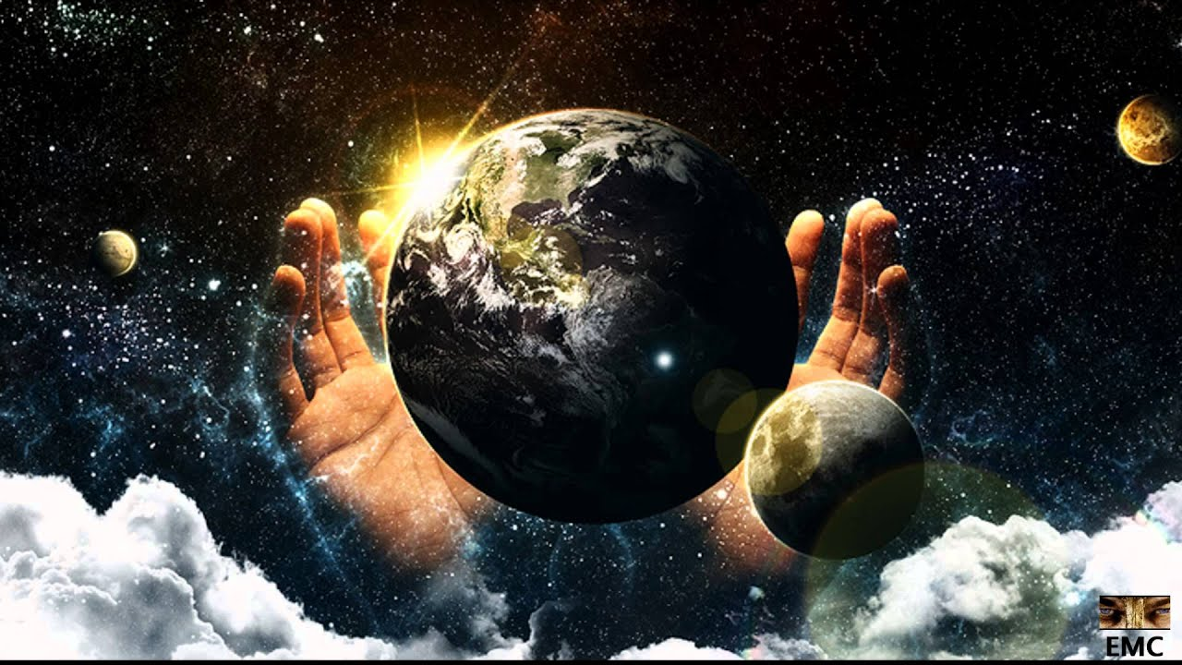
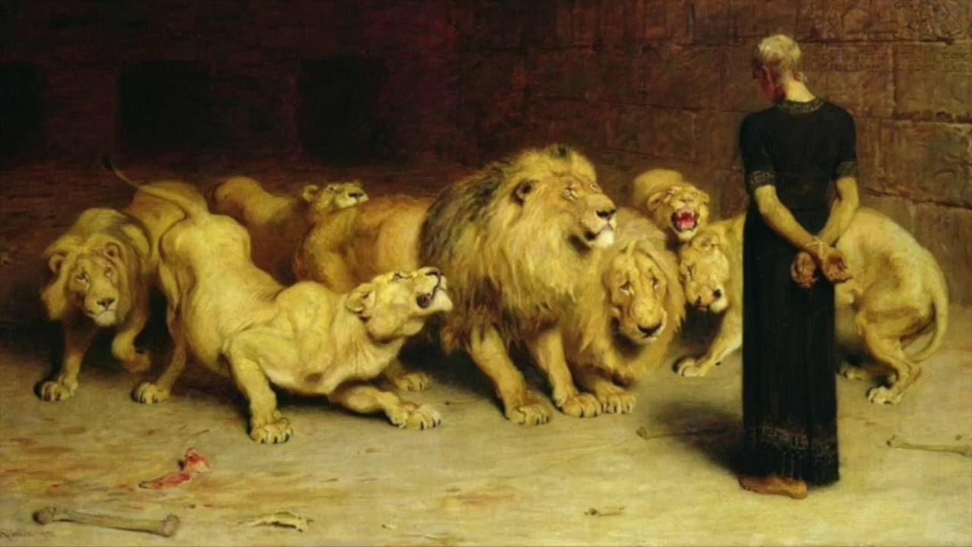
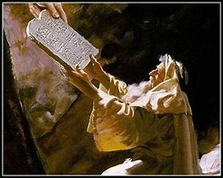
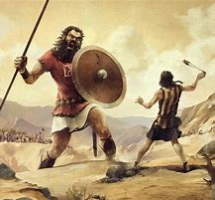
Old Testament Survey
Lesson 11: The Major Prophets
“….our tutor to bring us to Christ” (Gal 3:24)

Slide 2
Structure of the Old Testament
Section | Key Topics
Genesis - Deuteronomy | Creation through the exodus Books of the law
Joshua - Ruth | Conquest of Canaan through the time of the judges
1 Samuel – 2 Chronicles | The time of the kings, the divided kingdom, and the captivity
Ezra - Esther | The return to Judah
Psalms – Song of Solomon | Books of poetry and wisdom
Isaiah - Daniel | Major prophets
Hosea - Malachi | Minor prophets

Slide 3
Summary of OT Bible Chronology (In Round Numbers)
Event | Approximate Date
Creation | ~4,200 BC
Noah / The Flood | ~2,600 BC
Joseph / Israel to Egypt | ~2,000 BC
Moses / Exodus from Egypt | ~1,500 BC
Reign of Solomon | ~970 BC
The Divided Kingdom (Rehoboam / Jeroboam) | ~930 BC
The Assyrian captivity of Israel | ~740 BC
The Babylonian captivity of Judah | ~606 BC / ~587 BC
Return to Judah | ~536 BC
Birth of Christ | ~3 BC

Slide 4
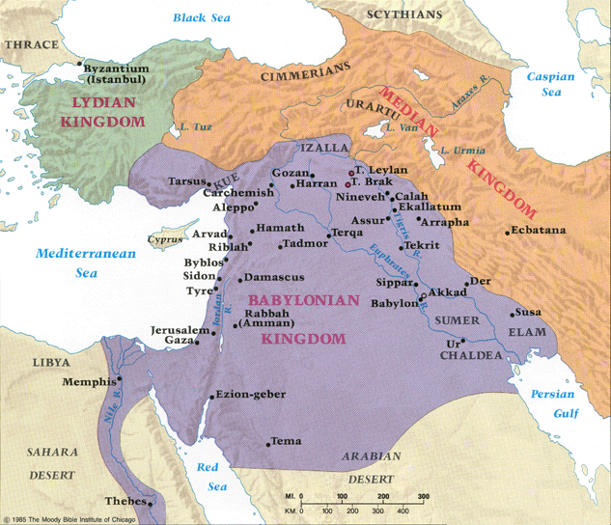
Babylonian Empire
Jerusalem to Babylon
(525 miles)
Houston to:
Lubbock, TX
Stillwater, OK
Pensacola, FL
Jerusalem to Shushan
(Persia)
(750 miles)
Houston to:
El Paso, TX
Kansas City, MO
Tallahassee, FL
Baghdad, Iraq
today
Avaz, Iran
today

Slide 5
Key Points from the Major Prophets
Name | Isaiah
Time frame | Reign of Hezekiah 740-700 BC
Location | Jerusalem
Key event | Assyria attacks Judah
Key message | The coming judgement of Judah

Slide 6
Key Points from the Major Prophets
Name |  | Jeremiah
Time frame |  | Last kings of Judah 627-575 BC
Location |  | Jerusalem, then Egypt
Key event |  | Destruction of Jerusalem
Key message |  | The judgement of Judah is here

Slide 7
Key Points from the Major Prophets
Name |  |  | Ezekiel
Time frame |  |  | Initial Babylonian captivity 595 – 570 BC
Location |  |  | Babylon
Key event |  |  | Destruction of Jerusalem
Key message |  |  | Judah is being judged, but there’s hope

Slide 8
Key Points from the Major Prophets
Name |  |  |  | Daniel
Time frame |  |  |  | Babylonian and Persian captivity 605 – 536 BC
Location |  |  |  | Babylon, Persia
Key event |  |  |  | Babylonian captivity, Persia overthrows Babylon
Key message |  |  |  | God rules in the kingdoms of men

Slide 9
Key Points from the Major Prophets
Name | Isaiah | Jeremiah | Ezekiel | Daniel
Time frame | Reign of Hezekiah 740-700 BC | Last kings of Judah 627-575 BC | Initial Babylonian captivity 595 – 570 BC | Babylonian and Persian captivity 605 – 536 BC
Location | Jerusalem | Jerusalem, then Egypt | Babylon | Babylon, Persia
Key event | Assyria attacks Judah | Destruction of Jerusalem | Destruction of Jerusalem | Babylonian captivity, Persia overthrows Babylon
Key message | The coming judgement of Judah | The judgement of Judah is here | Judah is being judged, but there’s hope | God rules in the kingdoms of men

Slide 10
For Each Major Prophet….
Time frame
Situation with Judah and / or Israel
Ruling kings
Books involved / mentioned
Key messages
Power verses / prophecies

Slide 11
Isaiah (1) “Yahweh is salvation”
Time frame
Prophesies ~740 – 700 BC
Verified via the campaign of Sennacherib of Assyria against Judah
Ministered in and around Jerusalem
Married “the prophetess” (Isa 8:3), with two sons
Situation with Judah and / or Israel
Israel taken captive by Assyria. Kingdom is destroyed, 722 BC.
Sennacherib:
"I shut up Hezekiah in Jerusalem like a bird in a cage."
Assyrian host was destroyed by God
Isaiah foretells the Jew’s salvation from captivity via Cyrus and the rebuilding of Jerusalem
Ruling kings
Uzziah, Jotham, Ahaz, and Hezekiah

Slide 12
Isaiah (2)
Books involved / mentions
Isaiah
Referred to as “the fifth gospel” by Jerome
2 Kings, 2 Chronicles, all 4 gospels, Acts, Romans
Outline of Isaiah
Ch 1-39
Approaching judgement on the nation of Judah and the nations around Judah
Ch 40-66
Comfort for the nation of Judah
Isa 40:1. "Comfort, yes, comfort My people!" Says your God.“
The coming Messiah
The restoration of Zion

Slide 13
Isaiah (3)
Power verses / prophecies
Isa 6:8. Also I heard the voice of the Lord, saying: "Whom shall I send, And who will go for Us?" Then I said, "Here am I! Send me."
Isa 55:8-9. 8 "For My thoughts are not your thoughts, Nor are your ways My ways," says the Lord. 9 "For as the heavens are higher than the earth, So are My ways higher than your ways, And My thoughts than your thoughts.
Isa 44:28. Who says of Cyrus, 'He is My shepherd, And he shall perform all My pleasure, Saying to Jerusalem, "You shall be built," And to the temple, "Your foundation shall be laid."'

Slide 14
Jeremiah (1) “God will uplift”
Time frame
~627-575 BC
Situation with Judah and / or Israel
Jeremiah mourned Josiah’s death
Preaches to the final kings of Judah
Remains in Jerusalem for a period of time after its fall to Babylon, 587/586 BC
Flees to Egypt after the Jewish revolt against Babylon. Continues his ministry there.
Ruling kings
Josiah, Jehoahaz, Jehoiakim, Jehoiachin, Zedekiah

Slide 15
Jeremiah (2)
Books involved / mentions
Jeremiah, Lamentations
2 Chronicles, Ezra, Nehemiah, Daniel, Matthew
Outline of Jeremiah
Ch 1-25
God’s approaching judgement against Judah because of its sin and idolatry
Ch 26-52
Conflicts between Jeremiah and the kings of Judah
Zedekiah wouldn’t listen to him (2 Chron 36:12)
The fall of Jerusalem and the final days of Judah, 587/586 BC.
Jeremiah’s flight to Egypt

Slide 16
Jeremiah (4)
Power verses / prophecies
Jer 18:5-6. 5 Then the word of the Lord came to me, saying: 6 "O house of Israel, can I not do with you as this potter?" says the Lord. "Look, as the clay is in the potter's hand, so are you in My hand, O house of Israel!
Jer 29:10. For thus says the Lord: After seventy years are completed at Babylon, I will visit you and perform my good word toward you, and cause you to return to this place.

Slide 17
Ezekiel (1) “God will strengthen”
Time frame
~595 – 570 BC
Situation with Judah and / or Israel
First exiles have been taken to Babylon.
Ezekiel is an exile, living on the banks of the Chebar in Chaldea
His wife dies suddenly in the ninth year of exile
Jerusalem is destroyed. 587/586 BC
Contemporary with Daniel and Jeremiah.
Ruling kings
Jehoiakim, Jehoiachin, Zedekiah

Slide 18
Ezekiel (2)
Books involved / mentioned
Ezekiel
Vivid, symbolic language in the prophecies
Jerome: “It was because of this obscurity [i.e. the difficulties of the prophecies] that the Jews forbade any one to read it till he had attained the age of thirty."
Outline of Ezekiel
Ch 1-24. Judgment on the nation of Judah
Ch 25-32 Judgment on the surrounding nations
Ammonites, Moabites, Edomites, Philistines, Tyre and Sidon, Egypt
Ch 33-48 The future blessing of God's people

Slide 19
Ezekiel (3)
Power verses / prophecies
Ezek 14:14. Even if these three men, Noah, Daniel, and Job, were in it, they would deliver only themselves by their righteousness," says the Lord God.
Ezek 3:16-19. “I have made you a watchman for the house of Israel”
Ezek 37:1-14. 1 The hand of the Lord came upon me and brought me out in the Spirit of the Lord, and set me down in the midst of the valley; and it was full of bones…. 12 Therefore prophesy and say to them, 'Thus says the Lord God: "Behold, O My people, I will open your graves and cause you to come up from your graves, and bring you into the land of Israel. 13 Then you shall know that I am the Lord, when I have opened your graves, O My people, and brought you up from your graves. 14 I will put My Spirit in you, and you shall live, and I will place you in your own land. Then you shall know that I, the Lord, have spoken it and performed it," says the Lord.'"

Slide 20
Daniel (1) “God is my judge”
Time frame
605 – 536 BC
Situation with Judah and / or Israel
Taken captive as a youth from Jerusalem with the first round of Jews. Jehoiakim is ruling. 606 / 605 BC
Jerusalem is destroyed. Zedekiah is ruling. 586 / 585 BC
Lives in Babylon / Persia for ~70 years, ~536 BC
Serves as both advisor and prophet to the kings of Babylon and Media / Persia.
Ruling kings
Jehoiakim, Jehoiachin, Zedekiah, Nebuchadnezzar, Darius

Slide 21
Daniel (2)
Books involved / mentioned
Daniel
Ezekiel, Matthew
Outline of Daniel
Ch 1-6. Historical events
Initial captivity, advising Nebuchadnezzar, the fiery furnace, the lion’s den
Ch 7-12. Prophecies concerning the world powers
Babylon, Persia, Greece, Rome.

Slide 22
Daniel (3)
Power verses / prophecies
Dan 1:8. But Daniel purposed in his heart that he would not defile himself with the portion of the king's delicacies, nor with the wine which he drank
Dan 9:2. I, Daniel, understood by the books the number of the years specified by the word of the Lord through Jeremiah the prophet, that He would accomplish seventy years in the desolations of Jerusalem
Dan 5:21. They fed him with grass like oxen, and his body was wet with the dew of heaven, till he knew that the Most High God rules in the kingdom of men, and appoints over it whomever He chooses.
Dan 5:24-29. 24 Then the fingers of the hand were sent from Him, and this writing was written…..

Slide 23
Looking to Jesus (1)
Isaiah
The entire chapter of Isaiah 53
Isa 53:5. But He was wounded for our transgressions, He was bruised for our iniquities; The chastisement for our peace was upon Him, And by His stripes we are healed.
Isa 7:14. Therefore the Lord Himself will give you a sign: Behold, the virgin shall conceive and bear a Son, and shall call His name Immanuel.

Slide 24
Looking to Jesus (2)
Jeremiah
Jer 31:31-34. 31 "Behold, the days are coming, says the Lord, when I will make a new covenant with the house of Israel and with the house of Judah — 32 not according to the covenant that I made with their fathers in the day that I took them by the hand to lead them out of the land of Egypt, My covenant which they broke, though I was a husband to them, says the Lord. 33 But this is the covenant that I will make with the house of Israel after those days, says the Lord: I will put My law in their minds, and write it on their hearts; and I will be their God, and they shall be My people. 34 No more shall every man teach his neighbor, and every man his brother, saying, 'Know the Lord,' for they all shall know Me, from the least of them to the greatest of them, says the Lord. For I will forgive their iniquity, and their sin I will remember no more."

Slide 25
Looking to Jesus (3)
Ezekiel
Ezek 37:24. "David My servant shall be king over them, and they shall all have one shepherd; they shall also walk in My judgments and observe My statutes, and do them.
Ezek 37:26. Moreover I will make a covenant of peace with them, and it shall be an everlasting covenant with them; I will establish them and multiply them, and I will set My sanctuary in their midst forevermore.

Slide 26
Looking to Jesus (4)
Daniel
Dan 2:44. And in the days of these kings the God of heaven will set up a kingdom which shall never be destroyed; and the kingdom shall not be left to other people; it shall break in pieces and consume all these kingdoms, and it shall stand forever.
Dan 7:13-14. 13 "I was watching in the night visions, And behold, One like the Son of Man, Coming with the clouds of heaven! He came to the Ancient of Days, And they brought Him near before Him. 14 Then to Him was given dominion and glory and a kingdom, That all peoples, nations, and languages should serve Him. His dominion is an everlasting dominion, Which shall not pass away, And His kingdom the one Which shall not be destroyed.

Slide 27
Key Points from the Major Prophets
Name | Isaiah | Jeremiah | Ezekiel | Daniel
Time frame | Reign of Hezekiah 740-700 BC | Last kings of Judah 627-575 BC | Initial Babylonian captivity 595 – 570 BC | Babylonian and Persian captivity 605 – 536 BC
Location | Jerusalem | Jerusalem, then Egypt | Babylon | Babylon, Persia
Key event | Assyria attacks Judah | Destruction of Jerusalem | Destruction of Jerusalem | Babylonian captivity, Persia overthrows Babylon
Key message | The coming judgement of Judah | The judgement of Judah is here | Judah is being judged, but there’s hope | God rules in the kingdoms of men

Slide 28
Date | Lesson Topic | Class Leader
Dec 1 (W) | Why study the OT? Theme of the OT. OT Summary. | Rick
Dec 5 (S) | Genesis (part 1) | Jordan
Dec 8 (W) | Genesis (part 2) | Jordan
Dec 12 (S) | The Exodus (Egypt to Canaan) | Rick
Dec 15 (W) | The Law | Rick
Dec 19 (S) | Joshua and Judges | Jordan
Dec 22 (W) | The United Kingdom: Saul, David, and Solomon | Rick
Dec 26 (S) | The Divided Kingdom: Israel | Jordan
Jan 2 (S) | The Divided Kingdom: Judah | Rick
Jan 5 (W) | Books of Poetry and Wisdom | Jordan
Jan 9 (S) | Major Prophets: Isaiah, Jeremiah, Ezekiel, Daniel | Rick
Jan 12 (W) | Old Testament Review | Jordan
Jan 16 (S) | Between the Testaments | Jordan

Slide 29
Thanks

Slide 30
Backup Material

Slide 31
Date | Lesson Topic | Class Leader
Dec 1 (W) | Why study the OT? Theme of the OT. OT Summary. | Rick
Dec 5 (S) | Genesis (part 1) | Jordan
Dec 8 (W) | Genesis (part 2) | Jordan
Dec 12 (S) | The Exodus (Egypt to Canaan) | Rick
Dec 15 (W) | The Law | Rick
Dec 19 (S) | Joshua and Judges | Jordan
Dec 22 (W) | The United Kingdom: Saul, David, and Solomon | Rick
Dec 26 (S) | The Divided Kingdom: Israel | Jordan
Jan 2 (S) | The Divided Kingdom: Judah | Rick
Jan 5 (W) | Books of Poetry and Wisdom | Jordan
Jan 9 (S) | Major Prophets: Isaiah, Jeremiah, Ezekiel, Daniel | Rick
Jan 12 (W) | Old Testament Review | Jordan
Jan 16 (S) | Between the Testaments | Jordan

