Slide 1
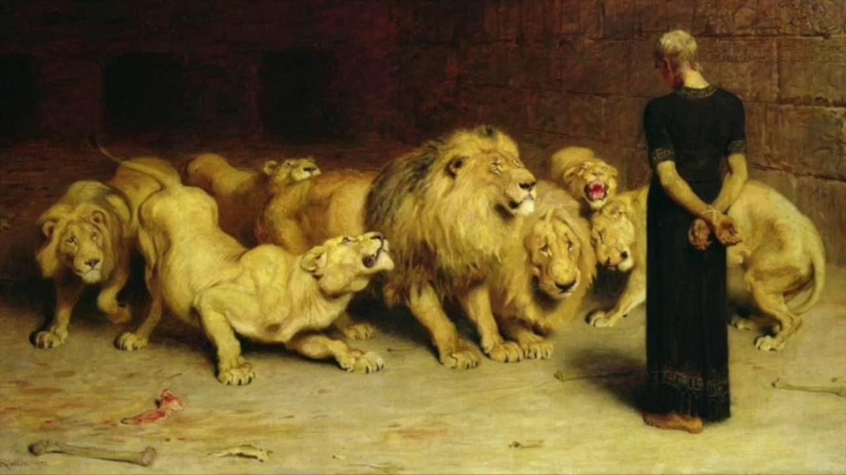
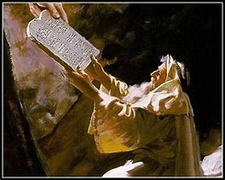
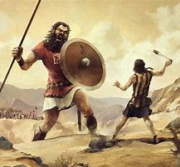
Old Testament Survey
Lesson 9: The Divided Kingdom – Judah
“….our tutor to bring us to Christ” (Gal 3:24)

Slide 2
Date | Lesson Topic | Class Leader
Dec 1 (W) | Why study the OT? Theme of the OT. OT Summary. | Rick
Dec 5 (S) | Genesis (part 1) | Jordan
Dec 8 (W) | Genesis (part 2) | Jordan
Dec 12 (S) | The Exodus (Egypt to Canaan) | Rick
Dec 15 (W) | The Law | Rick
Dec 19 (S) | Joshua and Judges | Jordan
Dec 22 (W) | The United Kingdom: Saul, David, and Solomon | Rick
Dec 26 (S) | The Divided Kingdom: Israel | Jordan
Jan 2 (S) | The Divided Kingdom: Judah | Rick
Jan 5 (W) | Books of Poetry and Wisdom | Jordan
Jan 9 (S) | Major Prophets: Isaiah, Jeremiah, Ezekiel, Daniel | Rick
Jan 12 (W) | Old Testament Review | Jordan
Jan 16 (S) | Between the Testaments | Jordan

Slide 3
Summary of OT Bible Chronology (In Round Numbers)
Event | Approximate Date
Creation | ~4,200 BC
Noah / The Flood | ~2,600 BC
Joseph / Israel to Egypt | ~2,000 BC
Moses / Exodus from Egypt | ~1,500 BC
Reign of Solomon | ~970 BC
The Divided Kingdom (Rehoboam / Jeroboam) | ~930 BC
The Assyrian captivity of Israel | ~740 BC
The Babylonian captivity of Judah | ~606 BC / ~587 BC
Return to Judah | ~536 BC
Birth of Christ | ~3 BC

Slide 4
The Time Between the Testaments
Why is everyone speaking Greek?
Why do many of the NT individuals (including Jesus) quote from a book written in Greek?
Who are the people in power called Romans?
What is a Pharisee, Sadducee, etc. ?
What is a synagogue?

