Slide 1
The Book of Ezekiel
March – August 2022

Slide 2
The Book of Ezekiel
Class #1 – Introduction

Slide 3
Opening Exercise
Get with a partner / small group, and list everything you know about Ezekiel (the guy or the book)

Slide 4
Ezekiel: Prophet to the Exiles
What is a prophet?
What was happening in Ezekiel’s time?
What did he write about?

Slide 5
What is a Prophet?
Deuteronomy 18:15-22

Slide 6
Deuteronomy 18
¹⁵ The Lord your God will raise up for you a prophet like me from among you, from your countrymen, you shall listen to him. … ¹⁸ I will raise up a prophet from among their countrymen like you, and I will put My words in his mouth, and he shall speak to them all that I command him. ¹⁹ It shall come about that whoever will not listen to My words which he shall speak in My name, I Myself will require it of him. ²⁰ But the prophet who speaks a word presumptuously in My name which I have not commanded him to speak, or which he speaks in the name of other gods, that prophet shall die.

Slide 7
What is a Prophet?
Deuteronomy 18:15-22
Jeremiah 23:16-22

Slide 8
Jeremiah 23
¹⁶ Thus says the Lord of hosts, “Do not listen to the words of the prophets who are prophesying to you. They are leading you into futility; They speak a vision of their own imagination, Not from the mouth of the … ¹⁸ “But who has stood in the council of the Lord, That he should see and hear His word? Who has given heed to His word and listened? … ²¹ “I did not send these prophets, But they ran. I did not speak to them, But they prophesied. ²² “But if they had stood in My council, Then they would have announced My words to My people...

Slide 9
What is a Prophet?
Deuteronomy 18:15-22
Jeremiah 23:16-22
A prophet is a messenger of God revealing the divine word to men.

Slide 10
What is a Prophet’s Purpose?
Interpret History
Enforce Covenants
Declare Future Events
Prophets used a variety of methods for doing this.

Slide 11
What’s Going on in Ezekiel?
World History
800s – 600s BC: Assyria in power
612: Nineveh Falls to Babylonians
Israel’s History
720s BC: Northern Kingdom Falls
609: Josiah killed by Pharaoh Neco

Slide 12
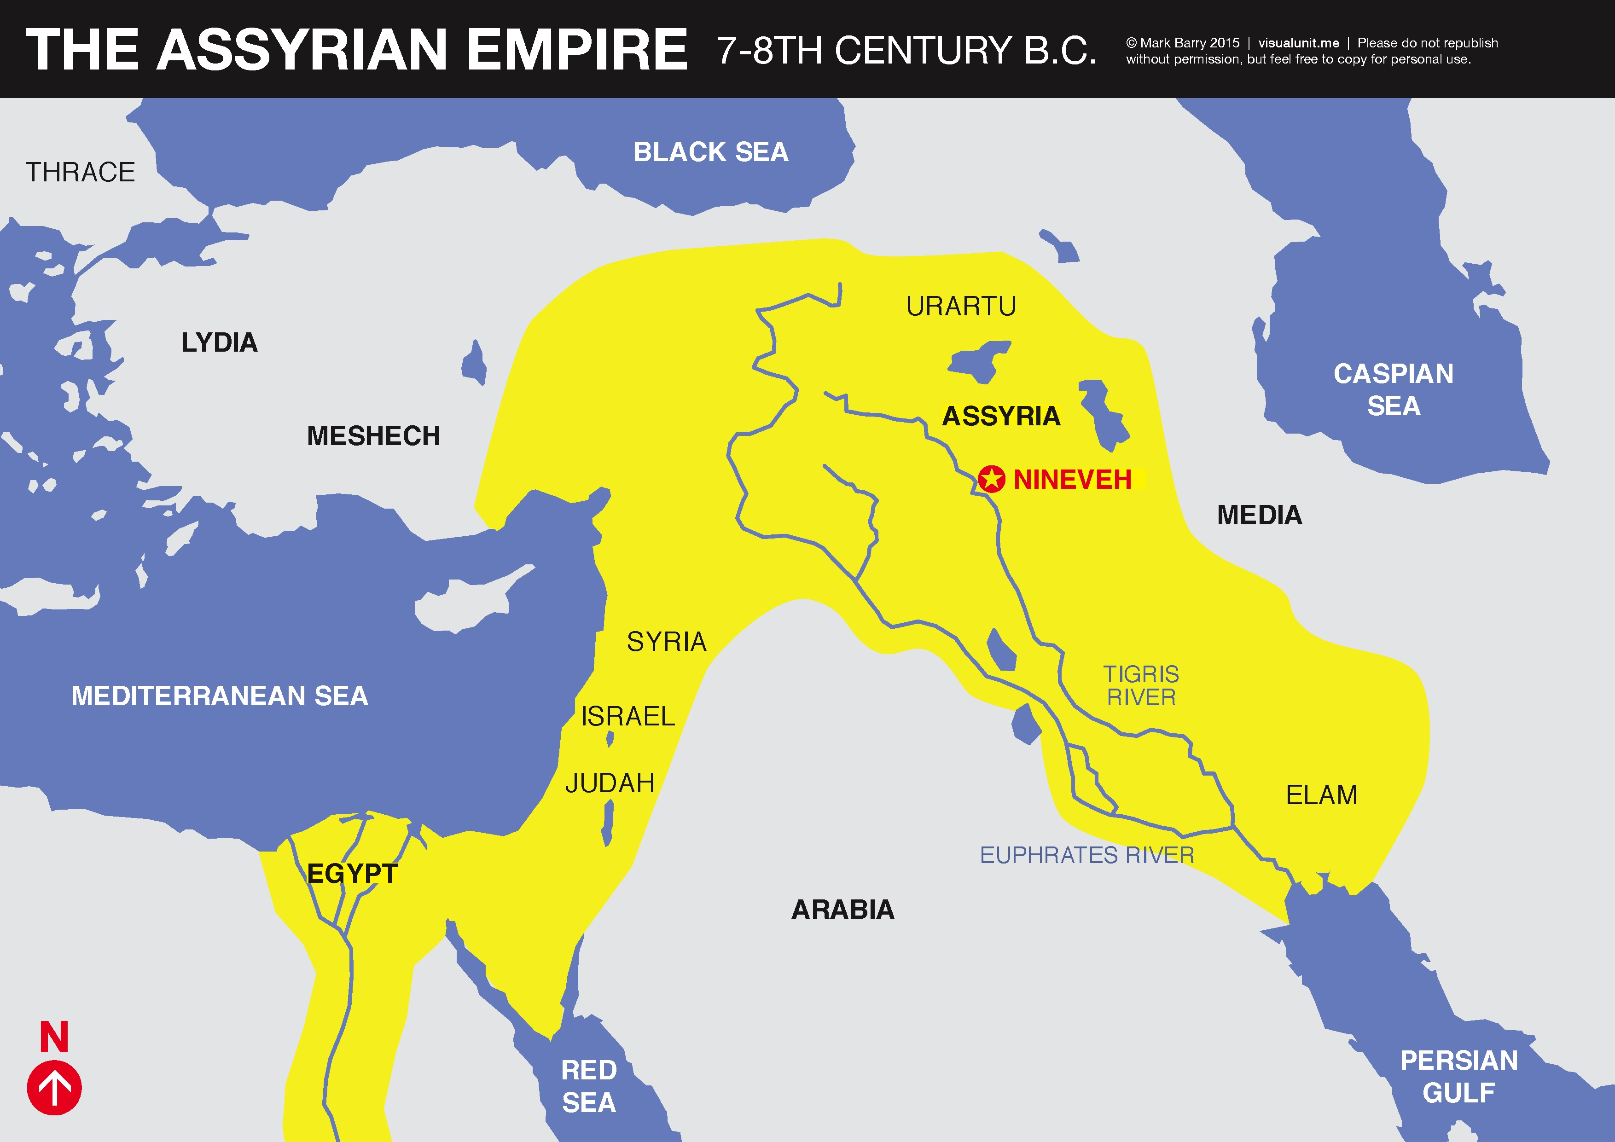

Slide 13
What’s Going on in Ezekiel?
World History
800s – 600s BC: Assyria in Power
612: Nineveh Falls to Babylonians
605: Assyria loses → Babylon now in power (Nebuch.)
Israel’s History
720s BC: Northern Kingdom Falls
609: Josiah killed by Pharaoh Neco
605: First captives to Babylon (Daniel 1)

Slide 14
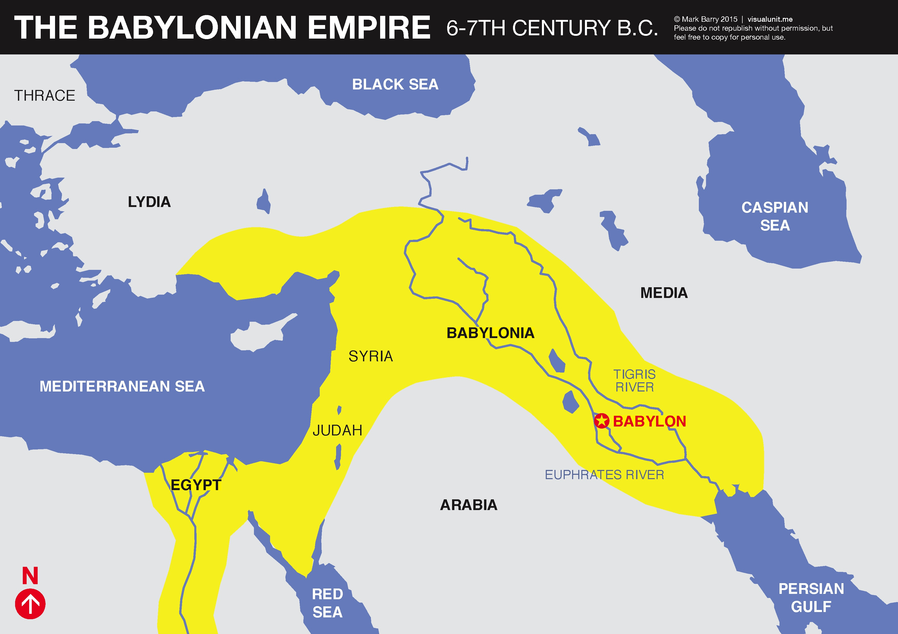

Slide 15
What’s Going on in Ezekiel?
World History
800s – 600s BC: Assyria in Power
612: Nineveh Falls to Babylonians
605: Assyria loses → Babylon now in power (Nebuch.)
Israel’s History
720s BC: Northern Kingdom Falls
609: Josiah killed by Pharaoh Neco
605: First captives to Babylon (Daniel 1)
598: Second Wave of Captives (Ezekiel)
586: Jerusalem falls, temple destroyed

Slide 16
Ezekiel in Context
597 – Captives to Babylon (King Jehoiachin, Ezekiel)
593 – Ezekiel called as a prophet of God (1:2)
Ezekiel 1-24
Judgment on Jerusalem
589 – Nebuchadnezzar besieges Jerusalem (24:1)
Ezekiel 25-32
Judg. on Nations
586 – Jerusalem, Temple Destroyed (33:21)
Ezekiel 33-48
Hope for Israel’s Future

Slide 17
Ezekiel in Context
Jerusalem Bowed
(1:2)
Jerusalem Besieged
(24:1)
Jerusalem Broken
(33:21)
Ezekiel 1-24
Judgment on Jerusalem
ch. 25-32
Judg. on Nations
Ezekiel 33-48
Hope for Israel’s Future
The LORD is not there [Jerusalem]
“The Lord is there” (48:35)
“The glory of the LORD departed…” (10:18)
“The glory of the LORD came” (43:4)

Slide 18
The Book of Ezekiel
For Sunday: Ezekiel 1

