Slide 1
The Book of Ezekiel
Class #2 – Ezekiel’s Vision

Slide 2
Class Objectives
Explain why Ezekiel was called at this particular time.
Identify 2-3 big ideas communicated in Ezekiel’s vision relevant to his message.
Connect Ezekiel’s vision to another Bible passage.

Slide 3
Group Discussion
What attributes of God are being communicated to Ezekiel in this vision?

Slide 4
The Thirtieth Year (1:1-3)
This is likely the 30th year of Ezekiel’s life.
Ezekiel is a priest, so this would be the year for him to begin work in the temple. (see Numbers 4)
He is, instead, exiled in Babylon.

Slide 5
Living Creatures (1:4-14)
These creatures are referred to as “cherubim” in Ezekiel 10.
Genesis 3:24 – Guarding Garden of Eden
Exodus 25:18 - On the Ark of Covenant
Psalm 99:1 – God enthtoned on them
Composite creatures, drawing on qualities of each animal.
Intense, quick, purposeful movement.

Slide 6
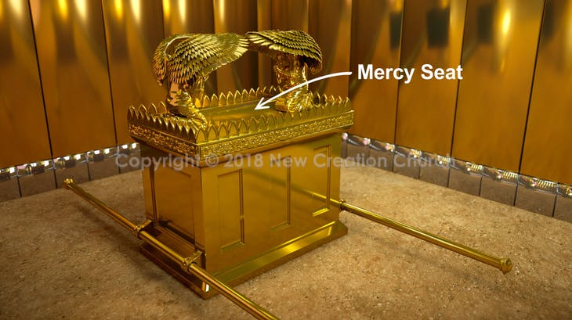

Slide 7
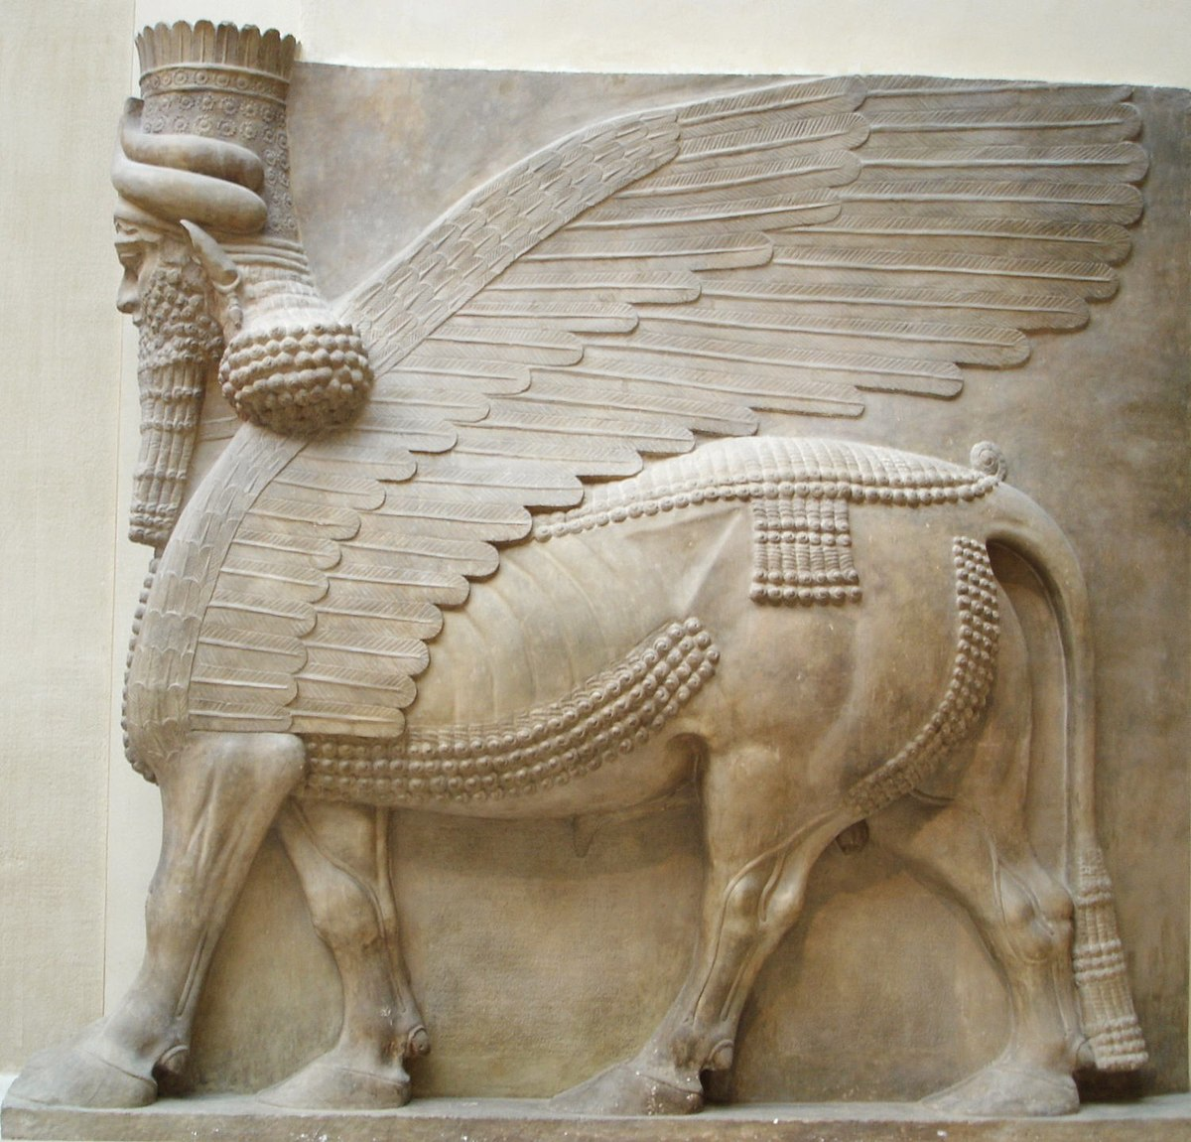
Assyrian god Shedu, from palace of Sargon II

Slide 8
Wheels (1:15-21)
“Wheel within a wheel” indicates multi-directional movement.
Eyes filling the wheels emphasize the vision of God.
The wheels and the creatures are animated by the same Spirit.

Slide 9
Platform & Throne (1:22-28)
The creatures are transporting God’s throne (royal chariot).

Slide 10
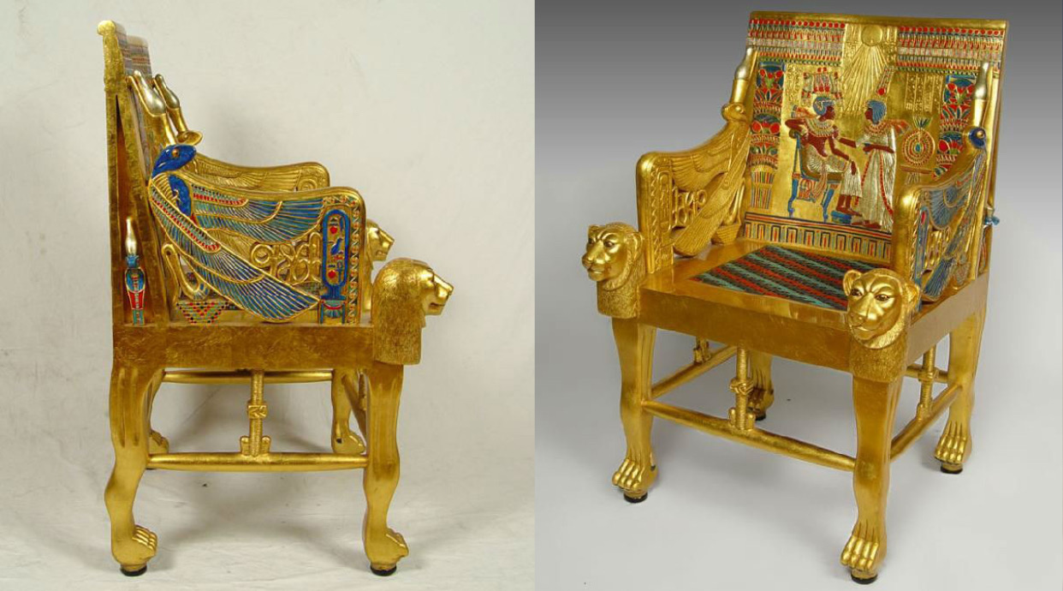
Throne Chair of King Tutankhamun (Egypt)

Slide 11
Platform & Throne (1:22-28)
The creatures are transporting God’s throne (royal chariot).
God’s appearance is of a man (?)
Ezekiel saw “the appearance of the likeness of the glory of the Lord.” (1:28)
And he fell on his face…

Slide 12
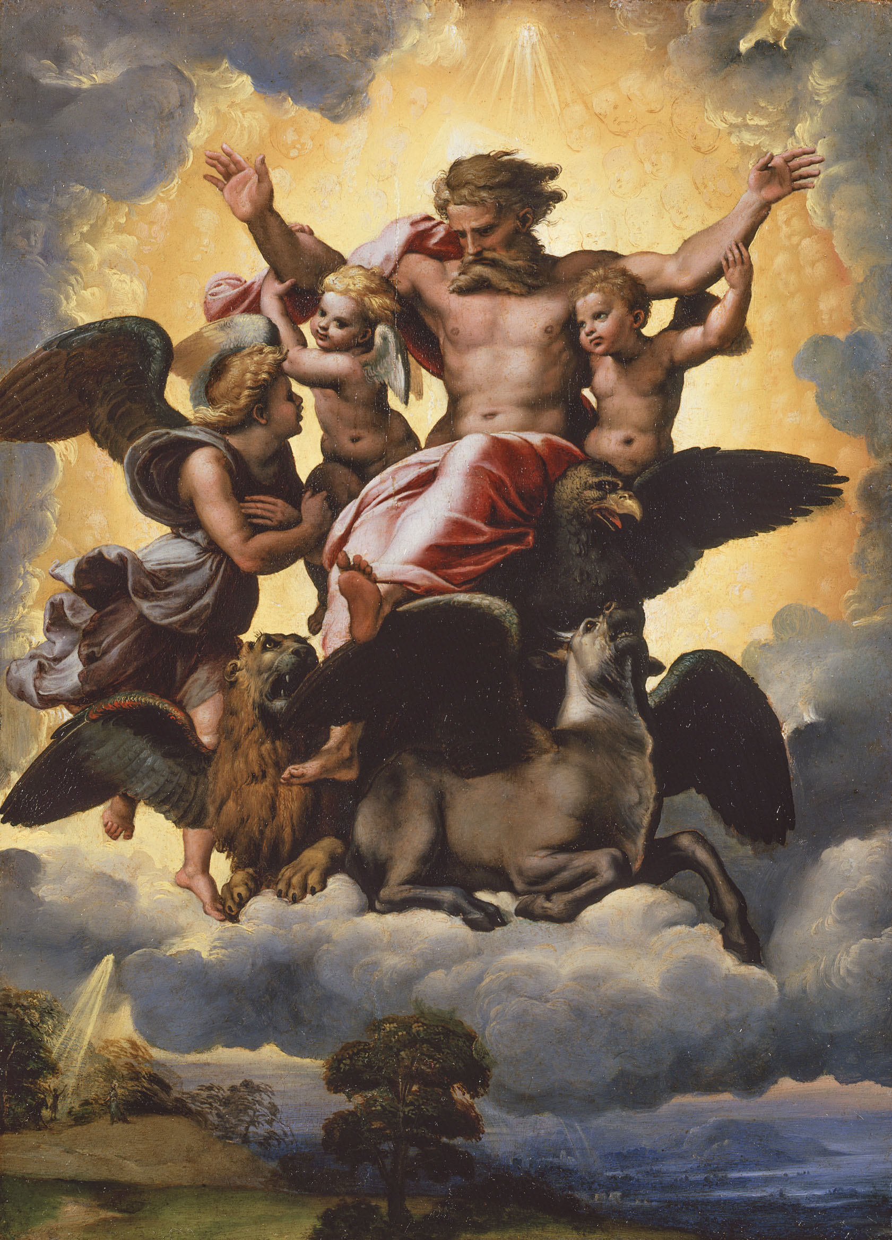

Slide 13
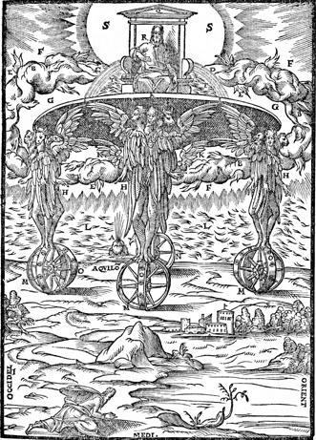

Slide 14
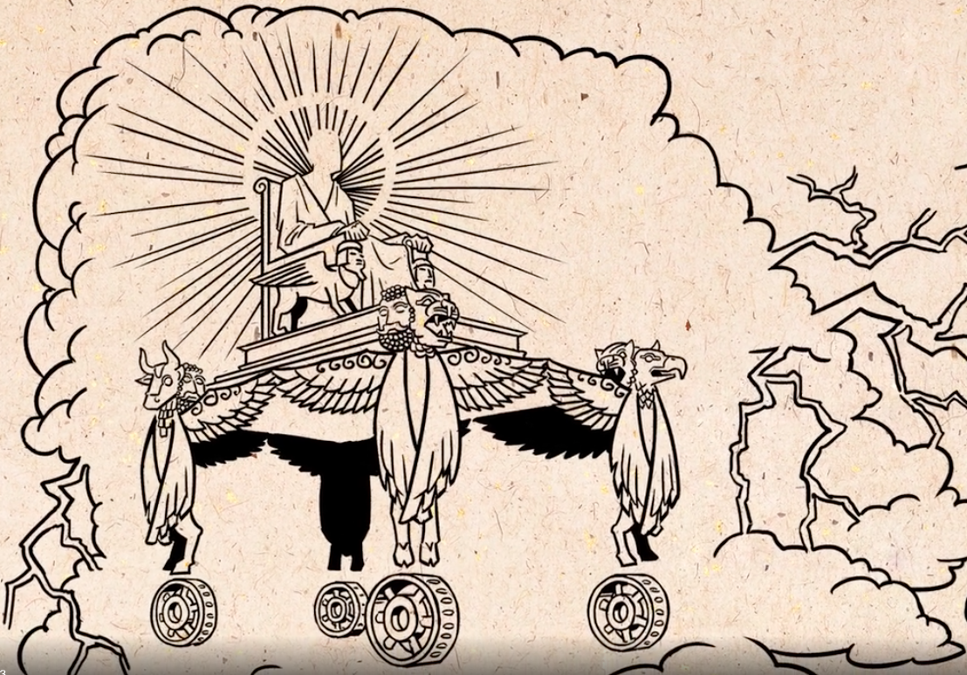

Slide 15
Class Objectives
Explain why Ezekiel was called at this particular time.
Identify 2-3 big ideas communicated in Ezekiel’s vision relevant to his message.
Connect Ezekiel’s vision to another Bible passage.

Slide 16
The Book of Ezekiel
For Wednesday: Ezekiel 2

