Slide 1
The Book of Ezekiel
Class #5 – The Judgement of Jerusalem

Slide 2
Review Chapters 1-4
Chapter 1 – The vision of God’s glory
Vision of awe and wonder for Ezekiel
Ezek 1:22. This was the appearance of the likeness of the glory of the Lord.
Chapter 2 – Ezekiel’s calling
Sent to the rebellious house of Israel.
Ezek 2:3. “they and their fathers have transgressed against Me to this very day”
Ezek 2:6. "And you, son of man, do not be afraid of them nor be afraid of their words…”

Slide 3
Review Chapters 1-4 (2)
Chapter 3 – A watchman for the house of Israel
Eats the scroll containing the words of God.
Sent to a familiar people with a familiar language, but….
Ezek 3:7. the house of Israel will not listen to you, because they will not listen to me.
Ezekiel is to be a watchman, and warn both the wicked and the righteous.

Slide 4
Review Chapters 1-4 (3)
Chapter 4 – The besieged Jerusalem
The model of Jerusalem under siege
An iron plate between the model and Ezekiel.
Lies on his left side for 390 days, then his right side for 40 days. “Bear their iniquity”
Eats the food and water of desperation, dung for fuel.
Ezek 4:16-17. Moreover He said to me, "Son of man, surely I will cut off the supply of bread in Jerusalem; they shall eat bread by weight and with anxiety, and shall drink water by measure and with dread, that they may lack bread and water, and be dismayed with one another, and waste away because of their iniquity.
Key verse: Ezek 2:5. “they will know that a prophet has been among them”

Slide 5
Class Objectives
Lay out the timeline of the prophecies of Ezekiel and the coming events
Recall the multiple prophesies that are being fulfilled
Describe the complete horror of the siege of Jerusalem resulting from God’s anger
Reading: Ezekiel 5:1-17

Slide 6
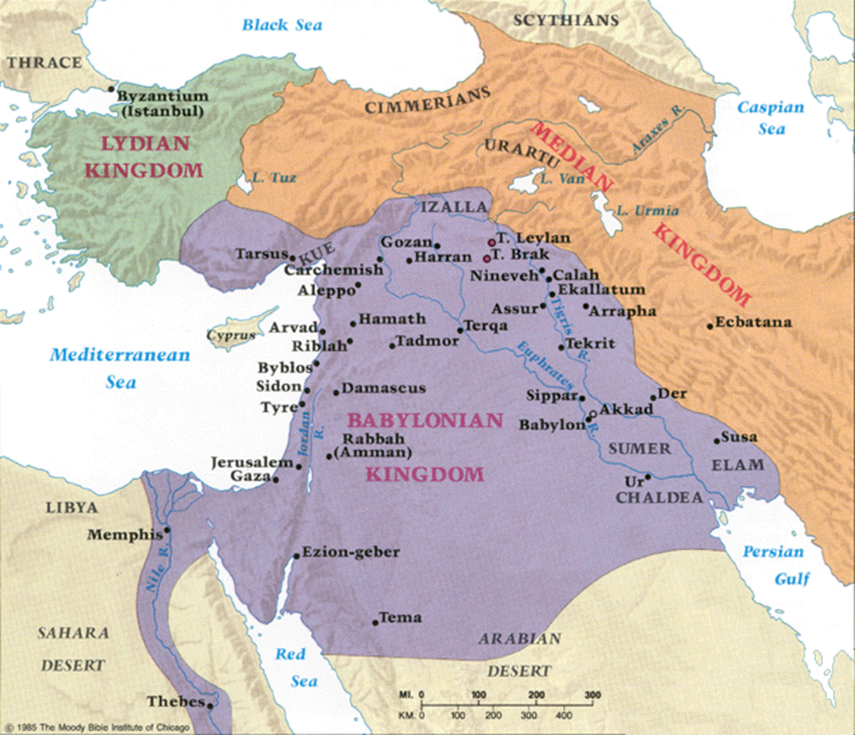
Geography
Jerusalem:
Zedekiah reigns
Jeremiah is warning them
They don’t listen
Babylon / Banks of the Chebar:
650 miles away
Ezekiel is a watchman to the house of Israel

Slide 7
Timeline
598
593
Years BC
588
586
0
5
Years of Jehoiachin’s
captivity
10
12
Taken into Babylonian
captivity
Ezekiel
called
Jerusalem
besieged
Jerusalem
destroyed
[Ezekiel confirmed]
Moses
~900 years ago

Slide 8
Ezekiel 5:1-4
The actions:
A sharp sword used as a barber’s razor
Shaved his head and beard
Divided his hair into 3 portions
1/3 burned in “Jerusalem”
1/3 struck with the sword
1/3 scattered, with a sword drawn after them
A small number bound in his garment
Some more burned with fire
What imagery do you see?

Slide 9
Ezekiel 5:5-10
Questions:
Who set up Jerusalem?
Who all could see Jerusalem?
What verbs described the Jews wickedness?
Just how bad had the Jews been relative to the nations around them?
Who would execute judgement on the Jews?
Who would see it happen?
How bad was the punishment?

Slide 10
Ezekiel 5:11-14
“because you have defiled My sanctuary with all your detestable things and with all your abominations….”
See 2 Chron 36:11-16
“I will also diminish you”
A verb meaning to reduce, diminish, cut short, trim; withdraw, remove. It basically means to reduce or diminish something…..length of a beard ….to remove or withdraw an inheritance (The Complete Word Study Dictionary: Old Testament.)
“will not spare, nor will I have pity”

Slide 11
Ezekiel 5:11-14 (2)
Direct mapping to the imagery of Ezekiel’s hair
One-third of you shall die of the pestilence, and be consumed with famine in your midst
…and one-third shall fall by the sword all around you
…and I will scatter another third to all the winds, and I will draw out a sword after them.
Just how angry was the Lord?
What about love?
See 2 Chron 36:15

Slide 12
Ezekiel 5:15-17
What would the surrounding nations take away from Jerusalem’s punishment?
How’s the food situation in Jerusalem?
Closing argument:
“So I will send against you famine and wild beasts, and they will bereave you. Pestilence and blood shall pass through you, and I will bring the sword against you. I, the Lord, have spoken."

Slide 13
The Prophesies
Lev 26:26, 29, 33
When I have cut off your supply of bread, ten women shall bake your bread in one oven, and they shall bring back your bread by weight, and you shall eat and not be satisfied….You shall eat the flesh of your sons, and you shall eat the flesh of your daughters….I will scatter you among the nations and draw out a sword after you…

Slide 14
The Prophesies (2)
Deut 28:52-57
"They shall besiege you at all your gates until your high and fortified walls….You shall eat the fruit of your own body, the flesh of your sons and your daughters ….he will not give any of them the flesh of his children whom he will eat, because he has nothing left in the siege and desperate straits in which your enemy shall distress you at all your gates. The tender and delicate woman among you…. will refuse to the husband of her bosom, and to her son and her daughter, her placenta which comes out from between her feet and her children whom she bears; for she will eat them secretly for lack of everything in the siege ….”

Slide 15
Recorded Reality
Lam 2:19-20.
"Lift your hands toward Him For the life of your young children, Who faint from hunger at the head of every street." "See, O Lord, and consider! To whom have You done this? Should the women eat their offspring, The children they have cuddled?
Lam 4:10-11.
The hands of the compassionate women Have cooked their own children; They became food for them In the destruction of the daughter of my people. The Lord has fulfilled His fury, He has poured out His fierce anger. He kindled a fire in Zion, And it has devoured its foundations.

Slide 16
Archeology
Under what is referred to as a “destruction layer…. [he] found pottery typical of the seventh century B.C., together with numerous arrowheads that showed there had been heavy fighting at this location. Some of the arrowheads were identified as Israelite in origin, but some where distinctively Babylonian.
Archeologists were able to examine the contents of the [toilet] pit to learn about the content of the meals the Ahiel family were having during the weeks leading up to the fall of Jerusalem. The story that the pit tells is one of starvation and subsistence.

Slide 17
Archeology (2)
Research determined that at the end of the siege, the Ahiel household were eating wild plants and weeds to survive. Since it was impossible to leave the city to bring back fresh food, people were forced to eat whatever grew within the city to survive.
Evidence of tapeworms were found, typically contracted from eating uncooked meat. It is likely that as the famine worsened, they slaughtered the animals they had with them within the city and ate them uncooked, as wood was needed for weapons and fortifications…

Slide 18
Closing Questions….
Could the Lord get this angry with us?
How do you feel about Heb 10:31?
“It is a fearful thing to fall into the hands of the living God.”

Slide 19
Ezekiel in Context
Jerusalem Bowed
(1:2)
Jerusalem Besieged
(24:1)
Jerusalem Broken
(33:21)
Ezekiel 1-24
Judgment on Jerusalem
ch. 25-32
Judg. on Nations
Ezekiel 33-48
Hope for Israel’s Future

Slide 20
Class Objectives
Lay out the timeline of the prophecies of Ezekiel and the coming events
Recall the multiple prophesies that are being fulfilled
Describe the complete horror of the siege of Jerusalem resulting from God’s anger

Slide 21
The Book of Ezekiel
For Sunday: Ezekiel 6

