Slide 1
The Book of Ezekiel
Class #8 – Trip to the Temple

Slide 2
Class Objectives
Match the early chapters of Ezekiel with their highlights.
Recall two abominations taking place in the temple.
Identify the crime worse than the idolatry that Ezekiel witnessed.

Slide 3
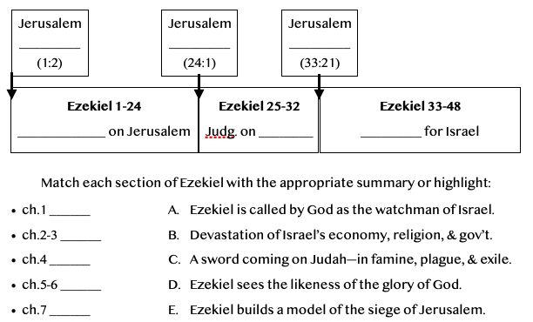
Review – Ezekiel 1-7

Slide 4
Ezekiel in Context
Jerusalem Bowed
(1:2)
Jerusalem Besieged
(24:1)
Jerusalem Broken
(33:21)
Ezekiel 1-24
Judgment on Jerusalem
ch. 25-32
Judg. on Nations
Ezekiel 33-48
Hope for Israel’s Future
The LORD is not there [Jerusalem]
“The Lord is there” (48:35)
“The glory of the LORD departed…” (10:18)
“The glory of the LORD came” (43:4)

Slide 5
Review – Ezekiel 1-7
D. Ezekiel sees the likeness of the glory of God.
ch.1 -
ch.2-3 -
ch.4 -
ch.5-6 -
ch.7 -
A. Ezekiel is called by God as the watchman of Israel.
E. Ezekiel builds a model of the siege of Jerusalem..
C. A Sword coming—in famine, plague, & exile.
B. Devastation of Israel’s economy, religion, & gov’t.

Slide 6
Opening Discussion
Read Ezekiel chapter 8
Try to get into the head of the people of Judah—how could this have happened?

Slide 7
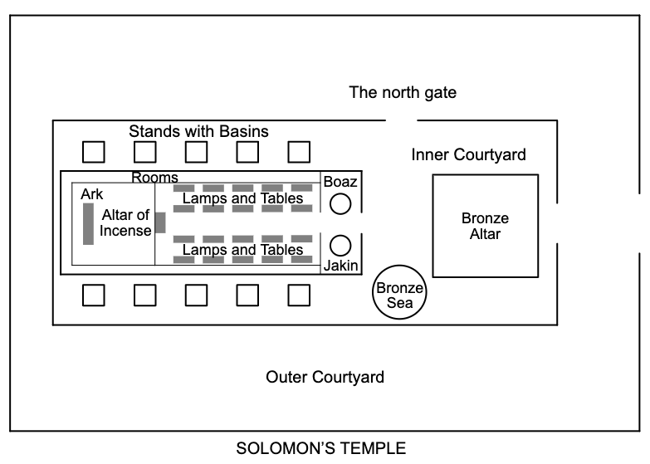

Slide 8
The Trip … (8:1-6)
This takes place 14 months after Ezekiel’s call (see 1:2)
He would have been bearing the iniquity of Judah (see 4:6)
The elders of Judah have come to his house. Why?
Ezekiel sees a vision of God (?) and is “transported” to the entrance of the inner court of the temple.

Slide 9
… & 1st Abomination (8:1-6)
He sees there an idol of jealousy set up, while the glory of Jehovah stands by in His temple.
see 2 Kings 21:5 - a practice carried out in the days of Manasseh.
Though Josiah had cleaned out the idols, here they are again.

Slide 10
The 2nd Abomination (8:7-13)
Then, Ezekiel is told to dig through the wall into the sanctuary.
There he sees the walls covered in idolatrous images of animals.
The seventy elders of Judah are each worshipping one of these images.
Jaazaniah, son of Shaphan, a man from a righteous family. (see 2 Kings 22:3)
“Jehovah does not see; Jehovah has forsaken the land.” (8:12)

Slide 11
3rd - 4th Abomination (8:16-18)
Next, Ezekiel sees women in the temple weeping for Tammuz, a Babylonian god of the seasons / fertility.
Finally, he sees twenty five men facing east ( backs to the temple of Jehovah) — bowing down to the sun.
And yet, God tells Ezekiel that these are “light” offenses, compared to the fact that they have filled the land with violence.

Slide 12
Class Objectives
Match the early chapters of Ezekiel with their highlights.
Recall two abominations taking place in the temple.
Identify the crime worse than the idolatry that Ezekiel witnessed.

Slide 13
The Book of Ezekiel
For Wednesday: Ezekiel 9-10

