Slide 1
The Book of Ezekiel
Classes #9 & #10
The Glory Departs

Slide 2
Class Objectives
Explain the role of the angelic scribe in God’s judgment.
Trace the movement of God’s glory and what it signifies.
Describe the long-term plan that God has for the exiles in Babylon.

Slide 3
Review of Ezekiel 8
Recall the abominations Ezekiel saw in the temple during his vision.
The “Idol of Jealousy” (8:5-6)
Idolatrous images on the walls (8:7-13)
Women weeping for Tammuz (8:14-15)
Men bowing to the sun (8:16)
Identify the crime worse than the idolatry that Ezekiel witnessed.
Violence in the land (8:17)

Slide 4
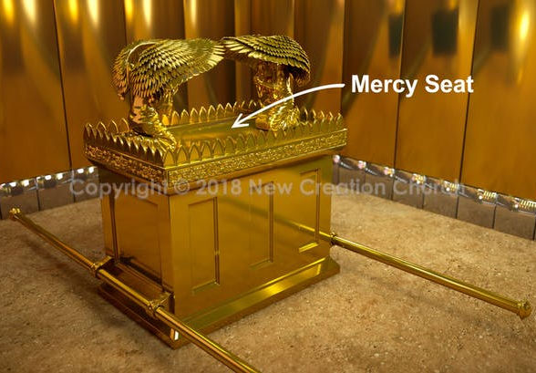
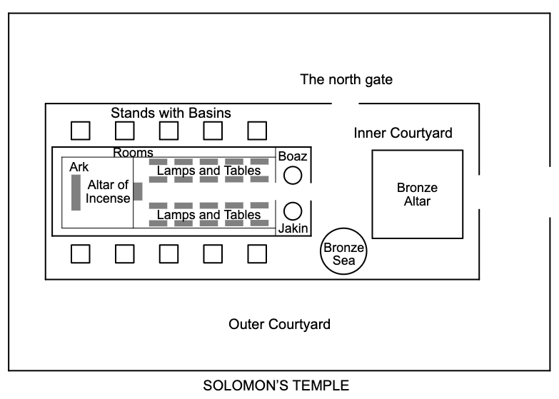
Striking & Sparing (9:1-11)
God summons six executioners and one scribe. (9:1-2)
God’s glory moves from the cherub (on the ark) to the threshold. (9:3)
Getting ready to leave the temple.
Angelic scribe marks all who grieve over the abominations of Jerusalem, so that they can be spared. (9:4-6)

Slide 5
Striking & Sparing (9:1-11)
The executioners are sent out to strike everyone starting with the elders in the temple. (9:5-7)
see 2 Kings 11:13-16; Jeremiah 7:1-11
What is Ezekiel’s reaction? (9:8)
“…destroying the whole remnant?”
What is God’s response? (9:9-10)
“…their conduct upon their heads.”

Slide 6
Discussion – Ezekiel 9
What is the pattern of God’s judgment? Where else in Scripture do we see this pattern?

Slide 7
The Glory Departs (10:1-22)
God tells the angel to gather coals to scatter on the city. (10:1-2, 6-8)
The glory of the Lord is described as getting up from the Holy of Holies and getting ready to leave. (10:3-5)
Why the redundant description here of God’s throne chariot from ch.1? (10:9-17, 20-22)

Slide 8
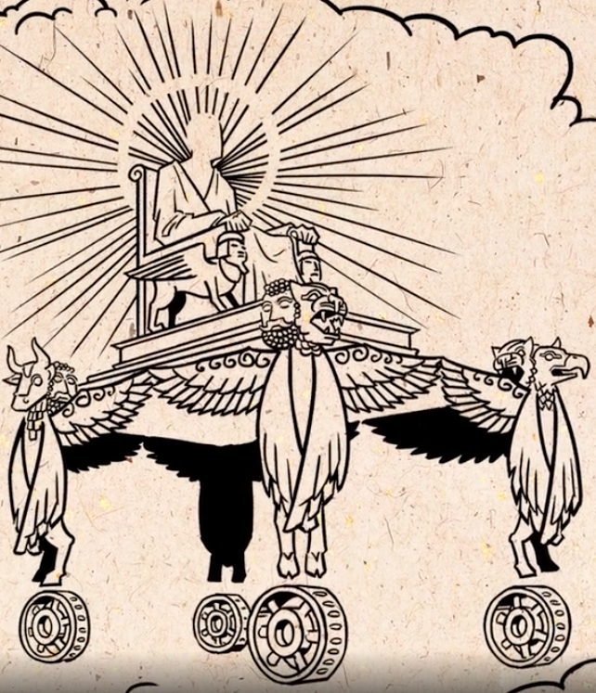
The Glory Departs (10:1-22)
Glory of God finally departs from the threshold, moves toward the east gate of the temple. (10:18-19)

Slide 9
City vs. Exiles (11:1-25)
25 men who deceive the people with false hope, saying that Jerusalem will be their protection. (11:1-3)
Message: You have filled the city with violence; it will not protect you, God will remove you from it. (11:4-12)
Pelatiah (“whom Jehovah delivers”) falls down dead, prompting another question from Ezekiel. (11:13)

Slide 10
City vs. Exiles (11:1-25)
Those in Jerusalem believed the exiles were judged by God and that the land their possession. (11:14-15)
Instead, God’s plan for the exiles:
He is a sanctuary for them (11:16)
He’ll gather them back to the land (17)
They will remove the idols (18)
He will give new heart, new spirit (19)
They will be His people (20)

Slide 11
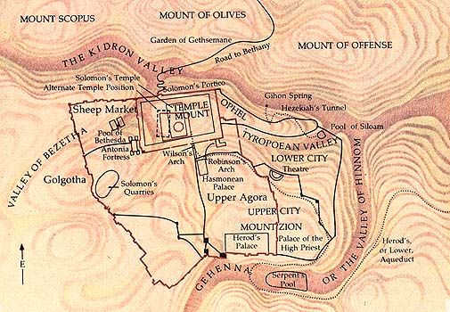
City vs. Exiles (11:1-25)
The glory of God goes out of Jerusalem, settles over the Mount of Olives, outside the city. (11:22-23)

Slide 12
Discussion – Ezekiel 9-11
What do we learn from the judgment on Jerusalem? How might we deceive ourselves like those in these chapters?

Slide 13
Class Objectives
Explain the role of the angelic scribe in God’s judgment.
Trace the movement of God’s glory and what it signifies.
Describe the long-term plan that God has for the exiles in Babylon.

Slide 14
The Book of Ezekiel
For Wednesday: TBD

