Slide 1
The Book of Ezekiel
Classes #9 & #10
The Glory Departs

Slide 2
Class Objectives
Explain the role of the angelic scribe in God’s judgment.
Trace the movement of God’s glory and what it signifies.
Describe the long-term plan that God has for the exiles in Babylon.

Slide 3
“TempleVision” (Ezekiel 8-11)
What does Ezekiel see in Jerusalem?
Chapter 8
Abominations (idolatry) in the temple
Chapter 9
Divine executioners strike Jerusalem
Those who grieve idolatry spared
Chapter 10
Glory of Jehovah departs the temple

Slide 4
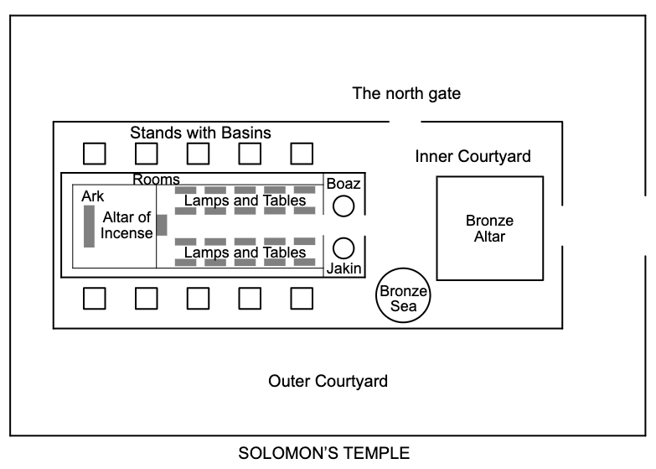
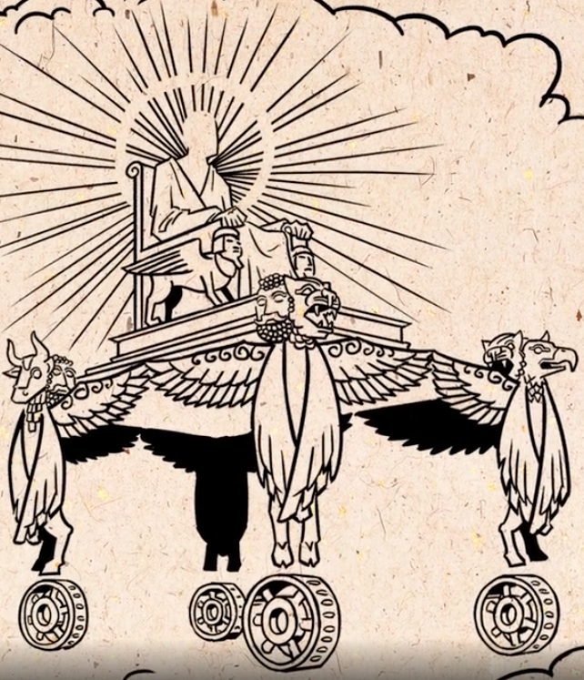
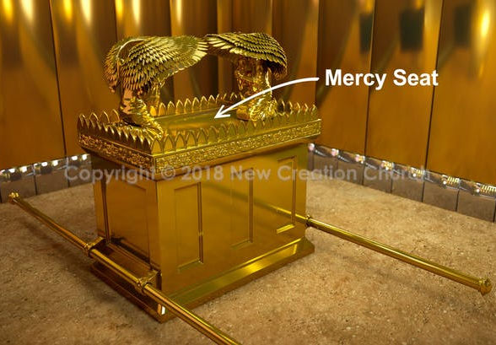
God’s Glory Departs
9:3;10:3
→ 10:18

Slide 5
City vs. Exiles (11:1-25)
25 men who deceive the people with false hope, saying that Jerusalem will be their protection. (11:1-3)
Message: You have filled the city with violence; it will not protect you, God will remove you from it. (11:4-12)
Pelatiah (“whom Jehovah delivers”) falls down dead, prompting another question from Ezekiel. (11:13)

Slide 6
City vs. Exiles (11:1-25)
Those in Jerusalem believed the exiles were judged by God and that the land their possession. (11:14-15)
Instead, God’s plan for the exiles:
He is a sanctuary for them (11:16)
He’ll gather them back to the land (17)
They will remove the idols (18)
He will give new heart, new spirit (19)
They will be His people (20)

Slide 7
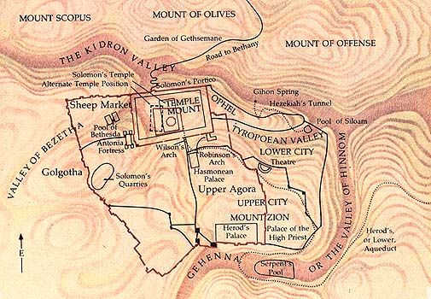
City vs. Exiles (11:1-25)
The glory of God goes out of Jerusalem, settles over the Mount of Olives, outside the city. (11:22-23)

Slide 8
Discussion – Ezekiel 9-11
What do we learn from the judgment on Jerusalem? How might we deceive ourselves like those in these chapters?

Slide 9
Class Objectives
Explain the role of the angelic scribe in God’s judgment.
Trace the movement of God’s glory and what it signifies.
Describe the long-term plan that God has for the exiles in Babylon.

Slide 10
Bible Project Video
https://youtu.be/R-CIPu1nko8

Slide 11
Ezekiel in Context
Jerusalem Bowed
(1:2)
Jerusalem Besieged
(24:1)
Jerusalem Broken
(33:21)
Ezekiel 1-24
Judgment on Jerusalem
ch. 25-32
Judg. on Nations
Ezekiel 33-48
Hope for Israel’s Future
1-3 Ezekiel’s Call
4-7 Signs of Destruction
8-11 Vision of the Temple

Slide 12
The Book of Ezekiel
For Wednesday: Ezekiel 12

