Slide 1
Digital Diet & Nutrition
Using Wisdom as Consumers of Media

Slide 2
Digital Diet and Nutrition
What’s wrong with the way we consume media?
How do I establish a healthy diet?
What should I consume in order to be properly nourished?

Slide 3
What’s Wrong with Our Consumption? (from The Wisdom Pyramid)
Information Gluttony (Too Much)
Perpetual Novelty (Too Fast)
Look-Within Autonomy (Too Me)

Slide 4
Digital Diet and Nutrition
What’s wrong with the way we consume media?
How do I establish a healthy diet?
What should I consume in order to be properly nourished?

Slide 5
Digital Diet (How much am I taking in?)
Set Limits of Time
Set Limits of Place

Slide 6
Digital Diet and Nutrition
What’s wrong with the way we consume media?
How do I establish a healthy diet?
What should I consume in order to be properly nourished?

Slide 7
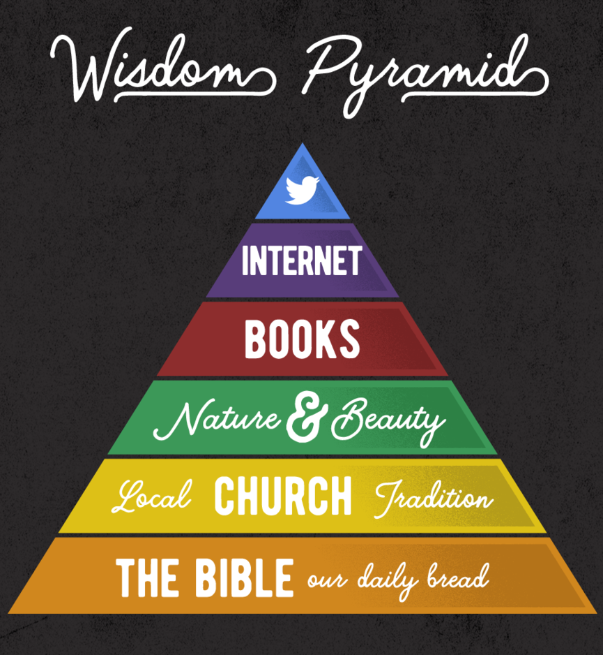
Digital Nutrition (What am I taking in?)
Use internet/social media selectively
Find wisdom, beauty in Nature & Books
Fullness requires church connection
The Bible is our daily bread.

Slide 8
Digital Diet & Nutrition
Eat what is good; delight yourselves in rich food.

