Slide 1
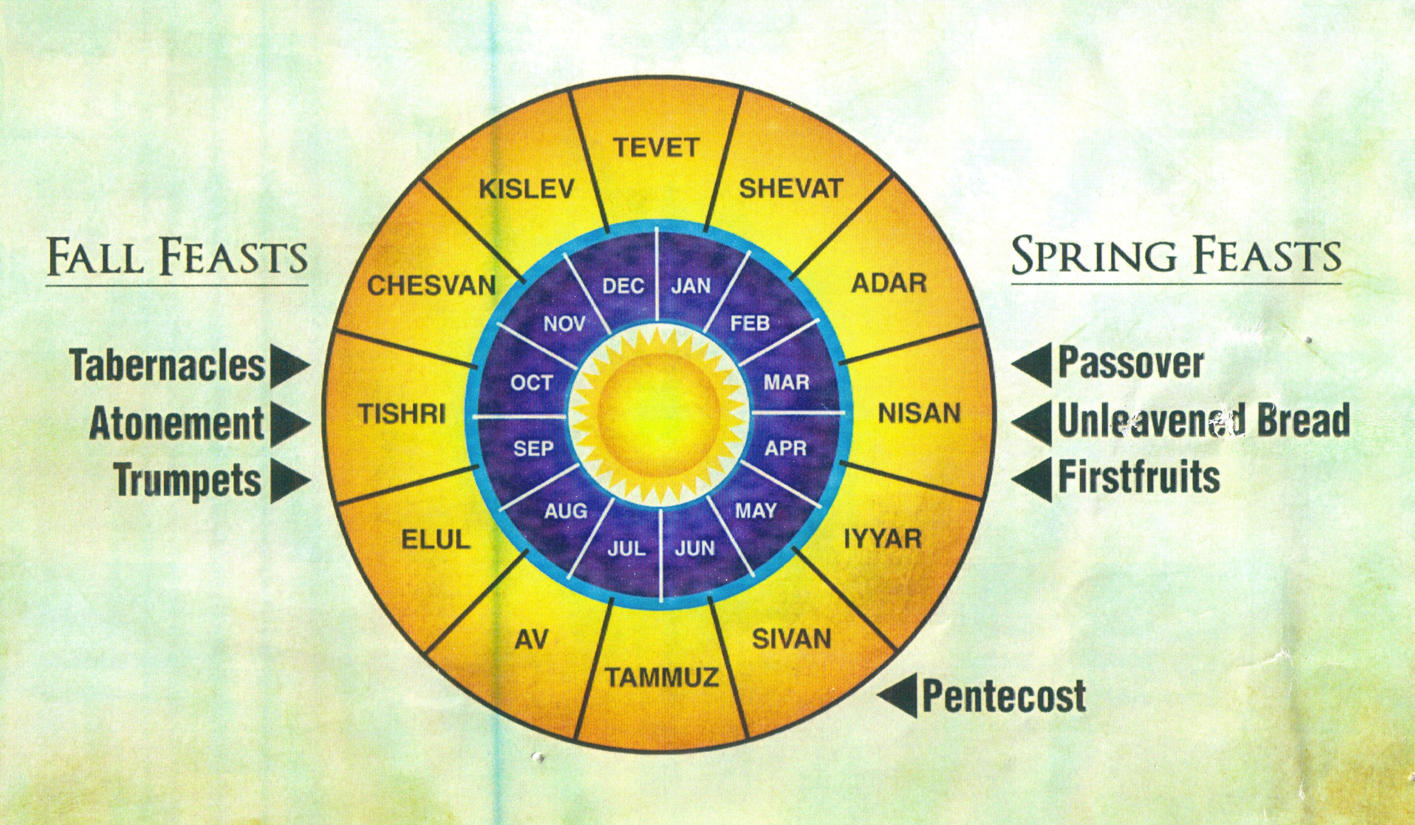

Slide 2
Christ Our Passover
Feasts of Passover & Unleavened Bread

Slide 3
What is the Passover? (Exodus 12)
Beginning of a new calendar
Remembrance of God’s protection
Meal of affliction, eaten in haste
Memorial passed down for generations
Sanctification of Israel, God’s firstborn

Slide 4
Colossians 2:16 Therefore no one is to act as your judge in regard to food or drink or in respect to a festival or a new moon or a Sabbath day – ¹⁷ things which are a mere shadow of what is to come; but the substance belongs to Christ.

Slide 5
Christ, Our Passover
Jesus is the Lamb
Jesus is the Firstborn
I am set free from bondage.
I am a firstborn child of God.
I eat the unleavened bread.

Slide 6
Christ Our Passover
This is the Day that the Lord has made; let us rejoice and be glad in it!

