Slide 1
The Book of Ezekiel
Class #22
Two Sisters

Slide 2
Class Objectives
Tell the story of the two sisters, identifying who the represent.
Explain the way that these two kingdoms “played the harlot.”
Make connections between their harlotry and ours.

Slide 3
Opening Discussion (Ez. 23)
How is this chapter distinct from a similar allegory in Ezekiel 16?

Slide 4
Oholah & Oholibah (23:1-21)
Two sisters who have prostituted themselves since Egypt. (23:1-4)
Oholah (Samaria) – 23:5-10
What she did:
Lusted after the Assyrians
Given into the hands of lovers
What it represents:
Paid tribute to Assyria (Jehu)
Taken captive by the Assyrians

Slide 5
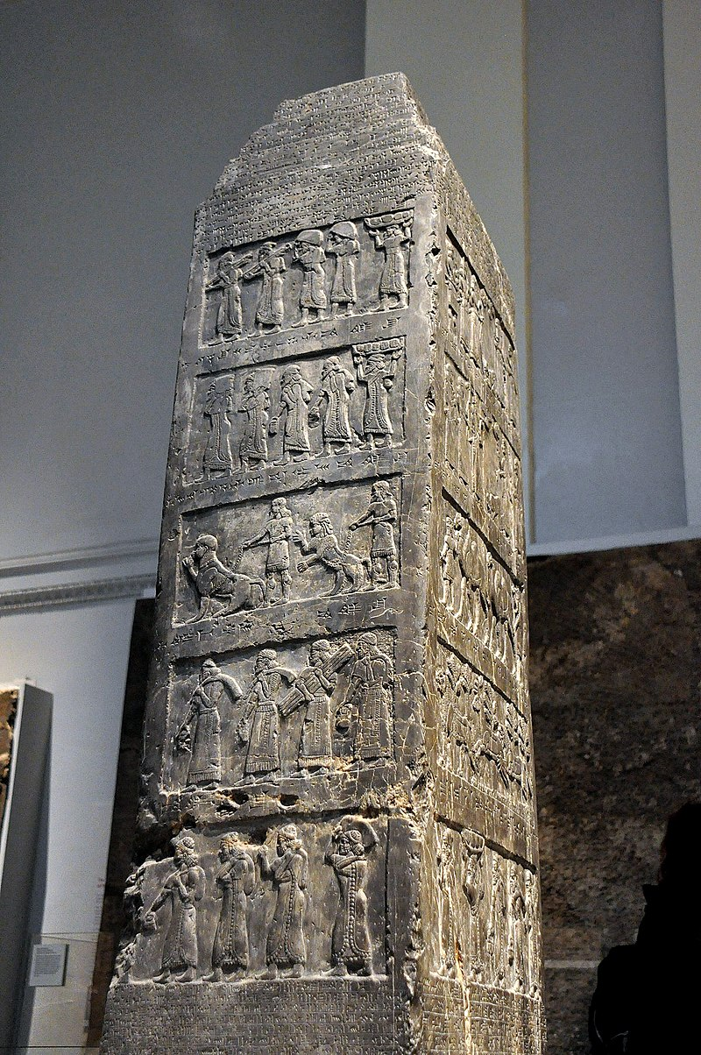
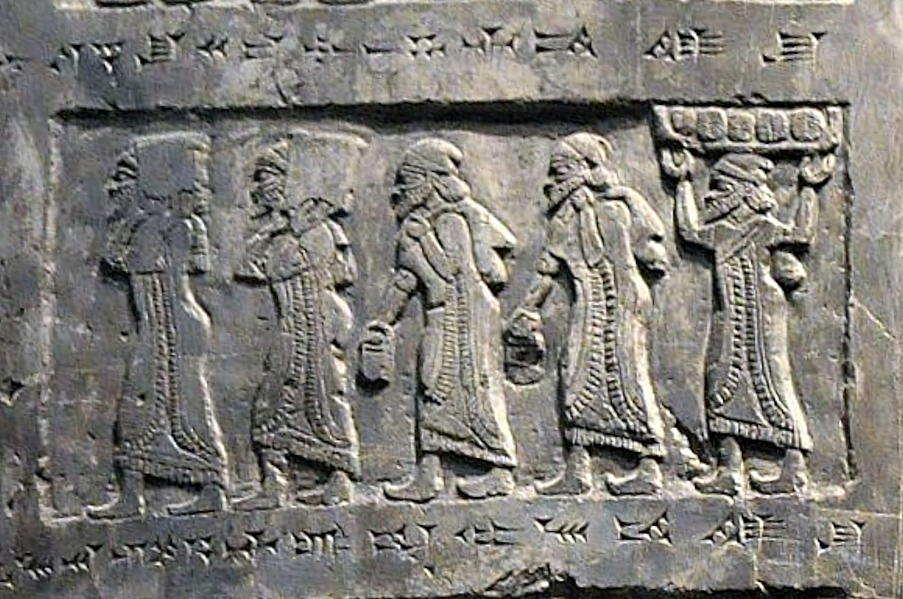
Black Obelisk of Shalamaneser (9th century B.C.)
Jehu, King in Samaria, bringing tribute

Slide 6
Oholah & Oholibah (23:1-21)
Oholibah (Jerusalem) – 23:11-21
What she did:
Lusted after the Assyrians
Lusted after the Chaldeans (Babylonians)
Longed for the Egyptians (?)
What it represents:
Ahaz turned to Assyria (2Kgs16)
Hezekiah showed off to Babylon (2Kgs20)
Seeking help from Egypt (Isaiah 30:1-5)

Slide 7
Judah’s Punishment (23:22-35)
Elements of God’s Punishment:
Bringing the lovers against them (Babylon)
“Judge you by their customs”
Remove their lewdness
Drink the cup of your sister
The reason or significance:
Isaiah’s prophecy to Hezekiah in 2 Kings 20
Punishment for rebellion
To (finally) forget Egypt forever
Followed in her path (but worse)

Slide 8
More Abominations (23:36-49)
Other sins among the people:
Idol worship, including child sacrifice, defiling of temple
Painted eyes and decorative ornaments
Shedding of blood
Connection to Harlotry:
Adopting practices of the nations they sought after
Cultural adaptation to fit in with nations
Injustice follows idolatry

Slide 9
Closing Discussion (ch.23)
In what ways do Christians “sell themselves” like these two sisters?

Slide 10
Class Objectives
Tell the story of the two sisters, identifying who the represent.
Explain the way that these two kingdoms “played the harlot.”
Make connections between their harlotry and ours.

Slide 11
The Book of Ezekiel
For Wednesday: Ezekiel 24

