Slide 1
The Book of Ezekiel
Class #25
Judgment on the Nations

Slide 2
Class Objectives
Explain why God includes oracles of judgment on the nations.
Identify the sins for which these nations are judged by God.

Slide 3
Sections of Ezekiel
Jerusalem Bowed
(1:2)
Jerusalem Besieged
(24:1)
Jerusalem Broken
(33:21)
Ezekiel 1-24
Judgment on Jerusalem
ch. 25-32
Judg. on Nations
Ezekiel 33-48
Hope for Israel’s Future
?

Slide 4
Thought Questions
Who is the audience of Ezekiel’s message?
So, why would God have Ezekiel speak oracles of judgment against other nations?
Why do so at this point in the book?
Which nations are included? Who is not?
Jewish exiles in Babylon,
Post-exilic Jews
Yahweh is not conquered;
God of the nations;
Just in His judgment
Dramatic pause;
Reminder of bigger picture
No Babylon? Won’t it be judged?
Point here: All will fall to Babylon

Slide 5
Ezekiel 25
For each nation:
Locate it on the map.
Recall origin and/or history.
Identify sins and consequence.
Ammon (1-7)

Slide 6
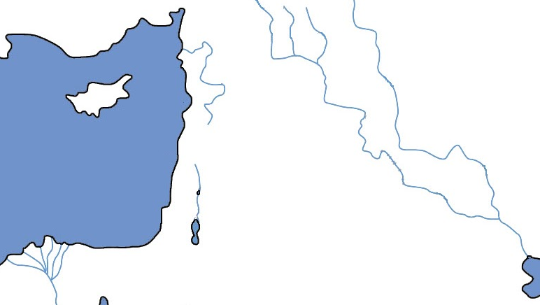
Ezekiel 25
Ammon

Slide 7
Ezekiel 25
For each nation:
Locate it on the map.
Recall origin and/or history.
Identify sins and consequence.
Ammon (1-7)
From Lot & Daughter (Genesis 19)
Competed for Trans-Jordan (Judges 11)
Judged for celebrating Judah’s demise
Will be given to “sons of the east” (ch.21)

Slide 8
Ezekiel 25
For each nation:
Locate it on the map.
Recall origin and/or history.
Identify sins and consequence.
Group 1: Moab (8-11)
Group 2: Edom (12-14)
Group 3: Philistia (15-17)

Slide 9
Ezekiel 25
Ammon
Moab

Slide 10
Ezekiel 25
For each nation:
Locate it on the map.
Recall origin and/or history.
Identify sins and consequence.
Moab (8-11)
From Lot & Daughter (Genesis 19)
Balak tries to stop Israel (Numbers 22-25)
Dismissed Yahweh as “just another god.”
“They will know that I am Yahweh.”

Slide 11
Ezekiel 25
Ammon
Moab
Edom

Slide 12
Ezekiel 25
For each nation:
Locate it on the map.
Recall origin and/or history.
Identify sins and consequence.
Edom (12-14)
From Esau (Genesis 36)
Refused to let Israel pass through (Nu. 20)
Took vengeance on Judah (25:12)
God will take vengeance on them (25:14)

Slide 13
Ezekiel 25
Ammon
Moab
Philistia
Edom

Slide 14
Ezekiel 25
For each nation:
Locate it on the map.
Recall origin and/or history.
Identify sins and consequence.
Philistia (15-17)
Originally from Crete (“Cherethites”)
Constant oppressor (Judges, Samuel)
Took vengeance with “scorn of soul” (15)
God will lay vengeance on them

Slide 15
Class Objectives
Explain why God includes oracles of judgment on the nations.
Identify the sins for which these nations are judged by God.

Slide 16
The Book of Ezekiel
For Sunday: Ezekiel 26-29

