Slide 1
The Book of Ezekiel
Class #26
Judgment on Tyre
Chapters 26-27

Slide 2
Class Objectives
Explain why God includes oracles of judgment on the nations.
Identify the sins for which Tyre is judged by God.
Explain why God spends so much more time with Tyre than the other nations.

Slide 3
Sections of Ezekiel
Jerusalem Bowed
(1:2)
Jerusalem Besieged
(24:1)
Jerusalem Broken
(33:21)
Ezekiel 1-24
Judgment on Jerusalem
ch. 25-32
Judg. on Nations
Ezekiel 33-48
Hope for Israel’s Future
?

Slide 4
Thought Questions
Who is the audience of Ezekiel’s message?
So, why would God have Ezekiel speak oracles of judgment against Tyre?
Why do so at this point in the book?
Which nations are included? Who is not?
Jewish exiles in Babylon, Post-exilic Jews
???
Dramatic pause; Reminder of bigger picture
Why not Babylon? Won’t it be judged?
Point → All will fall to Babylon

Slide 5
Ezekiel 25 – Brief Recap
For each nation:
Locate it on the map.
Recall origin and/or history.
Identify sins and consequence.
Ammon (1-7)
Tyre
(Ch 26-28)
Moab (8-11)
Edom (12-14)
Philistia (15-17)

Slide 6
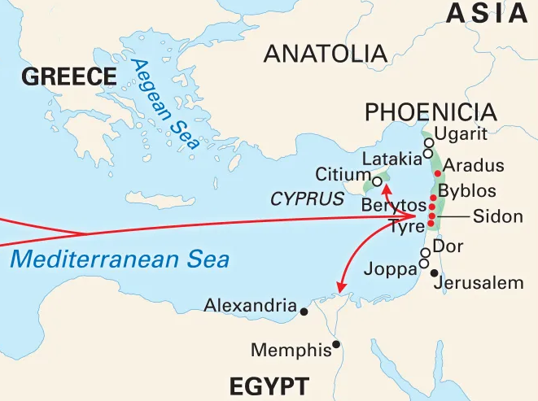
Ezekiel 25-28
Tyre
Ammon
Jerusalem
Moab
Philistia
Edom
https://www.britannica.com/place/Tyre

Slide 7
Judgement against Tyre – Ez 26-27
God lays out the case against Tyre in three sections:
Prophecy & Judgement on Tyre – Ez. 26:2-21
Lament for Tyre – Ez. 27:1-36
Prophecy & Lament for Ruler of Tyre – Ez. 28:1-19

Slide 8
1. Judgement on Tyre – Ez 26:1-21
Let’s read…
When did Ezekiel write the judgement? (v.1)
What else was happening about the same time?
Is the charge same or different from others? (v.2)
What is God’s case against Tyre?
v.3 – Jerusalem gone – no competition
v.4 – Jerusalem destroyed – Tyre too
v.5 – Tyre will prosper now? – No
v.7 – Many nations → Nebuchadnezzar
v.5, 14, 15 – Results of destruction?
V. 16, 19-21 “They will know that I am Yahweh.”

Slide 9
2. Lament for Tyre – Ez 27:1-36
Let’s read…
What is God’s case against Tyre?
Pride
v.3 – she was beautiful – perfect
v.5-7 – envied, supplied everyone else
v.8-11 – best laborers, crews, soldiers
Self-Centeredness
v.12-15 – Asia Minor; v.16-17 – Palestine
v.18-22 – Syria and Arabia; v. 23-24 – Mesopotamia
Consequences
v.25-27 – set up for success, but Babylon is coming
v.28-36 – those celebrating will be in mourning
v.33,36 – marketplace of the nations will be judged by God → and will be no more (v.36)

Slide 10
Why does God spend so long on Tyre?
Key Themes from Tyre
How is it different from the other nations?
Other Nations – set themselves up as opposition against Jerusalem
Tyre’s Goal: substitute themselves for Jerusalem and become the center of the universe (v.2)
However - Jerusalem was God’s city (Ps 48:1-2)
But it has been broken (Ez 1-24)
The Sea: led to Tyre’s prosperity, success
God will turn the sea against them (Ps 93:3-4)
No more sea in the future (Rev 21:1)

Slide 11
Tyre – Lessons for Us
Lessons for Us (and the exiles) from Tyre
Beware of Seduction – don’t trust in the sea (or your own power)
Look to God for true Beauty – Trust in Him, not the things of the temple, or the “holy” city
Faithfulness – increase your faith, Look up, not around, trust God → He will deliver…In His Time (e.g. Abraham and Isaac, departure from Egypt, crossing of Red Sea, Mt. Sinai, promised land, etc.)

Slide 12
Class Objectives – Achieved?
Explain why God includes oracles of judgment on Tyre.
Identify the sins for which Tyre is judged by God.
Explain why God spends so much more time with Tyre than the other nations.

Slide 13
The Book of Ezekiel
For Wednesday: Ezekiel 28
(wrap-up of Tyre)

