Slide 1
The Book of Ezekiel
Class #28
Judgment on Egypt (pt.1)

Slide 2
Class Objectives
Describe the historical relationship between Egypt and the people of God.
Explain why the judgment on Egypt was important for God’s people to hear.

Slide 3
Sections of Ezekiel
Jerusalem Bowed
(1:2)
Jerusalem Besieged
(24:1)
Jerusalem Broken
(33:21)
Ezekiel 1-24
Judgment on Jerusalem
ch. 25-32
Judg. on Nations
Ezekiel 33-48
Hope for Israel’s Future

Slide 4
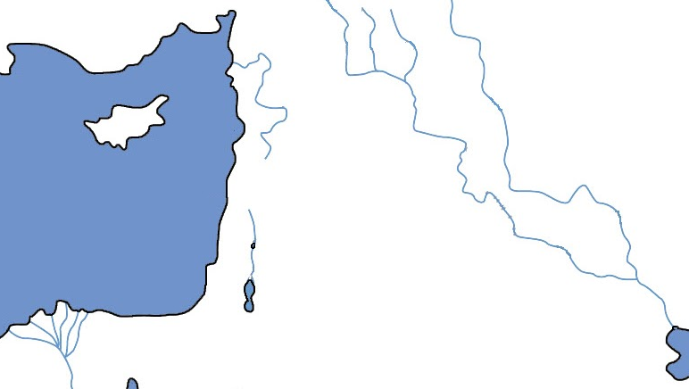
Ezekiel 25-32
Tyre/Sidon
Ammon
Moab
Philistia
Edom
Egypt

Slide 5
Review: Ezekiel 25-28
For what sins are the nations being judged?
Why does Tyre receive so much air-time?
Who is the audience of these oracles?
Pride, Arrogance, etc.
Mistreating God’s people
Much more powerful than other nations; Commercial powerhouse; Ample protection
The Jews in exile (and beyond)
See the bigger picture

Slide 6
Egypt & the People of God
Egypt is most famously the wicked oppressor of Israel, overthrown in God’s great salvation of His people. (Exodus 1-15)
But from the beginning and throughout, God’s people were always tempted to turn to / trust in Egypt for help or deliverance.
As the primary audience of Ezekiel, perhaps this message of judgment is to (finally) get them to stop trusting Egypt.

Slide 7
Against Pharaoh (Ezekiel 29:1-16)
“The Nile is mine, and I have made it.” (3, 9)
“Because they have been a staff of reed to the house of Israel.” (6-7, see 2 Kgs 18:21)
“I will put hooks in your jaws…bring you out of the midst of your rivers.” (4)
“Won’t be inhabited for 40 years…I will turn the fortunes…make them return.” (11-14)
“Never again be the confidence of the house of Israel.” (16)

Slide 8
Neb’s Wages (Ezekiel 29:17-21)
Note the date of this oracle—the latest in the entire book of Ezekiel.
Nebuchadnezzar is working for God (?), see Ezekiel 21 (also Isaiah 10:5-7; 45:1)
He didn’t get wages from Tyre—so he will get it from plundering Egypt.
Israel receives strength/voice not from Egypt, but when God gives it to them.

Slide 9
Laments for Egypt (Ezekiel 30)
For your section:
What is happening to Egypt & why?
What will it look like?
What will be the result?
Group 1 - 30:1-5
Group 2 – 30:6-9
Group 3 – 30:10-12
Group 4 – 30:13-19

Slide 10
Class Objectives
Describe the historical relationship between Egypt and the people of God.
Explain why the judgment on Egypt was important for God’s people to hear.

Slide 11
The Book of Ezekiel
For Wednesday: Ezekiel 30-32

