Slide 1
The Book of Ezekiel
Class #29
Judgment on Egypt (pt.2)

Slide 2
Class Objectives
Give an example of how God’s judgment on Egypt fits their sin/their pride.
Explain the relevance of these oracles of judgment for us today.

Slide 3
Sections of Ezekiel
Jerusalem Bowed
(1:2)
Jerusalem Besieged
(24:1)
Jerusalem Broken
(33:21)
Ezekiel 1-24
Judgment on Jerusalem
ch. 25-32
Judg. on Nations
Ezekiel 33-48
Hope for Israel’s Future

Slide 4
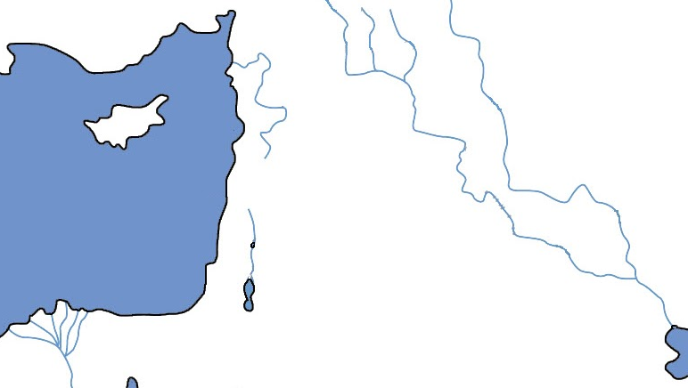
Ezekiel 25-32
Tyre/Sidon
Ammon
Moab
Philistia
Edom
Egypt

Slide 5
Overview of Ezekiel 30-32
Why do the Jews need to hear of Egypt’s doom?
Seven oracles against Egypt:
29:1-16
29:17-20
30:1-19
30:20-26
31:1-18
32:1-16
32:17-32
So they will stop trusting in Egypt and trust God.
Prideful Pharaoh fished from the Nile.
Egypt given as Nebuchad’s wages
Lament for Egypt, allies, & cities

Slide 6
Fourth Oracle (Ezekiel 30:20-26)
God will break the arm of Pharaoh so that he cannot wield a sword. (30:21-22)
Then He will strengthen the arm of Nebuchadnezzar to wield the sword of God. (30:24-25)
Thus Egypt will be scattered among the nations. (30:23,26)
What does this say about God’s activity with nations and rulers of the earth?

Slide 7
Overview of Ezekiel 30-32
Why do the Jews need to hear of Egypt’s doom?
Seven oracles against Egypt:
29:1-16
29:17-20
30:1-19
30:20-26
31:1-18
32:1-16
32:17-32
So they will stop trusting in Egypt and trust God.
Prideful Pharaoh fished from the Nile.
Egypt given as Nebuchad’s wages
Lament for Egypt, allies, & cities
Pharaoh’s arm broken, Neb’s strong

Slide 8
Fifth Oracle (Ezekiel 31:1-18)
Pharaoh and Egypt are addressed, and compared to Assyria. (31:1-3)
Description of Assyria: (31:3-9)
And what happened? (31:10-17)
To what end? (31:14)
Lesson for Pharaoh? Lesson for us?
A tree that made those in Eden envious...
Cut down and left.
“so that all trees may not be exalted…”

Slide 9
Overview of Ezekiel 30-32
Why do the Jews need to hear of Egypt’s doom?
Seven oracles against Egypt:
29:1-16
29:17-20
30:1-19
30:20-26
31:1-18
32:1-16
32:17-32
So they will stop trusting in Egypt and trust God.
Prideful Pharaoh fished from the Nile.
Egypt given as Nebuchad’s wages
Lament for Egypt, allies, & cities
Pharaoh’s arm broken, Neb’s strong
Egypt like Assyria; tall tree cut down

Slide 10
Sixth Oracle (Ezekiel 32:1-16)
Pharaoh sees himself as a young lion, while God sees him as a sea monster. (32:2)
How does God’s judgment fit Egypt’s pride?
How does this remind you of Exodus?
Trusted in the Nile, removed from it.
Cast on open field; disgraceful burial.
Sun—worshipped by Egyptians--darkened
The river is fouled; blood in the ravines.
I will set darkness on your land.
Destroy all its cattle/beasts.
They shall know that I am the LORD.

Slide 11
Overview of Ezekiel 30-32
Why do the Jews need to hear of Egypt’s doom?
Seven oracles against Egypt:
29:1-16
29:17-20
30:1-19
30:20-26
31:1-18
32:1-16
32:17-32
So they will stop trusting in Egypt and trust God.
Prideful Pharaoh fished from the Nile.
Egypt given as Nebuchad’s wages
Lament for Egypt, allies, & cities
Pharaoh’s arm broken, Neb’s strong
Egypt like Assyria; tall tree cut down
Pharaoh & Egypt will be devastated

Slide 12
7th Oracle (Ezekiel 32:17-32)
Beautiful & mighty, Egypt will go down to the grave with the other nations. (32:17-21)
Catalogue of nations who “spread terror in the land of the living” and now dwell “in the midst of the slain.” (32:22-30)
This is what Pharaoh will see when the same thing happens to him. (32:31-32)
What do we learn from this tour of Sheol?

Slide 13
Overview of Ezekiel 30-32
Why do the Jews need to hear of Egypt’s doom?
Seven oracles against Egypt:
29:1-16
29:17-20
30:1-19
30:20-26
31:1-18
32:1-16
32:17-32
So they will stop trusting in Egypt and trust God.
Prideful Pharaoh fished from the Nile.
Egypt given as Nebuchad’s wages
Lament for Egypt, allies, & cities
Pharaoh’s arm broken, Neb’s strong
Egypt like Assyria; tall tree cut down
Pharaoh & Egypt will be devastated
Those who spread terror, in the grave

Slide 14
Class Objectives
Give an example of how God’s judgment on Egypt fits their sin/their pride.
Explain the relevance of these oracles of judgment for us today.

Slide 15
The Book of Ezekiel
For Sunday: Ezekiel 33

