Slide 1
The Book of Ezekiel
Class #45
Ezekiel’s Temple

Slide 2
Class Objectives
Place Ezekiel’s temple vision in the larger context of the book.
Explain why the altar figures so prominently in Ezekiel’s temple.
Connect elements of the temple to their fulfillment in Christ.

Slide 3
Review
Work on the review section of your worksheet with people around you.

Slide 4
Structure of Ezekiel
Jerusalem Bowed
(1:2)
Jerusalem Besieged
(24:1)
Jerusalem Broken
(33:21)
Ezekiel 1-24
Judgment on Jerusalem
ch. 25-32
Judg. on Nations
Ezekiel 33-48
Hope for Israel’s Future

Slide 5
Ezekiel 33-48: Hope for Israel
D. Ezekiel’s role as watchman of Israel; Jerusalem falls
ch.33 –
ch.34 –
ch.35 -
ch.36 -
ch.37 –
ch.38-39 –
ch.40-48 -
B. Shepherds of Israel rebuked, God/David will be Shepherd
G. Mount Seir condemned for gloating/plunder of Judah
E. The mountains of Israel will be inhabited & fruitful again
A. Spirit revives the dry bones; two nations become one
C. Armies of Gog destroyed to vindicate Yahweh’s holiness
F. Vision of a new temple

Slide 6
Temple Complex (Ezekiel 40-43)

Slide 7
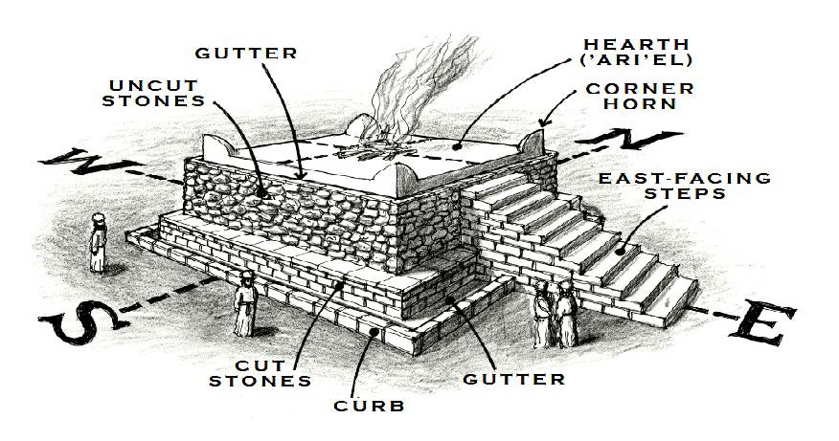
The Altar (Ezekiel 43:13-27)

Slide 8
The Altar (Ezekiel 43:13-27)
At the center of the temple complex is a huge, square altar. (43:13-17)
Question: Why is such prominent attention given to the altar?
Priests purify (atonement for) the altar before it can be used. (43:18-27)
This is a 7-day ceremony. (43:26)
At the end of 7 days, God will accept the sacrifices made on it. (43:27)

Slide 9
Points of Emphasis in Ezekiel 40-43
Boundaries (order, separation, protection, holy vs. profane)
God’s Dwelling (rooms, chambers, God’s glory dwells)
Atonement (altar in center, priests offer sacrifices)
Discussion: What are the various ways we see Jesus in these chapters?

Slide 10
The Book of Ezekiel
For Wednesday: Ezekiel 45

