Slide 1
The Book of Ezekiel
Class #46
Divisions of Labor

Slide 2
Class Objectives
Give an example of a restriction of access in Ezekiel’s temple.
Explain the division of labor among the Levites & priests.
Connect one instruction for the priests to our role as Christians.

Slide 3
Structure of Ezekiel
Jerusalem Bowed
(1:2)
Jerusalem Besieged
(24:1)
Jerusalem Broken
(33:21)
Ezekiel 1-24
Judgment on Jerusalem
ch. 25-32
Judg. on Nations
Ezekiel 33-48
Hope for Israel’s Future

Slide 4
Temple Complex (Ezekiel 40-43)

Slide 5
Ezekiel’s Temple and Us
Not a temple we are supposed to build or instructions we are to follow.
Pictures and symbols that Ezekiel’s readers would have understood.
The symbols must first be connected to a principle, then we can connect the principle to us (in Christ).
Example: Temple?
Example: Walls?
Example: Altar?

Slide 6
Entrance & Exits (Ezekiel 44:1-16)
44:5 - The main point of this section: Rules for access in God’s sanctuary.
East gate — through which the LORD entered — is forever closed. (1-2)
Prince can sit in it to eat, but he can only get there from the back way. (3)
Who is the prince?
Why does the east gate have this restriction?

Slide 7
Entrance & Exits (Ezekiel 44:1-16)
The people have failed to keep their charge, have profaned the temple, admitting the ‘unclean.’ (6-8)
No foreigner or uncircumcised person will enter the sanctuary. (9)
Levites will serve in the temple—including the oversight (protection) of the gates. (11, 14; see 2 Kgs 11:5)

Slide 8
Entrance & Exits (Ezekiel 44:1-16)
The Levites not allowed to serve as priests or come near the holy things because of their idolatry. (10,12-13)
The sons of Zadok—who kept their charge—will serve before God and with His holy things. (15-16)
Imagine a Levite complaining that this wasn’t fair. What would you say?

Slide 9
Zadokite Instructions (44:17-27)
Regulations for these priests:
Work clothes (17-18) - avoid sweat (Deut. 23)
Street clothes (19) - to not transmit holiness
Hair length (20) - in-between long & shaved
Wine (21) - no imbibing on the job (Lev. 10)
Marriage (22) - only to virgins
Public role (23-24) - teach the people
Mourning (25-27) - only family (Lev. 21:1-3)
What relevance does any of this have to us (if any)?

Slide 10
Inheritance (Ezekiel 45:1-8)
Zadokite priests receive no land as inheritance, because God is their inheritance. (28; see Numbers 18:20)
Sustenance comes from offerings and tithes—a portion of which goes to the priests. (29-31; Leviticus 6:14-18)
A vision of a newly-divided land—with portions for God (and the temple), the priests, and the prince. (45:1-8)

Slide 11
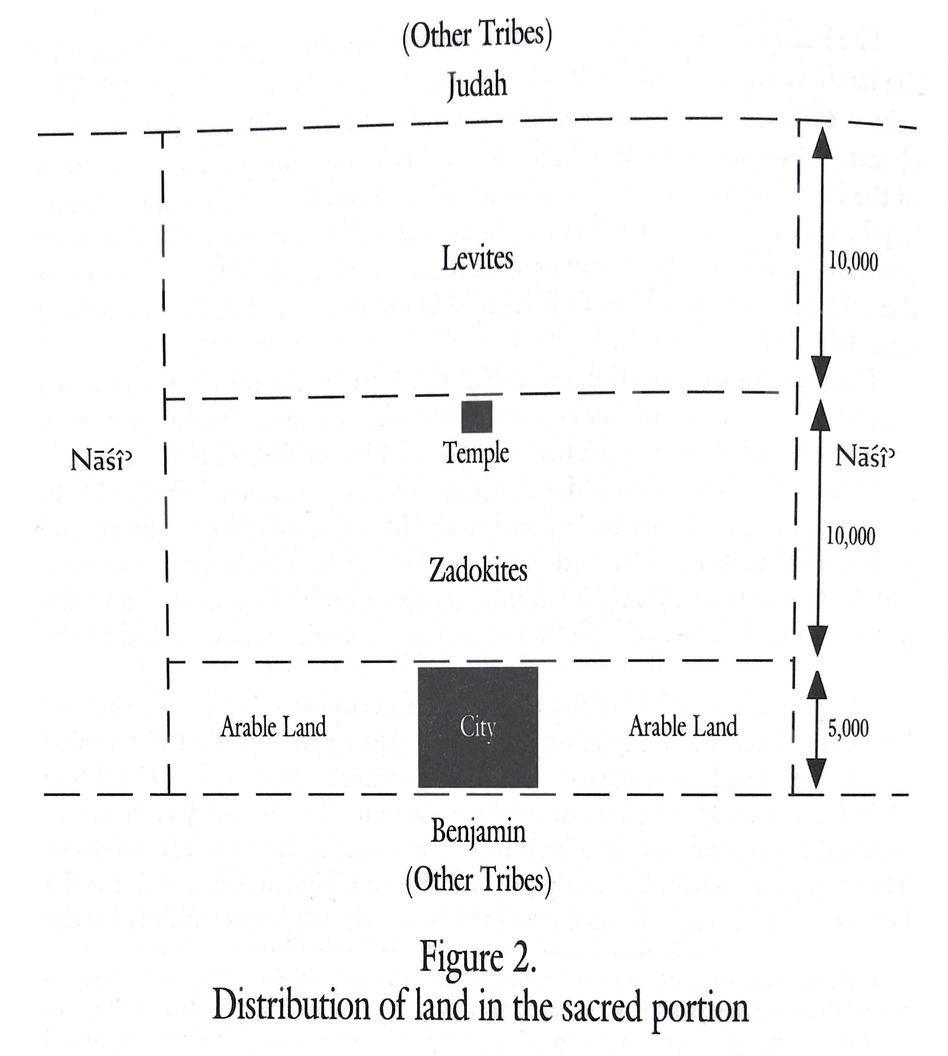

Slide 12
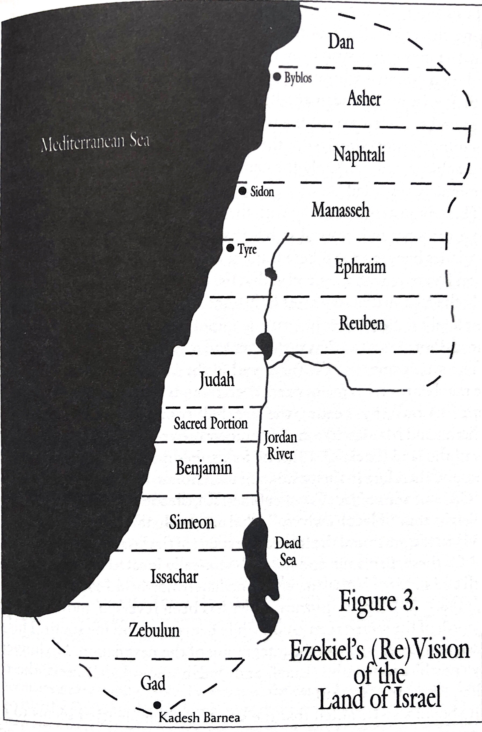

Slide 13
Class Objectives
Give an example of a restriction of access in Ezekiel’s temple.
Explain the division of labor among the Levites & priests.
Connect one instruction for the priests to our role as Christians.

Slide 14
The Book of Ezekiel
For Sunday: Ezekiel 45-46

