Slide 1
The Book of Ezekiel
Class #47
Justice & Worship

Slide 2
Class Objectives
Explain the emphasis on justice and fairness in Ezekiel’s envisioned society.
Explain the emphasis on ritual observance in Ezekiel’s envisioned society.

Slide 3
Structure of Ezekiel
Jerusalem Bowed
(1:2)
Jerusalem Besieged
(24:1)
Jerusalem Broken
(33:21)
Ezekiel 1-24
Judgment on Jerusalem
ch. 25-32
Judg. on Nations
Ezekiel 33-48
Hope for Israel’s Future
40-48
New temple, new society,
new land.

Slide 4
Ezekiel’s Temple (40-48)
Ezekiel 40-42
God orders the space:
Walls, gates, (holy vs. profane)
Designated spaces (Most Holy Place)
Rooms & Chambers
Ezekiel 43-44
God fills the space:
His glory comes & fills the temple
Altar (Atonement)
Prince, Levites, Priests, & their work
Symbols → Meaning (Principle) → Fulfillment in Christ’s kingdom (now and/or later)

Slide 5
Entrance & Exits (Ezekiel 44:1-16)
The Levites not allowed to serve as priests or come near the holy things because of their idolatry. (10,12-13)
The sons of Zadok—who kept their charge—will serve before God and with His holy things. (15-16)
What principle is at work here and how do we see it in Jesus’ kingdom?

Slide 6
Examples of Divisions of Labor
Members of the Body (1 Cor. 12)
Gifts in the Church (Eph. 4)
Elders & Deacons (Acts 6)
Men & Women (1 Tim. 2)
Parable of the Talents (Matt. 25)
Degrees of Suffering (John 21)

Slide 7
Zadokite Instructions (44:17-27)
Regulations for these priests:
Work clothes (17-18) - avoid sweat (Deut. 23)
Street clothes (19) - to not transmit holiness
Hair length (20) - in-between long & shaved
Wine (21) - no imbibing on the job (Lev. 10)
Marriage (22) - only to virgins
Public role (23-24) - teach the people
Mourning (25-27) - only family (Lev. 21:1-3)
What principle is at work here and how do we see it in Jesus’ kingdom?

Slide 8
Ezekiel’s Temple (40-48)
Ezekiel 40-42
God orders the space:
Walls, gates, (holy vs. profane)
Designated spaces (Most Holy Place)
Rooms & Chambers
Ezekiel 43-44
God fills the space:
His glory comes & fills the temple
Altar (Atonement)
Prince, Levites, Priests, & their work
Ezekiel 45-48
A new order for God’s land and society:

Slide 9
Inheritance (Ezekiel 44:28 – 45:8)
Zadokite priests receive no land as inheritance, because God is their inheritance. (28; see Numbers 18:20)
Sustenance comes from offerings and tithes—a portion of which goes to the priests. (29-31; Leviticus 6:14-18)
A vision of a newly-divided land—with portions for God (and the temple), the priests, and the prince. (45:1-8)

Slide 10
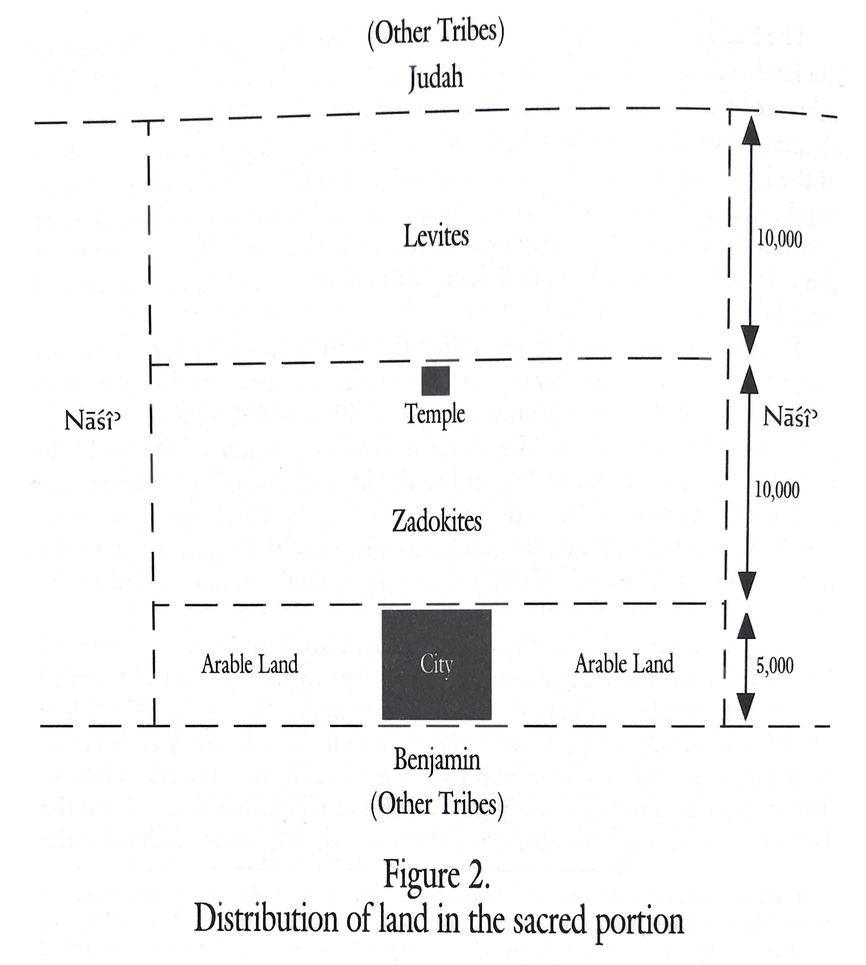

Slide 11
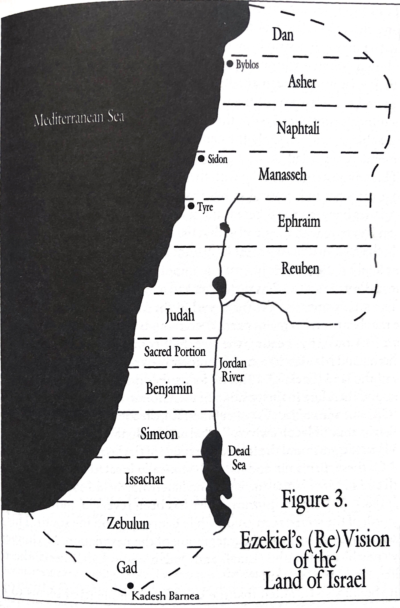

Slide 12
Economic Regulation (45:8-17)
Princes won’t oppress the people, evicting them from their land. (45:8-9)
They’ll execute justice/righteousness, let the people live on their land. (45:9)
Economic boundaries—resetting of weights & measures. (45:10-12)
Fair relationship btw. people/prince: people bring an offering; the prince provides for the feasts. (45:13-17)
How does this translate to New Covenant?

Slide 13
Ritual Observance (45:18 – 46:24)
Yearly celebrations that take place in this imagined society. (45:18-25)
More frequent days, Sabbath (weekly) & New Moon (monthly). (46:1-10)
Offerings made daily; prince plays a central role in the feasts. (46:11-15)
Rooms where offerings would be boiled or baked. (46:19-24)
How does this translate to New Covenant?

Slide 14
Class Objectives
Explain the emphasis on justice and fairness in Ezekiel’s envisioned society.
Explain the emphasis on ritual observance in Ezekiel’s envisioned society.

Slide 15
The Book of Ezekiel
For Wednesday: Ezekiel 47-48

