Slide 1
The Book of Ezekiel
Class #48
Waters & Land

Slide 2
Class Objectives
Describe the river in Ezekiel 47 and it’s significance in connection to related passages.
Overview the tribal portions in the newly-divided land.
Recite the last four words of the Book of Ezekiel.

Slide 3
Structure of Ezekiel
Jerusalem Bowed
(1:2)
Jerusalem Besieged
(24:1)
Jerusalem Broken
(33:21)
Ezekiel 1-24
Judgment on Jerusalem
ch. 25-32
Judg. on Nations
Ezekiel 33-48
Hope for Israel’s Future
40-48
New temple, new society,
new land.

Slide 4
Ezekiel’s Temple (40-48)
Ezekiel 40-42
God orders the space:
Walls, gates, (holy vs. profane)
Designated spaces (Most Holy Place)
Rooms & Chambers
Ezekiel 43-44
God fills the space:
His glory comes & fills the temple
Altar (Atonement)
Prince, Levites, Priests, & their work
Ezekiel 45-48
A vision of God’s people: Justice, worship, and abundant life in the land of their inheritance.

Slide 5
Read & Discuss
Ezekiel 47:1-12
What Bible passages are you reminded of in reading these verses?

Slide 6
Temple River (Ezekiel 47:1-12)
Water begins as a trickle from the altar, runs out of the east gate. (1-2)
Flows east, gets progressively deeper until it is impassable. (3-5)
Flows into the Dead Sea, making it fresh / inhabited. “Everything will live where the river goes.” (6-10)
On banks, flourishing trees with fruit for food, leaves for healing. (12)
What does this beautiful picture tell us about God’s kingdom?

Slide 7
Tribal Portions (47:13– 48:35)
God then lays out the division of the land, an equal portion for each tribe, double portion for Joseph. (13-14)
Outside boundaries are similar to the original border but exclude the area east of the Jordan. (15-20)
The land is Israel’s inheritance and is for the sojourner also. (21-23)
Tribal portions are listed north to south. (48:1-29)

Slide 8
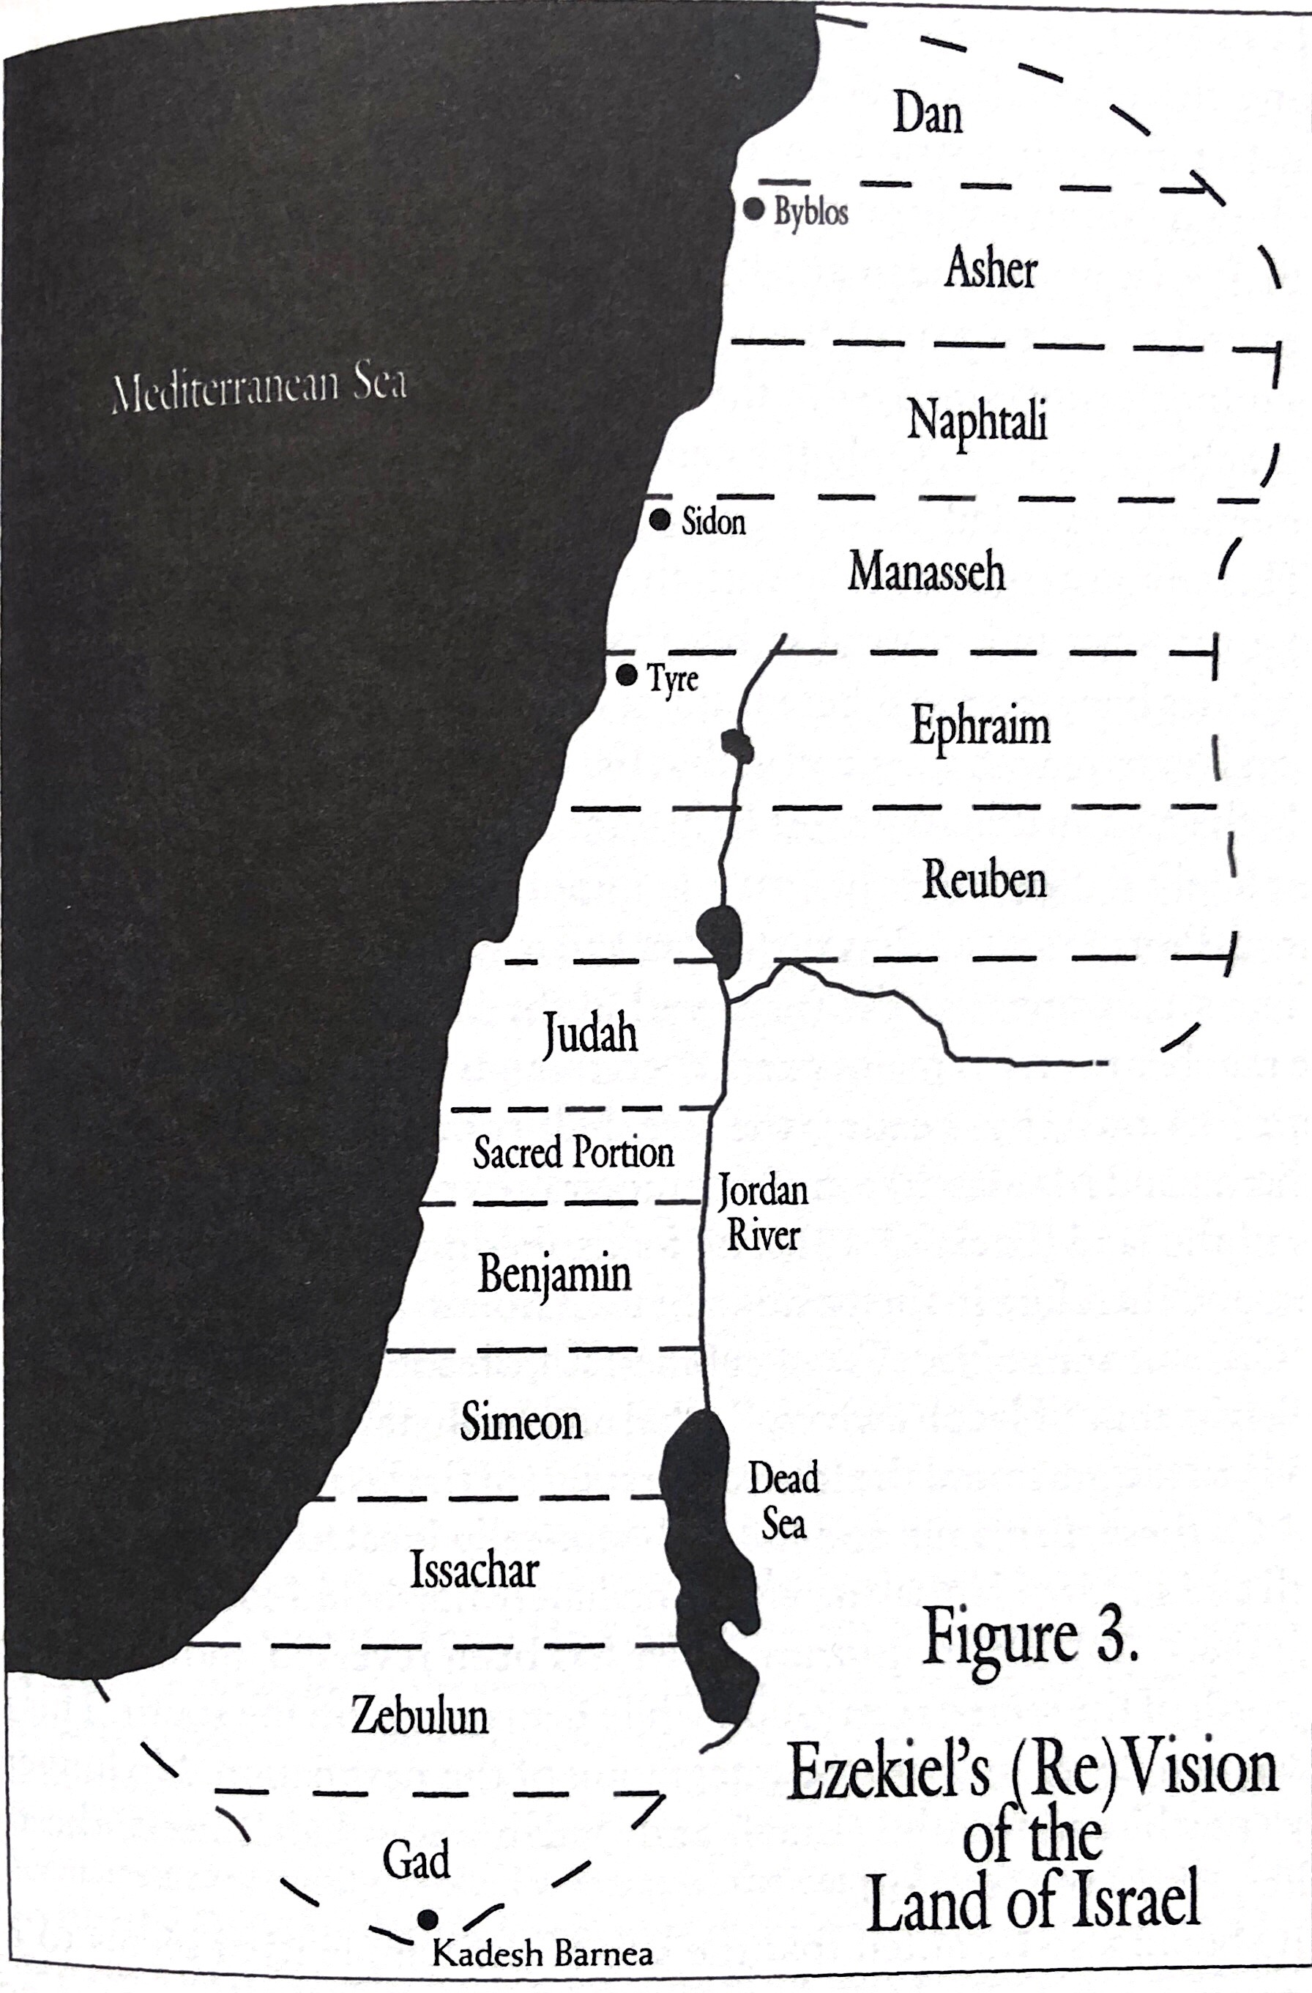

Slide 9
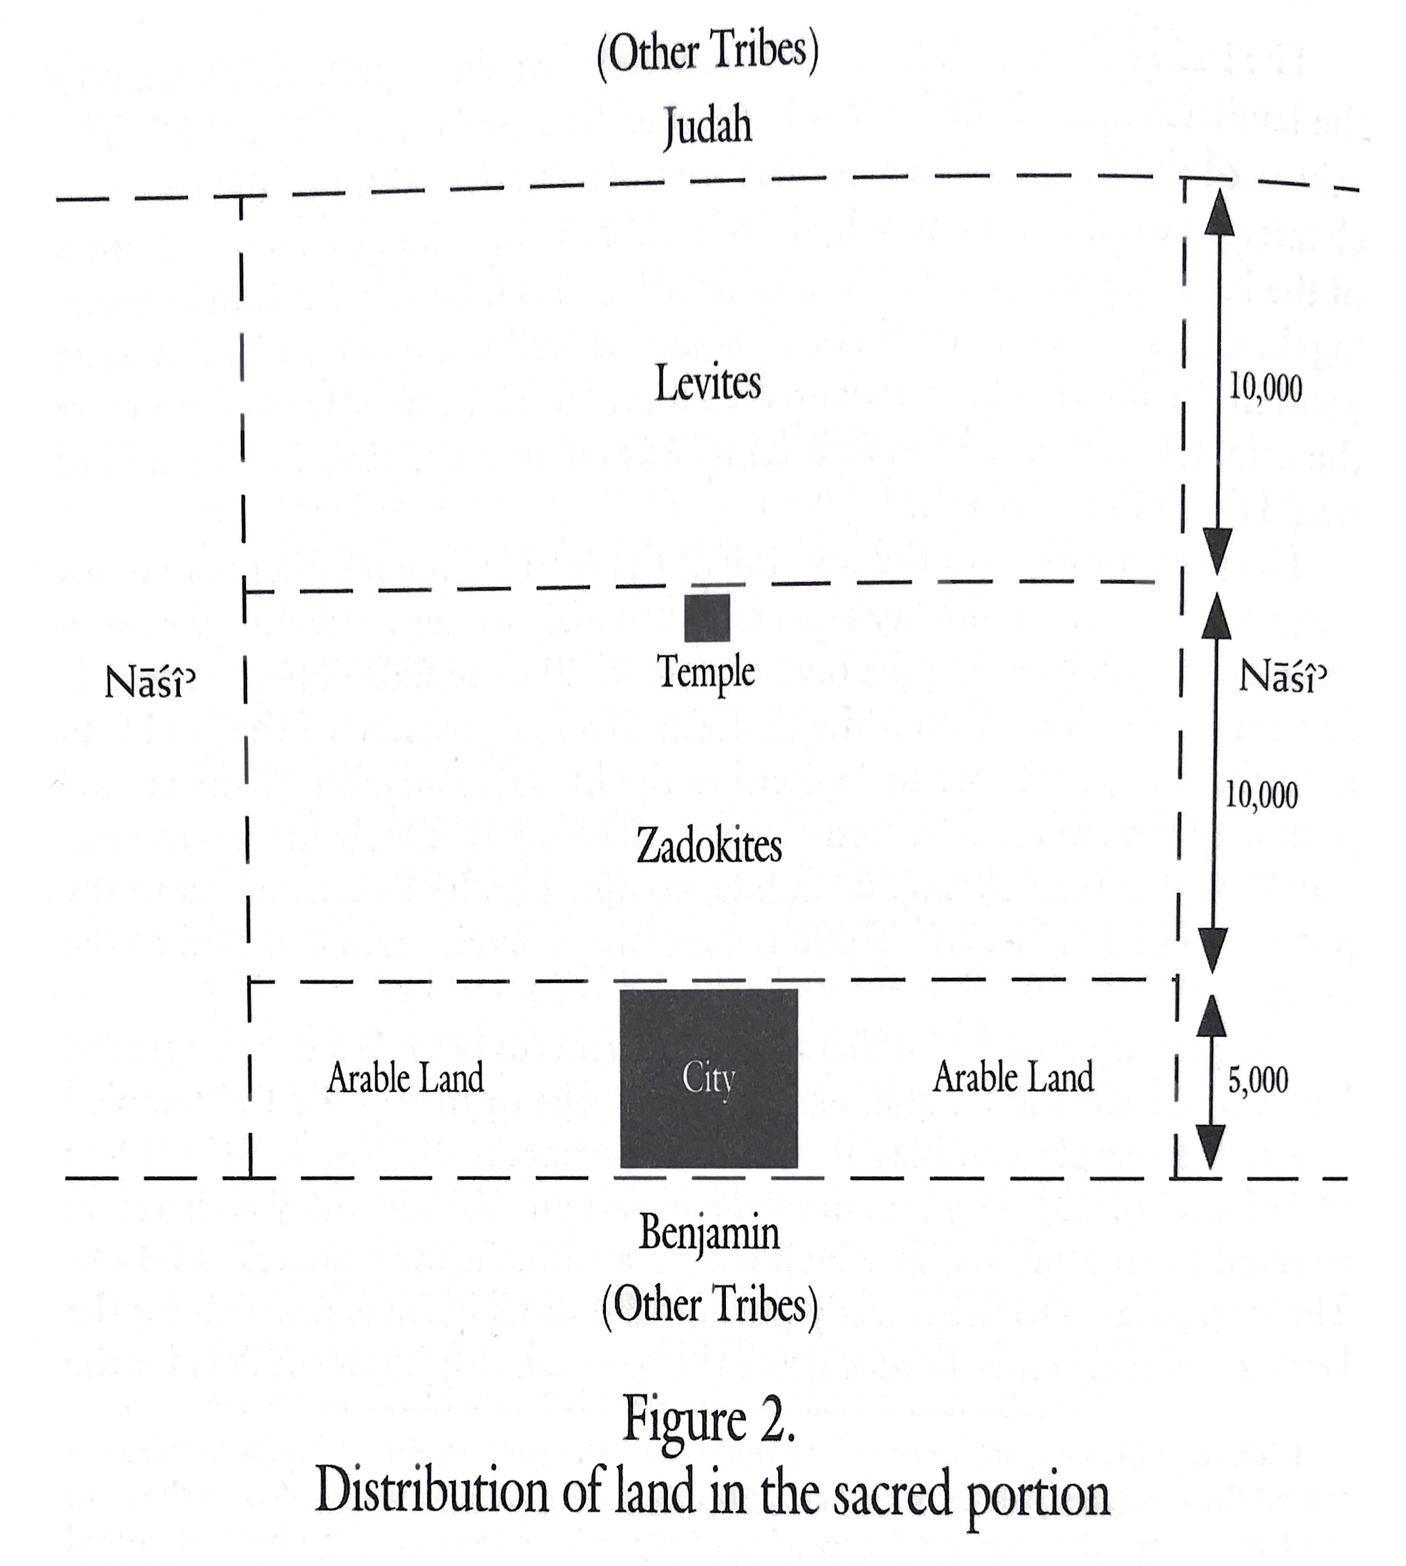

Slide 10
Tribal Portions (47:13 – 48:35)
The tribes are each given a gate of the city, and the name of the city encapsulates the point of the entire vision: The LORD is there. (48:30-35)

Slide 11
Ezekiel in Context
Jerusalem Bowed
(1:2)
Jerusalem Besieged
(24:1)
Jerusalem Broken
(33:21)
Ezekiel 1-24
Judgment on Jerusalem
ch. 25-32
Judg. on Nations
Ezekiel 33-48
Hope for Israel’s Future
The LORD is not there [Jerusalem]
“The Lord is there” (48:35)
“The glory of the LORD departed…” (10:18)
“The glory of the LORD came” (43:4)

Slide 12
Class Objectives
Describe the river in Ezekiel 47 and it’s significance in connection to related passages.
Overview the tribal portions in the newly-divided land.
Recite the last four words of the Book of Ezekiel.

Slide 13
The Book of Ezekiel
For Sunday: Review

