Slide 1
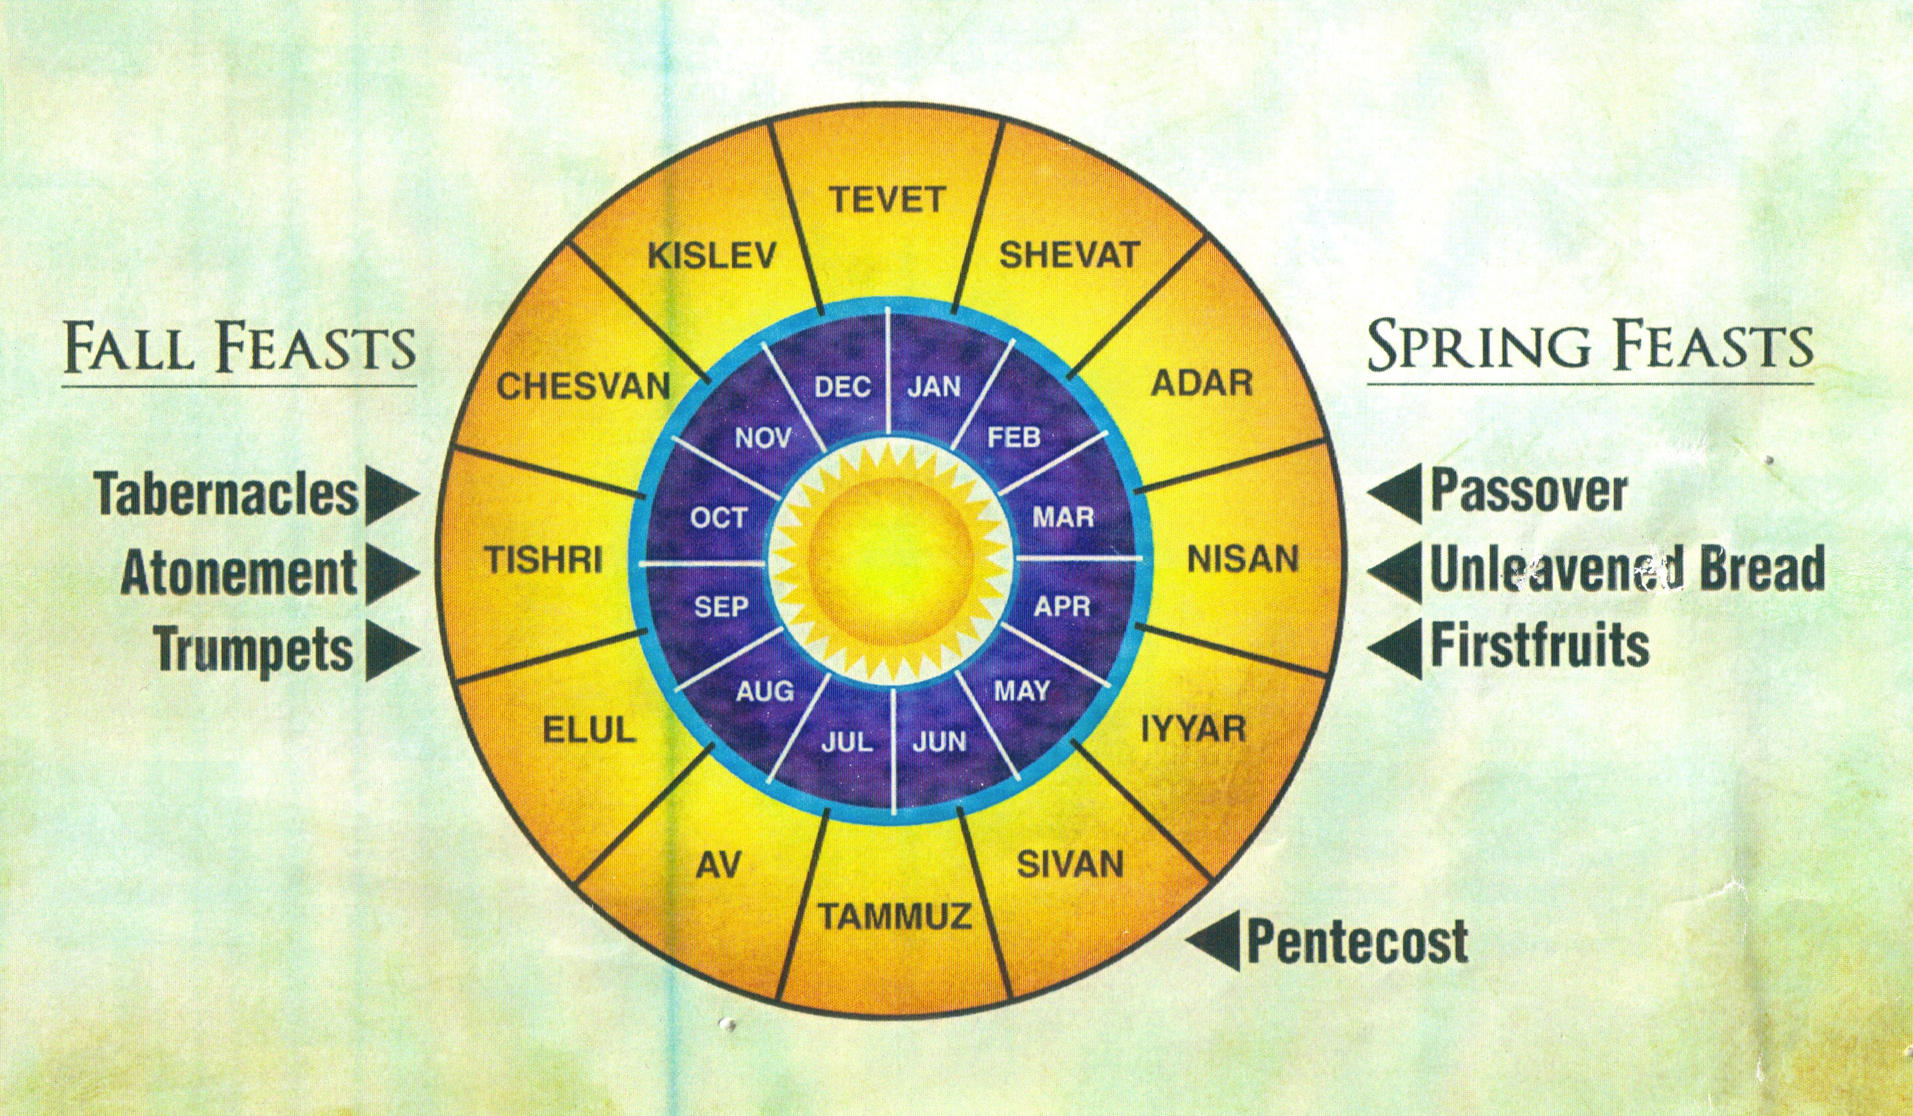
Barley
Olives/ Grapes
Wheat

Slide 2
Blow a Trumpet in Zion
Memorial, Repentance, Hope

Slide 3
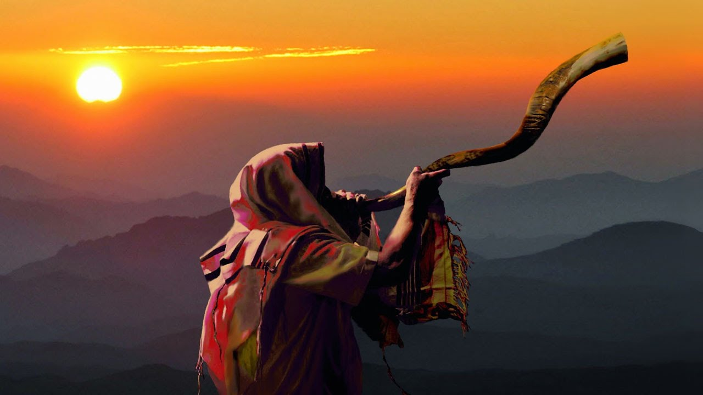
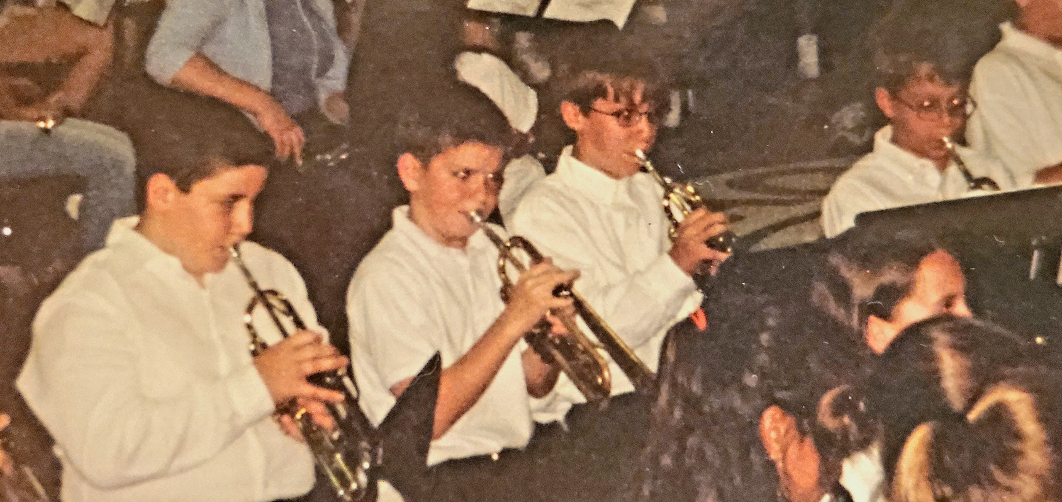
Uses of the Trumpet in Ancient Israel:
Call to assembly
Warning of attack
Battle cry / shout
Offerings / sacrifices
Proclaim the king
Announce a wedding

Slide 4
Feast of Trumpets (Leviticus 23)
²³ Again the Lord spoke to Moses, saying, ²⁴ “Speak to the sons of Israel, saying, ‘In the seventh month on the first of the month you shall have a rest, a reminder by blowing of trumpets, a holy convocation. ²⁵ You shall not do any laborious work, but you shall present an offering by fire to the Lord.’”

Slide 5
Feast of Trumpets (Leviticus 23:24)
Proclaim a Reminder … of What?
Creation
Deliverance
Exodus 34:22; Job 38:4-7
Numbers 10:9-10; Psalm 81:1-7

Slide 6
Holy Days Memorializing God’s Work
Exodus from Egypt
Wilderness
Wandering
God speaks at Sinai

Slide 7
Feast of Trumpets (Leviticus 23:24)
Proclaim a Reminder … of What?
Creation
Deliverance
Repentance
Psalm 81:7-16; Joel 2:1-16

Slide 8
Holy Days Pointing to Jesus & His Kingdom

Slide 9
Feast of Trumpets (Leviticus 23:24)
Proclaim a Reminder … of What?
Creation
Deliverance
Repentance
King’s Return
1 Thessalonians 4:13-18;
1 Corinthians 15:50-58

Slide 10
Blow a Trumpet in Zion
“We will all be changed, in a moment, in the twinkling of an eye, at the last trumpet.”

