Slide 2
Daniel: Class Schedule
Class Date | # | Text
August 31 | 1 | Intro to Book
September 7 | 2 | Daniel 1/Intro 2-7
September 14 | 3 | Daniel 2
September 21 | 4 | Daniel 3
September 28 | 5 | Daniel 4
October 5 | 6 | Daniel 5
October 12 | 7 | Daniel 6
October 19 | 8 | Daniel 7
October 26 | 9 | Intro Daniel 8-12
November 2 | 10 | Daniel 9-10
November 9 | 11 | Daniel 9-10
November 16 | 12 | Daniel 11-12
November 23 |  | No Class
November 30 | 13 | Daniel 11-12

Slide 3
Prophesies
Describe key prophecies pertaining to the time period of Daniel:
Ezekiel 36:22-31________________________________________
Jeremiah 29:10 ________________________________________
Jeremiah 25:12 ________________________________________
2 Chron 36:15-17_______________________________________

Slide 4
Foreign Authorities
Nebuchadnezzar (605 BC)
When does he come on the biblical scene? 2 Kings 24______________________________
On what terms do we find Nebuchadnezzar and Judah?______________________________
Belshazzar(540 BC?)
Who was he? _______________________________________
His “reign” directly predicated what global event?__________________________________
Darius (521 BC)
What relation did he have with Nebuchadnezzar?__________________________________
What did he do for the Jewish people? Ezra 6 _____________________________________

Slide 5
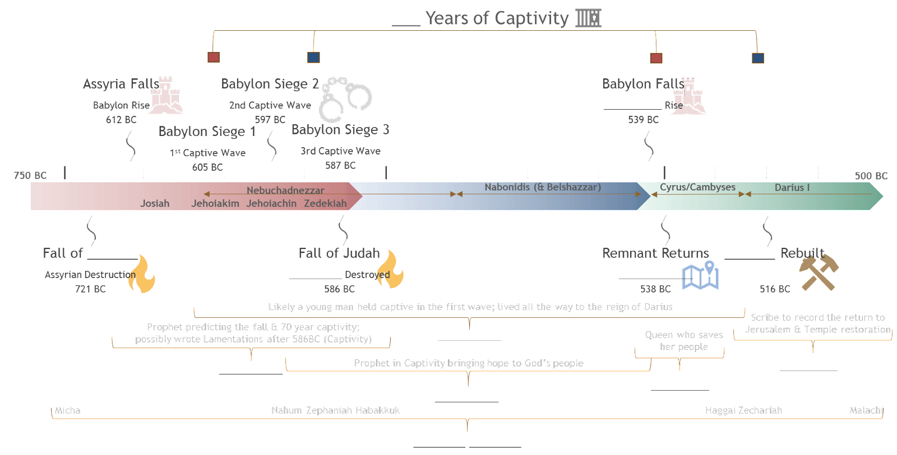

Slide 6
The Book of Daniel
Style:
Ch. 1-6: Story
Ch. 7-12: Vision
Ch. 1 Hebrew
Ch. 2-7
Aramaic
Ch. 8-12
Hebrew
Language:
Prologue
God rules in the kingdoms of man.
God preserves His sacred people.
Theme:

