Slide 2
Daniel: Class Schedule
Class Date | # | Text
August 31 | 1 | Intro to Book
September 7 | 2 | Daniel 1/Intro 2-7
September 14 | 3 | Daniel 2
September 21 | 4 | Daniel 3
September 28 | 5 | Daniel 4
October 5 | 6 | Daniel 5
October 12 | 7 | Daniel 6
October 19 | 8 | Daniel 7
October 26 | 9 | Intro Daniel 8-12
November 2 | 10 | Daniel 9-10
November 9 | 11 | Daniel 9-10
November 16 | 12 | Daniel 11-12
November 23 |  | No Class
November 30 | 13 | Daniel 11-12

Slide 3
Daniel 2 – kingdoms vs. Kingdom
Discuss!
What Bible story(s) does this remind you of?
What’s the significance?

Slide 4
Daniel 2 – kingdoms vs. Kingdom
2:17-24 – What are the two main points Daniel makes about God?
He removes / sets up kings. (21)
He reveals hidden things. (22)

Slide 5
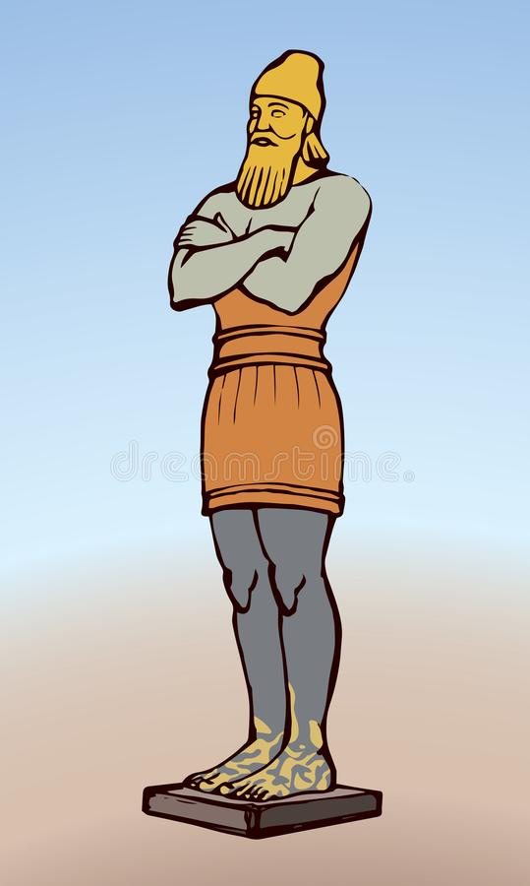
Daniel 2 – kingdoms vs. Kingdom
Head of Gold (Babylon)
Chest of Silver (Persia)
Middle of Bronze (Greece)
Legs of Iron (Rome)
Stone (Kingdom of Christ)

Slide 6
Daniel 2 – kingdoms vs. Kingdom
What are the lessons for…
Nebuchadnezzar?
The Hebrews in exile?
Christians in 2022?

Slide 7
The Book of Daniel (Structure)
Style:
Ch. 1-6: Story
Ch. 7-12: Vision
Ch. 1 Hebrew
Ch. 2-7
Aramaic
Ch. 8-12
Hebrew
Language:
Prologue
God rules in the kingdoms of man.
God preserves His sacred people.
Theme:

Slide 8
Daniel 2-7: God Rules in the Kingdoms of Men
Ch. 2: Nebuchadnezzar’s dream of statue representing four kingdoms supplanted by God’s eternal kingdom.
Ch. 7: Daniel’s vision of beasts representing four kingdoms overthrown by Son of Man on the throne.
Ch. 3: Three Hebrews refuse to bow down and survive the fiery furnace.
Ch. 6: Daniel refuses not to pray and survives the lion’s den.
Ch. 4: Nebuchadnezzar loses kingdom after display of pride.
Ch. 5: Belshazzar loses kingdom after display of pride.

Slide 9
Chapter 3 for Next Week (9/21)
Handout on Website

