Slide 1
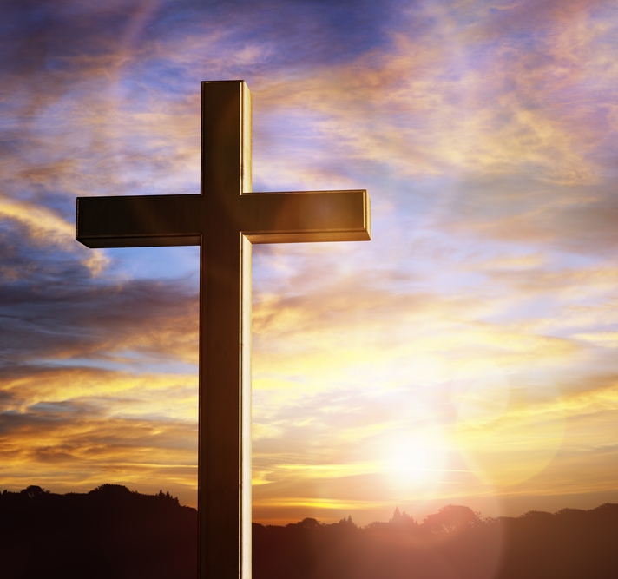
We Saw Thee Not

Slide 2
Faith
What is faith? Hebrews 11:1
Why do we need faith? Hebrews 11:6
How do we get faith? Romans 10:17
Who is the object of our faith? 1 Corinthians 2:5, Philippians 4:13
Do we need to ask God for help with our faith? - Luke 17:5
What can faith do? Mark 11:22-24
How does faith apply to us? Proverbs 3:5-6, 2 Corinthians 5:7, Mark 16:16
What is the goal of our faith? Romans 10:9, 2 Timothy 4:7-8

Slide 3
We saw thee not when thou didst come, To this poor world of sin and death- [Mt 2:1-2] Nor yet beheld thy cottage home, In that despised Nazareth - [Mt 2:21-23] But we believe thy footsteps trod; Its streets and plains, thou Son of God
Verse 1

Slide 4
Verse 2
We saw thee not when lifted high; Amid that wild and savage crew - [Mt 27:22-23]
Nor heard we that imploring cry, "Forgive, they know not what they do!“ - [Luke 23:33-34]
But we believe the deed was done, That shook the earth and veiled the sun - [Mt 27:45] [Mt 27:51-52]

Slide 5
Verse 3
We gazed not in the open tomb, Where once thy mangled body lay- [Mk 16:4-6]
Nor saw thee in that "upper room," Nor met thee on the open way - [Luke 24:33-36]
But we believe that angels said, "Why seek the living with the dead?“ - [Luke 24:4-5]

Slide 6
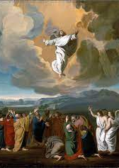
Verse 4
We walked not with the chosen few Who saw thee from the earth ascend
Who raised to heaven their wondering view, Then low to earth all prostrate bend
But we believe that human eyes Beheld that journey to the skies
[Lk 24:45-53]

