Slide 1
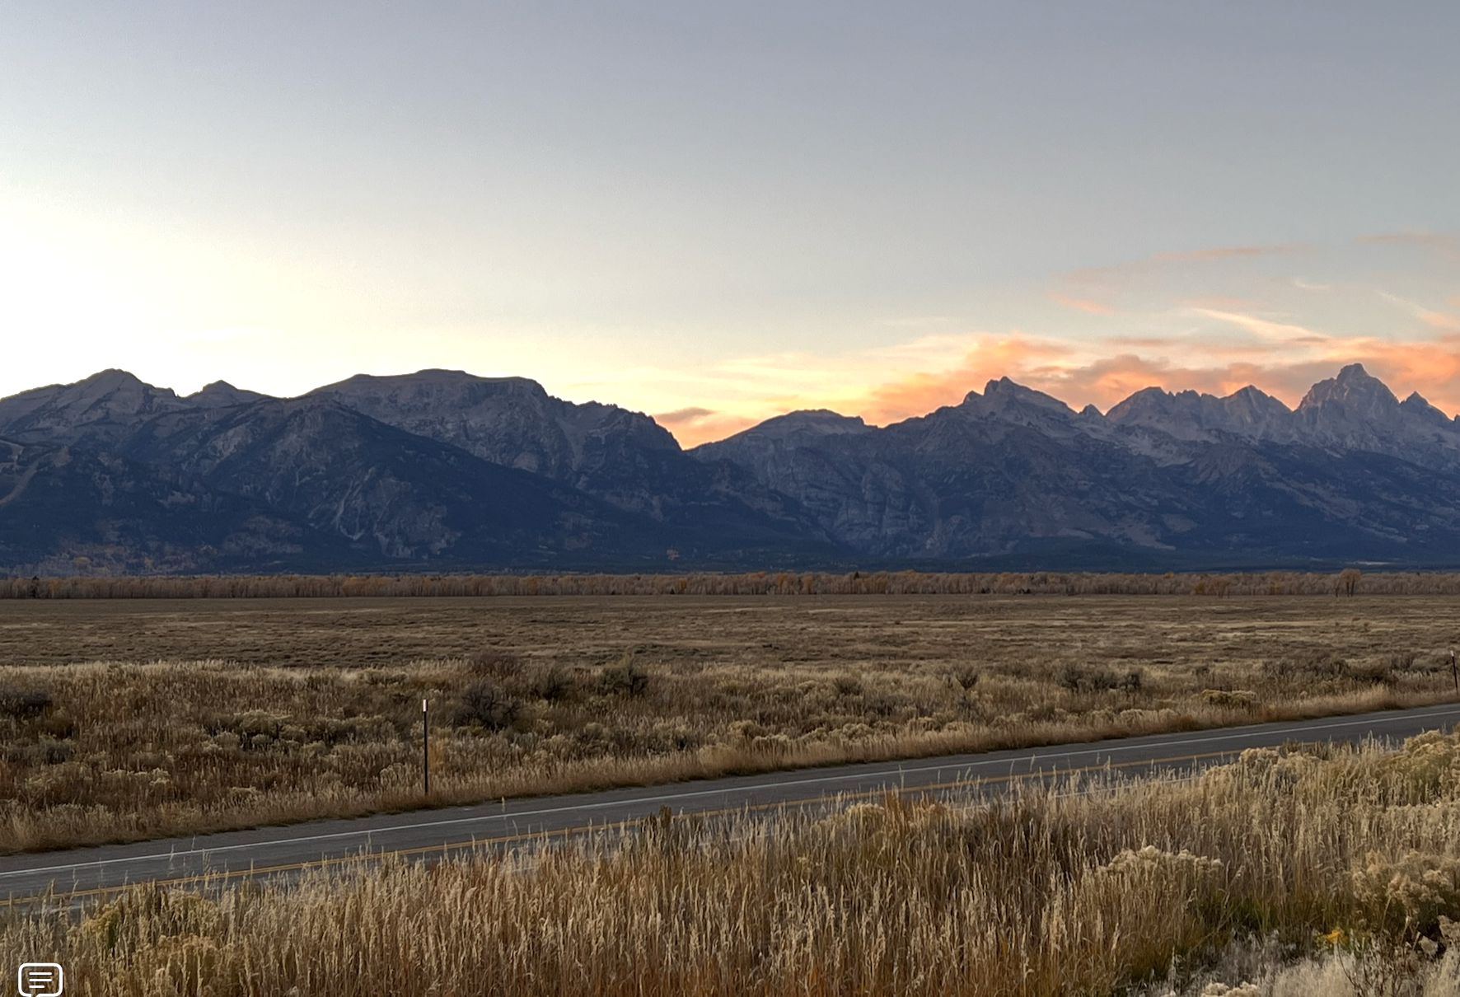
Blessed Are The Peacemakers
Matthew 5:9

Slide 2
Peacemakers are at Peace with God
Christians understand where peace originates
Grace to you and peace from God our Father and the Lord Jesus Christ. (Phil 1:2 )

Slide 3
do not be anxious about anything, but in everything by prayer and supplication with thanksgiving let your requests be made known to God. And the peace of God, which surpasses all understanding, will guard your hearts and your minds in Christ Jesus. Finally, brothers, whatever is true, whatever is honorable, whatever is just, whatever is pure, whatever is lovely, whatever is commendable, if there is any excellence, if there is anything worthy of praise, think about these things. What you have learned and received and heard and seen in me—practice these things, and the God of peace will be with you. (Phil. 4:6-9)

Slide 4
2. God’s family Respect and have Confidence in God’s Word and Ways:
Eph 4:16-17 “in the futility of their thinking” but to be renewed in their attitudes and to be like Christ.
Eph 4:25 – Therefore each of you must put off falsehood and speak truthfully to his neighbor,
Eph 4:26 – Do not let the sun go down while you are still angry,

Slide 5
2. God’s family Respect and have Confidence in God’s Word and Ways:
Eph 4:29 – Do not let any unwholesome talk come out of your mouths, but only what is helpful for building others up…
Eph 4:31-32 – Get rid of all bitterness, rage and anger, brawling and slander, along with every form of malice. 32 Be kind and compassionate to one another, forgiving each other, just as in Christ God forgave you.

Slide 6
Wives to be submissive to their husbands and show them respect.
He tells husbands to love their wives even to the point of personal sacrifice.
Children must be obedient to parents in all things
Parents must sacrifice for their children and discipline them according to God’s admonitions.
He tells employees to obey their Mgr. (even the evil ones)
He tells owners to be kind and unthreatening to those who serve and work for them.

Slide 7
3. He recognizes the source of conflict.
What causes quarrels and what causes fights among you? Is it not this, that your passions are at war within you? You desire and do not have, so you murder. You covet and cannot obtain, so you fight and quarrel. You do not have, because you do not ask. You ask and do not receive, because you ask wrongly, to spend it on your passions. You adulterous people! Do you not know that friendship with the world is enmity with God? Therefore whoever wishes to be a friend of the world makes himself an enemy of God. (James 4:1-4)

Slide 8
4. He recognizes peace is defined from God’s perspective.
Please forgive the trespass of your servant. For the LORD will certainly make my lord a sure house, because my lord is fighting the battles of the LORD, and evil shall not be found in you so long as you live. If men rise up to pursue you and to seek your life, the life of my lord shall be bound in the bundle of the living in the care of the LORD your God. And the lives of your enemies he shall sling out as from the hollow of a sling.

Slide 9
And when the LORD has done to my lord according to all the good that he has spoken concerning you and has appointed you prince over Israel, my lord shall have no cause of grief or pangs of conscience for having shed blood without cause or for my lord working salvation himself. And when the LORD has dealt well with my lord, then remember your servant.” (1 Sam. 25:28-31)

Slide 10
B. He Leads Others to Make Peace with God:
How then will they call on him in whom they have not believed? And how are they to believe in him of whom they have never heard? And how are they to hear without someone preaching? And how are they to preach unless they are sent? As it is written, “How beautiful are the feet of those who preach the good news!” (Rom. 10:14-15).
Evangelizing those that do not know God comes from our ability and willingness to integrate with them.
Preaching Reconciliation

Slide 11
All this is from God, who through Christ reconciled us to himself and gave us the ministry of reconciliation; that is, in Christ God was reconciling the world to himself, not counting their trespasses against them, and entrusting to us the message of reconciliation. Therefore, we are ambassadors for Christ, God making his appeal through us. We implore you on behalf of Christ, be reconciled to God. (2 Cor. 5:18-20)
For he himself is our peace, who has made us both one and has broken down in his flesh the dividing wall of hostility by abolishing the law of commandments expressed in ordinances, that he might create in himself one new man in place of the two, so making peace, (Eph. 2:14-15)

Slide 12
Righteousness Is a Perquisite for Peace.
We must pursue Purity & Peace:
14 Pursue peace with all people, and holiness, without which no one will see the Lord (Hebrews 12:14)
10 Mercy and truth have met together; Righteousness and peace have kissed. (Psalms 85:10)

Slide 13
We must seek Truth & Peace:
Jesus said, “Do not think that I came to bring peace on the earth; I did not come to bring peace, but a sword” (Matt 10:34).
17 Sanctify them by Your truth. Your word is truth. (John 17:17)

Slide 14
Blessed Are The Peacemakers
Matthew 5:9

