Slide 1
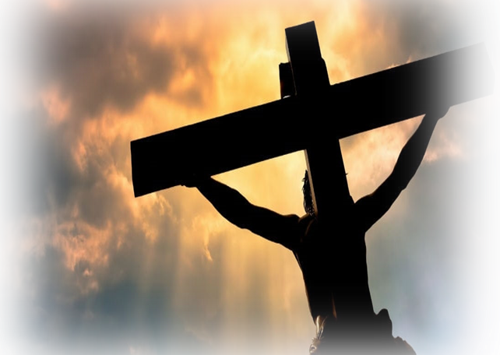
One Solitary Life
The Miracle of the Redemption Story
Notes:
To prepare or minds for the Lord’s Supper, my comments will concern the purpose and meaning of life of which Jesus Christ is the foundation and Chief Corner Stone. Without Jesus, our lives have no meaning or purpose. Without Him, we would only have death and the grave. With Him, we have everything

Slide 2
One Solitary Life
Jesus was born in an obscure village, the child of a peasant woman whose only husband was not His father. He was raised in yet another obscure village. He grew into a man with common features whose physical countenance lacked stately form or majesty.
As a man, he remained in obscurity and labored as a common carpenter. With His meager wages, he provided for Himself and His widowed mother.

Slide 3
One Solitary Life
He never received a formal education.
He never wrote a book
He never possessed wealth.
He never held a position of authority and power.
He never owned a home
He never had a wife or children
He never traveled more than two hundred miles from the place He was born.
He never wronged or harmed anyone, but was meek and lowly in heart.
He never did any of the things that usually accompany greatness – as the world counts greatness.

Slide 4
One Solitary Life
When He reached the age of 30, He laid His carpentry tools down to become an itinerant preacher. For three brief years, He taught:
Faith and Love
Mercy and Grace
Forgiveness, and selfless service to others.
Despite His humble and obscure origins, He spoke with indisputable power and authority. Even the most learned of teachers were amazed by His wisdom.

Slide 5
One Solitary Life
Profoundly, He made a magnificent and breathtaking declaration. He declared that:
He was God
He was the Son of the God most High
He was the long promised Messiah
He promised that through His sacrificial death, burial, and resurrection, He would give to all men the free gift of eternal life and make them also the sons of God – even as He is.

Slide 6
One Solitary Life
Profoundly, He made a magnificent and breathtaking declaration. He revealed that:
He was God
He was the Son of the God most High
He was the long promised Messiah
He promised that through His sacrificial death, burial, and resurrection, He would give to all men the free gift of eternal life and make them also the sons of God – even as He is.

Slide 7
One Solitary Life
And though His claims were difficult to accept, He confirmed them with extraordinary signs, wonders, powers, and miraculous healings – even the raising of the dead. And many of the people believed Him.
Jesus quickly rose from obscurity to become the most prominent and beloved figure in all the land. The people came to Him by the thousands to hear His gracious words and to obtain His blessings.

Slide 8
One Solitary Life
But just as quickly as Jesus became known, the religious leaders of the land opposed Him.
Unable to deny His powers, they attributed them to Satan.
They rejected His teachings and sought to discredit Him with carefully designed theological riddles. Jesus easily defeated them all and His fame and following grew.

Slide 9
One Solitary Life
And as the word of Jesus spread, the religious leaders’ alarms grew into fear and hatred. They plotted His death. In the third year of His ministry, they were finally able to turn the tide of popular opinion against Him.
All the people who had come to Jesus abandoned Him
Even His most beloved friends hid in fear.
One of His closest disciples denied Him – not once – not twice - but three times.
Another betrayed Him for the paltry price of thirty pieces of silver and turned Him over to His enemies.

Slide 10
One Solitary Life
And as the word of Jesus spread, the religious leaders alarms grew into fear and hatred. They plotted His death. In the third year of His ministry, they were finally able to turn the tide of popular opinion against Him.
All the people who had come to Jesus forsook Him
Even His most beloved friends hid in fear.
One of His closest disciples denied Him – not once – not twice - but three times.
Another betrayed Him for the paltry price of thirty pieces of silver and turned Him over to His enemies.

Slide 11
One Solitary Life
Though He was defenseless, they sent an army to arrest Him for crimes He did not commit.
They ridiculed and mocked Him.
They beat Him with their fists
They spat upon Him with their lips.
They subjected Him to the mockery of rigged trials and
They sentenced Him to death by crucifixion – the death of a common criminal.

Slide 12
One Solitary Life
When they executed Him
A scourger flayed His flesh – from front to back and from top to bottom.
Then they nailed Him upon a cross between two criminals.
And there He hung dying, suspended between heaven and earth and between God and man.

Slide 13
One Solitary Life
His executioners gambled for the only piece of property He had on earth – His garment cloth.
The few that remained still sneered and ridiculed Him
And yet, while still dying on the cross, He forgave them all – including you and me.
When He was dead, they laid Him in a borrowed grave through the kindness of a friend.

Slide 14
One Solitary Life
In Life and Death
In life, Jesus’s enemies feared Him.
In death, they feared Him more.
In life, they sent an army to arrest Him.
In death, they sent another army to keep Him in His grave.
They failed.

Slide 15
One Solitary Life
In Life and Death
In life, God subjected Jesus to lowliness, oppression, and suffering.
In death, God raised Him into life and made Him the most powerful and consequential figure in all creation for all eternity.

Slide 16
One Solitary Life
To this day, the empty tomb speaks the silent testimony of His resurrection – and our resurrection to come.

Slide 17
One Solitary Life
Twenty long centuries have come and gone, and today Jesus is the centerpiece of the human race. I am far within the mark when I say that:
all the armies that ever marched,
all the navies that ever sailed;
all the parliaments that ever sat and
all the kings that ever reigned, put together,
have not affected the life of man upon this earth as powerfully as has this one solitary life

Slide 18
One Solitary Life
An Answer to an Unspoken Question
How is Jesus the Centerpiece of the Human Race?
I answer them with you

