Slide 1
Ten Words
A Study of the Ten
Commandments
2. No Graven Image

Slide 2
READ: EXODUS 20:1-6
Review / Reflect on Passage
Topics for our class today:
What is a graven image and why is it bad?
What was God’s purpose regarding this commandment for His People at Mt Sinai?
What does God want us to learn / know / do today?

Slide 3
What exactly IS a Graven Image?
Ten Words – A Study of the 10 Commandments

Slide 4
Commandment 2 – No Graven Images
What does the text say?
Exodus 20:4-6 (NASB)
“(4) You shall not make for yourself an idol [KJV “carved image”], or any likeness of what is in heaven above or on the earth beneath or in the water under the earth.
(5) You shall not worship them or serve them; for I, the Lord your God, am a jealous God, visiting the iniquity of the fathers on the children, on the third and the fourth generations of those who hate Me,
(6) but showing lovingkindness to thousands, to those who love Me and keep My commandments.

Slide 5
What does Graven Image mean?
Exodus 20:4-6 (NASB) – Strong’s Concordance
Exodus 20:4 - pesel: an idol, image HEB: תַֽעֲשֶׂ֨ה־ לְךָ֥֣ פֶ֣֙סֶל֙ ׀ וְכָל־ תְּמוּנָ֡֔ה NAS: You shall not make for yourself an idol, or any KJV: Thou shalt not make unto thee any graven image, or any likeness INT: shall not make an idol any likeness
Deuteronomy 27:15 (NIV – Parallel Passage)
“Cursed is anyone who makes an idol—a thing detestable to the LORD, the work of skilled hands—and sets it up in secret.” Then all the people shall say, “Amen!”

Slide 6
Commandment 2 – No Graven Images
What are the people NOT to do?
Exodus 20:4-6 (NASB)
“(4) You shall not make for yourself an idol [KJV “carved image”],
or any likeness of what is in heaven above
or on the earth beneath
or in the water under the earth.
(5) You shall not worship them or serve them;
Why are they not to do it?
(5) for I, the Lord your God, am a jealous God,
visiting the iniquity of the fathers on the children, on the third and the fourth generations of those who hate Me,
(6) but showing lovingkindness to thousands, to those who love Me and keep My commandments.

Slide 7
Why did God elaborate so much on this commandment at Mt. Sinai?
Ten Words – A Study of the 10 Commandments

Slide 8
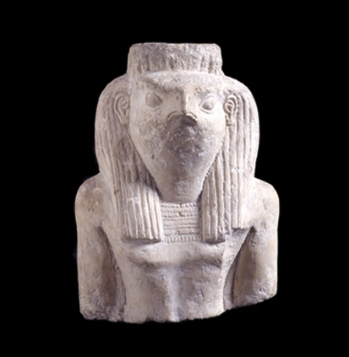
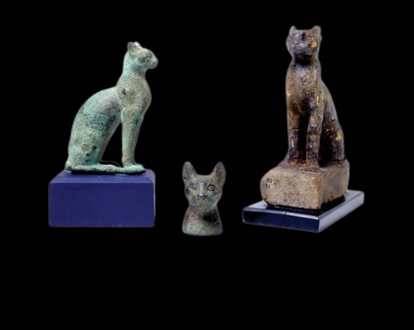
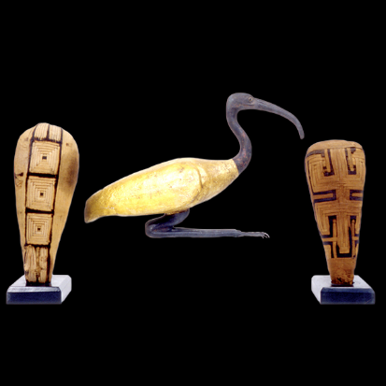
What system of worship did the Israelites see while in Egypt?
Brief Timeline
Israelites in Egypt ~1500-1300 BCE
Egyptian deities first mentioned ~3000 BCE
Partial List of Egyptian gods
Ra was the king of the deities and the father of all creation. He was the patron of the sun, heaven, kingship, power, and light. The ancient Egyptians worshipped many gods.
- Amun
- Anubis
- Bastet (Bast)
- Bes
- Geb
- Hathor
- Horus
- Isis
- Ma’at
- Neith
- Nephthys
- Nut
- Osiris
- Ptah
- Ra
- Sekhmet
- Seth
- Sobek
- Thoth
These gods and goddesses often represented the natural world, for example the sky, earth, wind, or sun. They took the form of animals or combined animal and human forms.
Ra
Bast
Thoth

Slide 9
Why did God forbid images and anything else to represent him in worship?
God wanted to break them of the habit / norm that they saw / participated in for 300 years in Egypt.
Let’s explore this idea with some questions:
Did the Egyptians worship idols?
What of the ‘magicians’? Ex. 7:11, 22
Did the Israelites worship idols?
Did Moses or Aaron claim they were God?
Why is Idol worship abhorrent to God?
God is free / omnipresent
God cannot be contained
God is a Spirit
Idol worship represents a lack of trust in God
Question: Did the Israelites know their true God?
Hint - Ex 2:23-25; Ex 3:4-6

Slide 10
The Why…God was and is a Jealous God
No image can capture God’s glory. Man cannot create the image of God.
This commandment prohibits creation of image for particular purpose: to bow before and serve
Is God a Jealous God – Ex 34:14; Num 25:11; Deut 4:24; Deut 6:14-15; Josh 24:19; Ezk 39:25; Acts 12:21-23
Why is God jealous?
He created us; He cared for us; He desires for us to be His children; He loves us
Gen. 1:26-27 - “Let us make man in our image according to our likeness…”

Slide 11
Why did God spend so much time with the people on this commandment?
God foresaw the hold these idols had over them.
Exodus 32:1-4 (Aaron – spokesman for the true and living God)
When the people saw that Moses was so long in coming down from the mountain, they gathered around Aaron and said, “Come, make us gods^{[a]} who will go before us. As for this fellow Moses who brought us up out of Egypt, we don’t know what has happened to him.”
² Aaron answered them, “Take off the gold earrings that your wives, your sons and your daughters are wearing, and bring them to me.” ³ So all the people took off their earrings and brought them to Aaron. ⁴ He took what they handed him and made it into an idol cast in the shape of a calf, fashioning it with a tool. Then they said, “These are your gods,^{[b]} Israel, who brought you up out of Egypt.”

Slide 12
In David’s Time – Psalm 115:3-8
Our God is in the heavens; he does whatever he pleases.
Their idols are silver and gold, the work of men’s hands. They have mouths, but do not speak; eyes, but do not see. They have ears, but do not hear; noses, but do not smell. They have hands, but do not feel; feet, but do not walk; and they do not make a sound in their throat.
Those who make them are like them; so are all who trust in them.

Slide 13
In Isaiah’s time – Isaiah 44:9-21
9 All who make idols are nothing, and the things they treasure are worthless. Those who would speak up for them are blind; they are ignorant, to their own shame. 10 Who shapes a god and casts an idol, which can profit him nothing? 11 He and his kind will be put to shame; craftsmen are nothing but men. Let them all come together and take their stand; they will be brought down to terror and infamy.
12 The blacksmith takes a tool and works with it in the coals; he shapes an idol with hammers, he forges it with the might of his arm. He gets hungry and loses his strength; he drinks no water and grows faint. 13 The carpenter measures with a line and makes an outline with a marker; he roughs it out with chisels and marks it with compasses. He shapes it in the form of man, of man in all his glory, that it may dwell in a shrine. 14 He cut down cedars, or perhaps took a cypress or oak. He let it grow among the trees of the forest, or planted a pine, and the rain made it grow. 15 It is man's fuel for burning; some of it he takes and warms himself, he kindles a fire and bakes bread. But he also fashions a god and worships it; he makes an idol and bows down to it.
16 Half of the wood he burns in the fire; over it he prepares his meal, he roasts his meat and eats his fill. He also warms himself and says, "Ah! I am warm; I see the fire."17 From the rest he makes a god, his idol; he bows down to it and worships. He prays to it and says, "Save me; you are my god.“ 18 They know nothing, they understand nothing; their eyes are plastered over so they cannot see, and their minds closed so they cannot understand.
19 No one stops to think, no one has the knowledge or understanding to say, "Half of it I used for fuel; I even baked bread over its coals, I roasted meat and I ate. Shall I make a detestable thing from what is left? Shall I bow down to a block of wood?“ 20 He feeds on ashes, a deluded heart misleads him; he cannot save himself, or say, "Is not this thing in my right hand a lie?“ 21 "Remember these things, O Jacob, for you are my servant, O Israel. I have made you, you are my servant; O Israel, I will not forget you.

Slide 14
In Christ’s Time – Acts 17
Verse 16
16 While Paul was waiting for them in Athens, he was greatly distressed to see that the city was full of idols.
Verses 21-23
21 (All the Athenians and the foreigners who lived there spent their time doing nothing but talking about and listening to the latest ideas.)
22 Paul then stood up in the meeting of the Areopagus and said: “People of Athens! I see that in every way you are very religious. 23 For as I walked around and looked carefully at your objects of worship, I even found an altar with this inscription: to an unknown god. So you are ignorant of the very thing you worship—and this is what I am going to proclaim to you.

Slide 15
How can we apply no graven images to us today?
Ten Words – A Study of the 10 Commandments

Slide 16
What About Us Today?
What is the definition of an idol today?
Not just a physical representation - anything that functions as a focus for our worship - even if it has NO physical representation.
Think in terms of God being a jealous God
Anything that gets between us and God is an idol
To establish any idol in our hearts is to forsake Him.
What are examples of idols today?
Money, possessions, career, family, addiction, sports, etc.
How do we recognize when idols creep in and prevent it?

Slide 17
Focus on Christ – Support Each Other
Mistreating other people and worshiping idols have the same root: a violation of the divine image
Strengthen our belief / faith in God
Deut. 4:12 - didn’t see but heard on Mt. Sinai.
Rom. 10:17 - Faith comes by hearing - this is how God chose to reveal himself.
Live in this world, but not of this world
Matt. 22:17-21 - “Give to Caesar what is Caesar and to God what is God’s…”
Rom. 12:1-2 - worship God in everything we do. Heart, soul and body. 12 Therefore, I urge you, brothers and sisters, in view of God’s mercy, to offer your bodies as a living sacrifice, holy and pleasing to God—this is your true and proper worship. 2 Do not conform to the pattern of this world, but be transformed by the renewing of your mind. Then you will be able to test and approve what God’s will is—his good, pleasing and perfect will.
We do not need a physical representation of Christ to worship Him.
1 Cor 3:16 Don’t you know that you yourselves are God’s temple and that God’s Spirit dwells in your midst?
Image of God in His church: John 17:21 - Jesus unites us to Himself so that we are made in His image. We are one.

Slide 18
Ten Words
For Next Wednesday
3. Lord’s Name in Vain

Slide 19
Ten Words: Class Schedule
Date | Class | Teacher
Wed. 1/18 | Class Introduction | David Haley
Sun. 1/22 | Bellaire Business Meeting | N/A
Wed. 1/25 | No Other Gods Before Me | David Haley
Sun. 1/29 | No Graven Images | Robert McDonald
Wed. 2/1 | Lord’s Name in Vain | Robert McDonald
Sun. 2/5 | Remember the Sabbath Day | Robert McDonald
Wed. 2/8 | Honor your Father and Mother | David Haley
Sun. 2/12 | Do Not Murder | Robert McDonald
Wed. 2/15 | Do Not Commit Adultery | Robert McDonald
Sun. 2/19 | Do Not Steal | David Haley
Wed. 2/22 | Do Not Bear False Witness | David Haley
Sun. 2/26 | Do Not Covet / Class Conclusion | David Haley

