Slide 1
Singing and Invitation are About to Begin

Slide 2
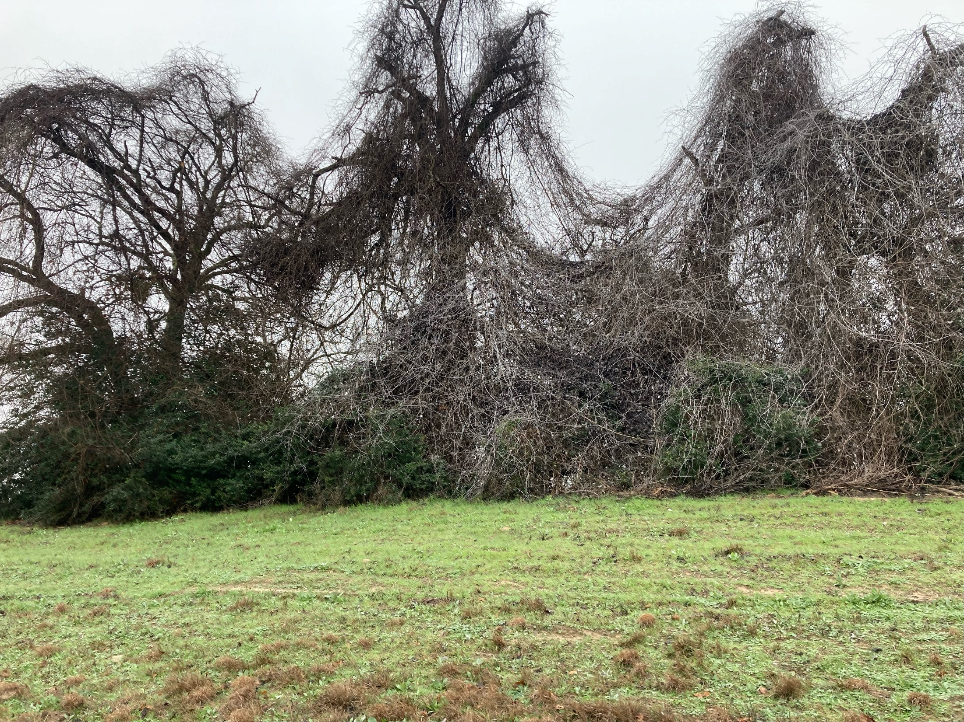

Slide 3
Closing Prayer
“My house shall be a house of prayer” John 2:14

