Slide 1
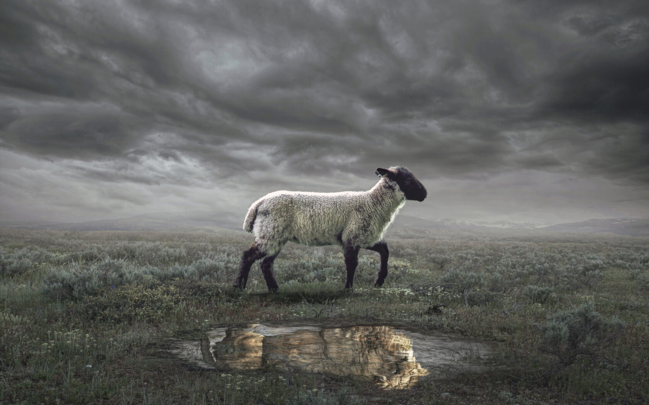
The Revelation
2. The words of this prophecy

Slide 2
Review Quiz
What is the genre of the Book of Revelation?
Apocalyptic Literature
Prophecy
Letter
All of the Above

Slide 3
Review Quiz
In the Bible, what is an apocalypse?
The end of the world
An unveiling of reality
Zombies, definitely zombies

Slide 4
Review Quiz
Which O.T. book contains the most apocalyptic writing?
Genesis
Psalms
Isaiah
Daniel

Slide 5
Review Quiz
Which of the following are characteristics of apocalyptic?
Brings comfort during crisis
Contains an angelic guide
Secret code to fool enemies
Flashes of disjointed images
Shows a transcendent reality

Slide 6
What are we reading?
Apocalyptic Literature is “a story, written in a time of crisis and distress, that is given by otherworldly beings explaining how God will reverse everything so the righteous will triumph.”
- Mark Roberts

Slide 7
What are we reading?
¹ The Revelation of Jesus Christ, which God gave Him to show to His bond-servants, the things which must soon take place; and He sent and communicated it by His angel to His bond-servant John, ² who testified to the word of God and to the testimony of Jesus Christ, even to all that he saw. ³ Blessed is he who reads and those who hear the words of the prophecy, and heed the things which are written in it; for the time is near.
⁴ John to the seven churches that are in Asia:

Slide 8
What is Prophecy?
In the Bible, prophecy does NOT mean fortune-telling or predicting the future.
It means a word from God, delivered by a man or woman of God (prophet).
The Hebrew prophets did the following:
Interpret History
Enforce Covenants
Describe Future Events

Slide 9
What does the prophet talk about?
Eight things:
Lord of History
Divine Compassion
Election of Israel
Call to Repentance
Rebellion of Israel
Redemption/Restoration
Judgment to Come
Kingdom of God

Slide 10
Judgment & Hope (from Isaiah 2017-18)
Rebellion
Restoration
Repentance
”The Day of the Lord”
Retribution

Slide 11
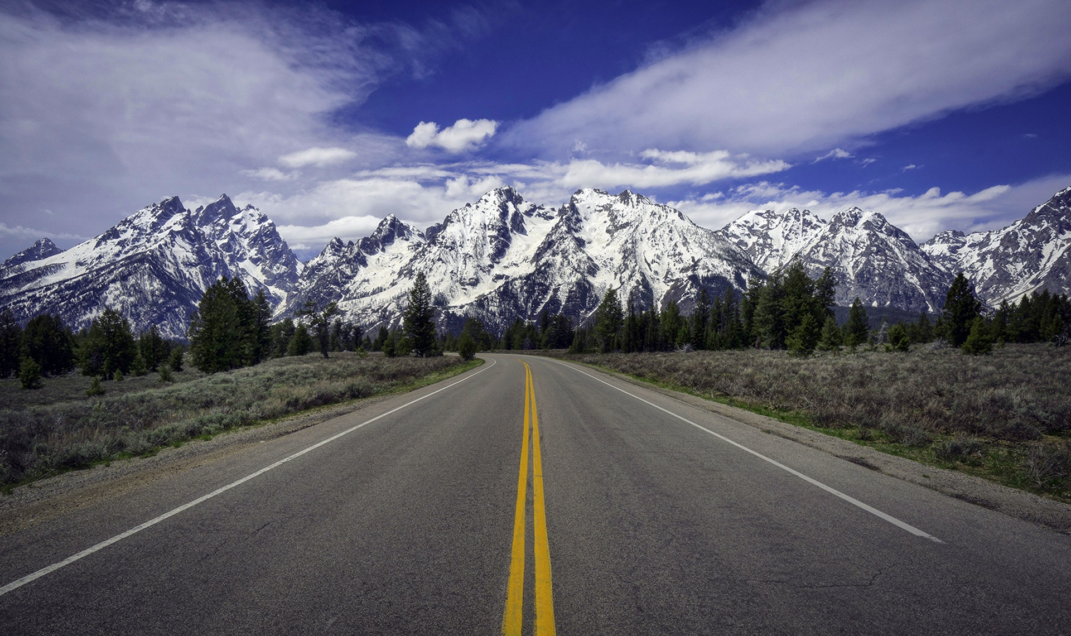
Prophetic View of Time

Slide 12
To when is Ezekiel referring?
^{36:33} Thus says the Lord God, “On the day that I cleanse you from all your iniquities, I will cause the cities to be inhabited, and the waste places will be rebuilt. ³⁴ The desolate land will be cultivated instead of being a desolation in the sight of everyone who passes by. ³⁵ They will say, ‘This desolate land has become like the garden of Eden; and the waste, desolate and ruined cities are fortified and inhabited.’ ³⁶ Then the nations that are left round about you will know that I, the Lord, have rebuilt the ruined places and planted that which was desolate; I, the Lord, have spoken and will do it.”

Slide 13
Apocalyptic View of Time
A common feature in apocalyptic literature is the division of time into periods, with the current moment placed toward the end.
Not as a precise chronology or timeline
Shows God has ordered history/is in control
Encourages reader to hang on a bit longer
Example: 70 Weeks prophecy (Daniel 9)
Response to “Act and don’t delay!” (9:19)
Numbers are symbolic, not literal
The critical moment is the last “week”

Slide 14
“For the time is near”
Revelation says the events of the book will happen “soon.” (1:1; 22:6)
“Soon” in the Bible isn’t always soon
Deut 32:35 - “near” = 800 years
Rom 16:20 - God will “soon” crush Satan
Think of time in Revelation:
Prophetically (layers of fulfillment)
Apocalyptically (hold on a little longer)
Don’t forget the original readers!

Slide 15
How should we interpret Revelation?
Our attempt at a “sweet spot”
Preterist
Past Focus
As a Code
Present Focus
As a Lens
Futurist
Future Focus

Slide 16
The Revelation
For Wednesday:
3. To to churches that are in Asia

