Slide 1
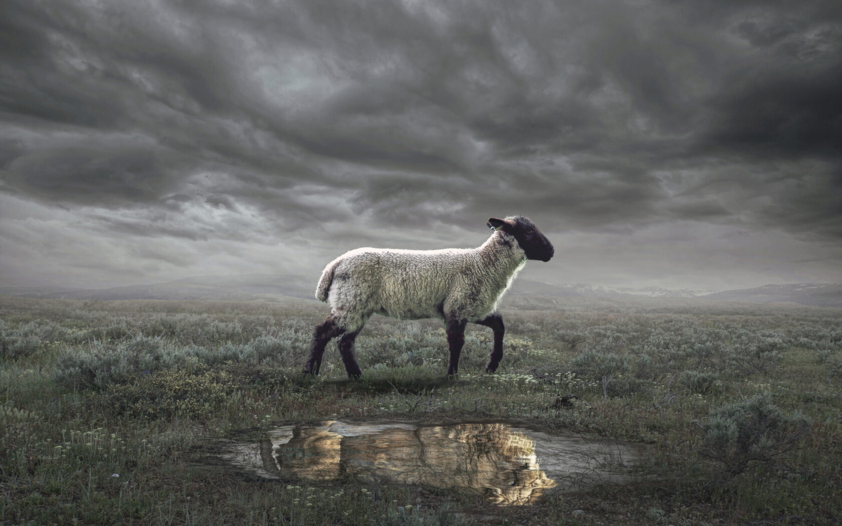
The Revelation
4. Write what you see in a book

Slide 2
Review Quiz
What is the genre of the Book of Revelation?
Prophecy
Apocalyptic Literature
Letter

Slide 3
Review Quiz
What are some characteristics of apocalyptic literature?
Written as a code to break
Written to evoke emotion
Brings comfort & challenge
Uses exaggerated images
Should be read literally

Slide 4
Review Quiz
What’s the first question to ask in Bible study?
What does this mean to me?
What did this mean to the first readers?
What’s for lunch?

Slide 5
Review Quiz
What was the challenge facing the Christians in 1st century Asia?
Compromise
Apathy
Persecution

Slide 6
What are we reading?
¹ The Revelation of Jesus Christ, which God gave Him to show to His bond-servants, the things which must soon take place; and He sent and communicated it by His angel to His bond-servant John, ² who testified to the word of God and to the testimony of Jesus Christ, even to all that he saw. ³ Blessed is he who reads and those who hear the words of the prophecy, and heed the things which are written in it; for the time is near.
⁴ John to the seven churches that are in Asia:

Slide 7
What are we reading?
⁹ I, John, your brother and partner in the tribulation and the kingdom and the patient endurance that are in Jesus, was on the island called Patmos on account of the word of God and the testimony of Jesus. ¹⁰ I was in the Spirit on the Lord's day, and I heard behind me a loud voice like a trumpet ¹¹ saying, “Write what you see in a book and send it to the seven churches, to Ephesus and to Smyrna and to Pergamum and to Thyatira and to Sardis and to Philadelphia and to Laodicea.”

Slide 8
Hearing what John saw
What do we do when we hear a description of a visual scene?
Visualize (imagination)
Overview (big picture)
Filter (primary vs. secondary)
The original readers of Revelation would have heard it read aloud (in one sitting).

Slide 9
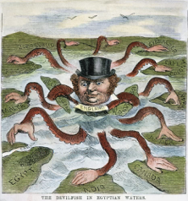
”The Devilfish in Egyptian Waters”

Slide 10
Converting the Imagination
The visions of Revelation do not work through rational logic but imagination.
God is equipping us with us images with which to see and understand the world.
Revelation combines images and a narrative to shape our reality.
But the symbolic world is no less real than the world we see. Maybe more real.

Slide 11
A Biblical Imagination
The imagery of Revelation is drawing largely from the Hebrew Bible (O.T.)
Many Biblical images/symbols/themes reach their culmination in Revelation.
Pick an image and trace it through the entire Bible.

Slide 12
Tips for Reading Revelation
Read aloud or listen.
Read long, continuous chunks.
Visualize what is being described.
Feel the emotions being evoked.
Keep the big picture in view.
Find the comfort or challenge.

Slide 13
Structure of Revelation
Letters to the Churches (1-3)
The Throne of God & the Lamb (4-5)
Seven Seals (6-8)
Seven Trumpets (8-11)
Seven Signs (12-14)
Seven Bowls (15-16)
Fall of Babylon (17-19)
Final Battle (19-20)
New Heavens & New Earth (21-22)
These are likely ”retellings” of the same basic storyline.

Slide 14
The Revelation
For Wednesday (3/22)
5. The one who holds the stars

