Slide 1
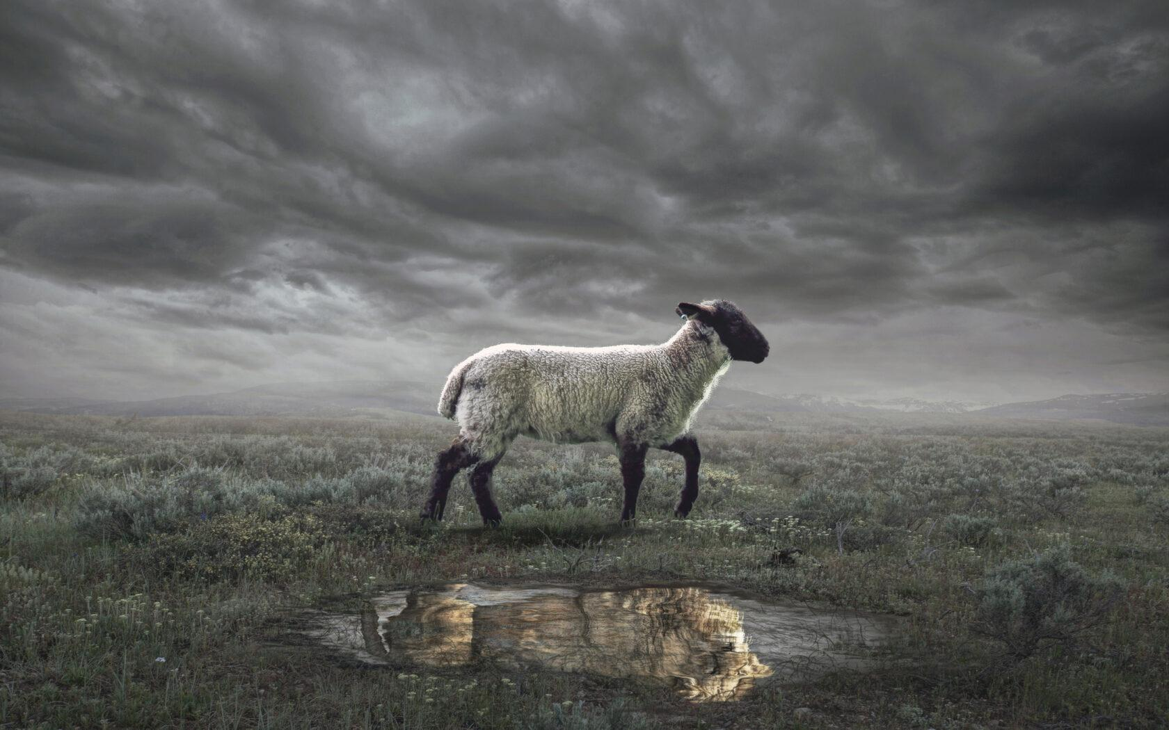
The Revelation
6. Who walks among the lampstands

Slide 2
Review Quiz
What is the genre of the Book of Revelation?
Prophecy
Apocalyptic Literature
Letter

Slide 3
Review Quiz
What are some characteristics of apocalyptic literature?
Written as a code to break
Written to evoke emotion
Brings comfort & challenge
Uses exaggerated images
Should be read literally

Slide 4
Review Quiz
What’s the first question to ask in Bible study?
What does this mean to me?
What did this mean to the first readers?
What’s for lunch?

Slide 5
Review Quiz
What was the challenge facing the Christians in 1st century Asia?
Compromise
Apathy
Persecution

Slide 6
What is the current situation?
John potentially in exile in Patmos
Greek culture came in years before changing societal and religious practices
The Roman Empire takes control
Adopts Greek culture, philosophy, and religion
They did change some of the gods name to make it their own
Largely a pagan and imperial society
All kinds of gods were worshiped and leaders were worshiped as gods
Sexual immorality and idol worship were key tenants of society

Slide 7
What is the current situation?
Judaism is tolerated and allowed to practice their ways and not participate in the culture and religion of the Romans
Christians were viewed as a sect of Judaism and “grandfathered” in to being able worship God
Around the destruction of Jerusalem, it became apparent that the Jews and Christians were different.
Judaism this allowed to practice their ways but Christians begin to take more heat from all sides and are not extended the same exemptions as the Jews

Slide 8
Review of the Vision of Jesus in Revelation?
7 golden lampstand
Son of man among the lampstands dressed in a robe to his feet and with a golden sash around his chest
Hair white like wool or snow
Eyes like blazing fire
Feet were like bronze glowing in a furnace
Voice of Rushing Waters
Right hand had 7 stars
Double edged sword coming out of his mouth
Face bright and brilliant like the sun

Slide 9
Uniform Structure of Letters
Jesus is… (description, see chapter 1)
Jesus knows… (church’s situation)
Jesus says… (comfort or challenge)
Jesus will… (promise, see ch. 21-22)
“He who has an ear, let him hear what the Spirit says to the churches.”

Slide 10
Challenge #1: Persecution
Smyrna – The Persecuted Church
No rebuke for this church
Slander from the Jews
Synagogue of Satan
Warning of trials to come
Prison, persecution, death
Don’t fear! “The one who is victorious will not be hurt by the second death”

Slide 11
Challenge #1: Persecution
Philadelphia – The Faithful Church
Praise for not denying the Lord’s name
No rebuke
Considered to be “Little Athens” because of the overwhelming pagan influence

Slide 12
Challenge #2: Compromise
Pergamum – The Compromising Church
Strong pagan and imperialist influence
Rebuked for holding to the teaching a Balaam by listening to the teachings of the Nicolaitans
With a society built around pagan god worship, the influence to be a part of society to fit in and be successful is strong
Can you participate in society without embracing it?
We are supposed to be set apart from society!

Slide 13
Challenge #2: Compromise
Thyatira – The Corrupt Church
City built upon pagan society & guilds
Participation was almost required for success in society
Jezebel ‘the prophetess’ teaching fornication and idol worship

Slide 14
Challenge #3: Apathy
Laodicea – The Lukewarm Church
Neither hot nor cold
Not a spectrum; both hot water is pleasing and cold water is pleasing. Lukewarm is not pleasing in any case
God will vomit them out
Because of the wealth of Laodicea it is assumed these Christians were well off
They were physically rich but spiritually poor
Success leads to sense of self importance and do not need help from anyone.

Slide 15
Challenge #3: Apathy
Sardis – the spiritually dead church
Had a reputation of being alive but had fallen asleep
Reputation is not enough
A tactful way of say ‘their performance leaves a lot to be desired’
“I will come live a thief in the night’
Not a reference to the second coming but that the Lord, trials, or persecution will come at anytime and we need to be prepared
Reference to invasion by the Persians

Slide 16
Challenge #3: Apathy
Ephesus - The Loveless Church
Praised for rooting out false teaching and those trying to turn them from God’s word
Rebuked because “you have left your first love”
What does this mean?

Slide 17
What About Us?
Where do we see Bellaire in these letters?
Are we persecuted? If so, how?
Are we guilty of compromise? If so, how?
Are we apathetic? If so, how?
What kind of cultural accommodations do we as Christians make today?
Individually?
As a congregation

Slide 18
The Revelation

