Slide 1
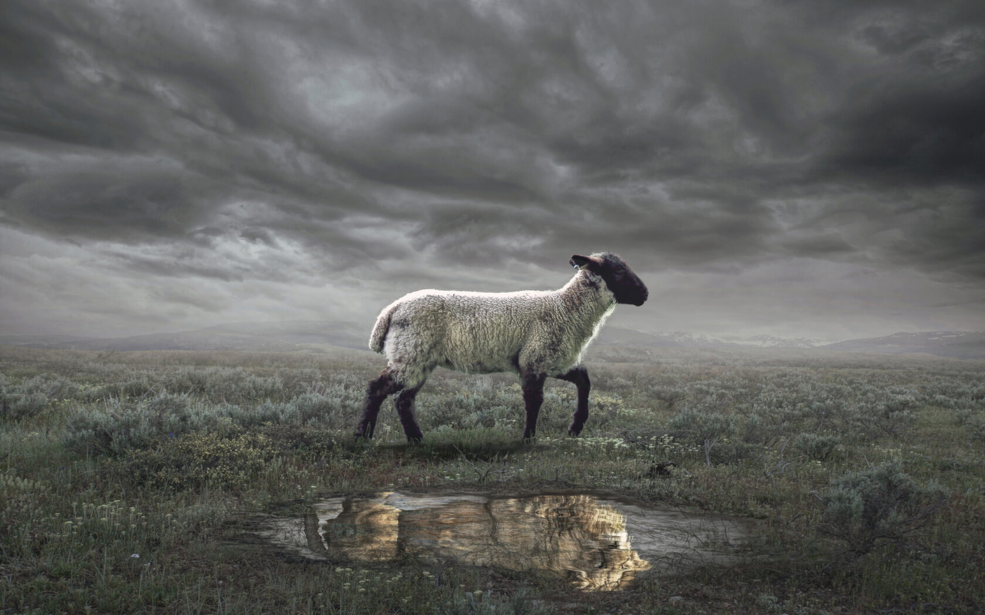
The Revelation
7. A throne stood in heaven
chapters 4-5

Slide 2
Review Quiz
What were the dangers facing the Christians in 1st century Asia?
___________
____________
_______
Persecution
The Revelation pulls back the curtain to comfort (God reigns, evil will fall) and challenge (get on the right side or else).
Compromise
Apathy

Slide 3
Structure of Revelation
Letters to the Churches (1-3)
The Throne of God & the Lamb (4-5)
Seven Seals (6-8)
Seven Trumpets (8-11)
Seven Signs (12-14)
Seven Bowls (15-16)
Fall of Babylon (17-19)
Final Battle (19-20)
New Heavens & New Earth (21-22)

Slide 4
Defining Terms
What does it mean that God is holy?
What does is mean that God is worthy?

Slide 5
Revelation 4-5
Hear & see (imagine) what John is describing.
Reflect on the holiness of God and the worthiness of God and the Lamb.

Slide 6
Revelation 4:1-11
John is shown a transcendent reality:
“a door in heaven” – God’s space
“what must take place” – God’s time
Focal point: God on the throne
Like the visions of the prophets
A direct contradiction to Caesar
God’s heavenly subjects recognize His holiness and lay their authority at His feet—because He gave it to them.

Slide 7
A theater of praise
Revelation 4 shows the heavenly creatures in God’s presence constantly praising Him, offering Him everything.
Revelation 5 tells the story of God’s redemption through the Lamb.
By 5:13, all creatures in heaven, on (and under) the earth, and in the sea join the praise of God & the Lamb.
Have we joined the song?

Slide 8
The Revelation
For Wednesday (4/2)
7. I saw a Lamb standing, as slain

