Slide 1
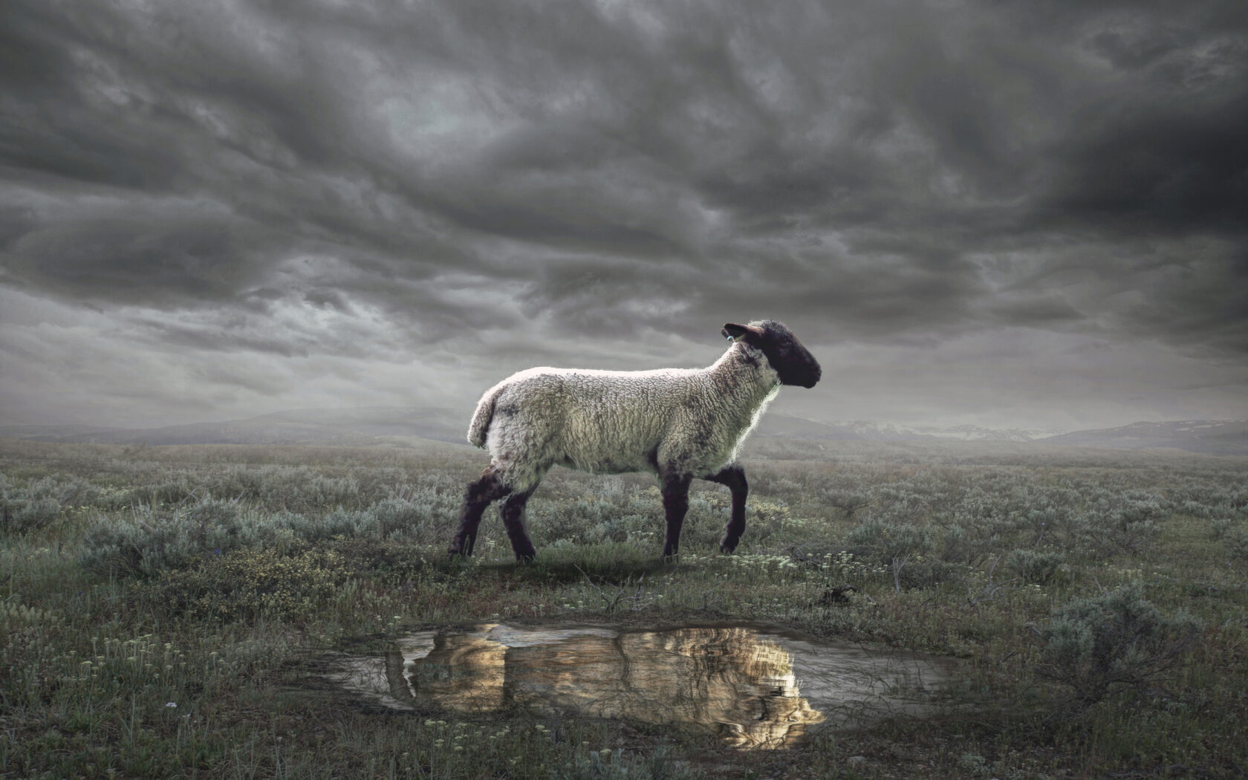
The Revelation
10. Who are these in white robes?
chapter 7

Slide 2
Review Quiz
What is the genre of the Book of Revelation?
______
_________
____________
Addresses specific circumstance
Letter
Call to faithfulness, looks to future
Prophecy
Apocalyptic
Reality unveiled in symbolic visions

Slide 3
Review Quiz
What were the dangers facing the Christians in 1st century Asia?
___________
____________
_______
Persecution
The Revelation pulls back the curtain to comfort (God reigns, evil will fall) and challenge (get on the right side or else).
Compromise
Apathy

Slide 4
Review Quiz
What is the clear message of the heavenly vision in Revelation 4?
God the Creator sits—sovereign and holy—on the throne.

Slide 5
Review Quiz
What is the scroll in God’s hand which only the Lamb is worthy to open in Revelation 5?
God’s plan–to deal with evil and rescue His people.

Slide 6
Review Quiz
What happens when the seals of the scroll are opened in Revelation 6?
Judgments of God are carried out on the earth.
Seals 1-4: Partial judgments of conquest, war, famine, and death.
Seal 5: Martyred souls cry for justice
Seal 6: Full pouring out of God’s wrath

Slide 7
What are the seal judgments (ch.6) referring to?
Prediction of specific events that will bring about the end of the world?
Prediction of events leading to the downfall of Rome? Or Jerusalem?
Picture of how God deals with human evil (in Rome; throughout history; at the end)
What does this say about conquest, war, famine, and destruction on the earth?

Slide 8
Revelation by the Chapter
Glorified Christ among the lampstands (1)
The state of the churches revealed (2-3)
God, sitting on the throne in heaven (4)
The Lamb is worthy to open the scroll (5)
First 6 seals opened → Judgments (6)
Interlude: Washed Israel is sealed (7)
7th seal opened → 7 Trumpets (8-11)
Think: Plagues against Egypt, Israel protected (Exodus 8-12)
Think: Slaughter in Jerusalem, faithful marked (Ezekiel 9)
Read (Hear) Revelation 6-7

Slide 9
Revelation 7:1-17
God’s Servants Sealed (1-8) – pause in judgment to mark out God’s faithful
John hears a military roll call of Israel
144,000 (12 x 12,000) a complete number
The Great Multitude (9-17) – John sees an innumerable host, from every nation
Who can stand? (6:17) They can (7:9)
Rescued by God, washed in the blood
Brought through the tribulation to life
Follow the Lamb, join the heavenly song

Slide 10
Revelation 7
What does this vision mean for the Christians in Roman Asia?
What does it mean for us?

Slide 11
The Revelation
For Wednesday (4/12)
11. Seven trumpets were given …

