Slide 1
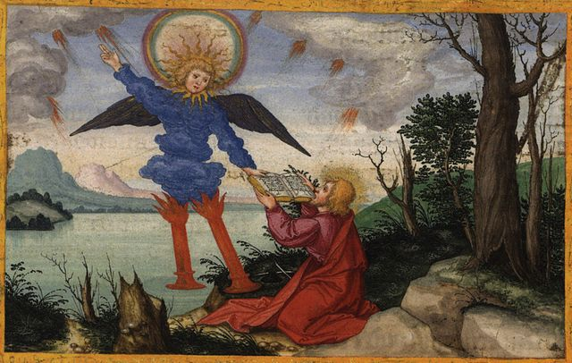
The Revelation
13. Take the scroll and eat it
chapter 10

Slide 2
Review Quiz
What is your favorite image/picture/scene in Revelation so far? Why?

Slide 3
Revelation by the Chapter
Glorified Christ among the lampstands (1)
Seven churches charged to conquer (2-3)
God, the throne, the Lamb, and the scroll (4-5)
Six seals opened (6)
Interlude: God’s people sealed (7)
7th seal opened (8)
Six Trumpets (8-9)
Interlude: John’s call, church’s witness (10-11)
7th trumpet sounds (11)
God’s plan to judge wicked, rescue the righteous
Not chronological (within or between cycles)

Slide 4
Revelation by the Chapter
Glorified Christ among the lampstands (1)
Seven churches charged to conquer (2-3)
God, the throne, the Lamb, and the scroll (4-5)
Six seals opened (6)
Interlude: God’s people sealed (7)
7th seal opened (8)
Six Trumpets (8-9)
Interlude: John’s call, church’s witness (10-11)
7th trumpet sounds (11)
Show the role of God’s people in God’s plan
Descriptions are concurrent with the judgments

Slide 5
Revelation by the Chapter
Glorified Christ among the lampstands (1)
Seven churches charged to conquer (2-3)
God, the throne, the Lamb, and the scroll (4-5)
Six seals opened (6)
Interlude: God’s people sealed (7)
7th seal opened (8)
Six Trumpets (8-9)
Interlude: John’s call, church’s witness (10-11)
7th trumpet sounds (11)
Sense of finality, God’s plan now completed

Slide 6
Revelation 10-11
Read (listen) to these chapters.
What part do God’s people (first John, then the church) play in God’s plan?

Slide 7
Thunders & a Scroll (Rev. 10)
Mighty Angel (1-2) – representative of God, authority over land and sea
“little scroll” (2) – God’s plan (like in 5:1)
7 thunders (3-4) – sealed up, not written
More judgments that are not carried out?
Action of God not revealed to man?
Angel’s oath (5-7) – see Daniel 12:4-9
In Daniel, it would be time, times, ½ a time
In Rev. 10, there will be no more delay
God’s mystery fulfilled in the 7th trumpet

Slide 8
Thunders & a Scroll (Rev. 10)
Eat the scroll (8-11) – like Ezekiel 2-3
Follows the chain of revelation from 1:1-3
God (5:1) → Lamb (5:7) → Angel (10:1) → John (10:10) → Readers
Sweet to taste, but bitter to swallow…
a message for peoples, nations, kings…

Slide 9
Reflections on Revelation 10
Why / how is the message of Revelation bittersweet?

Slide 10
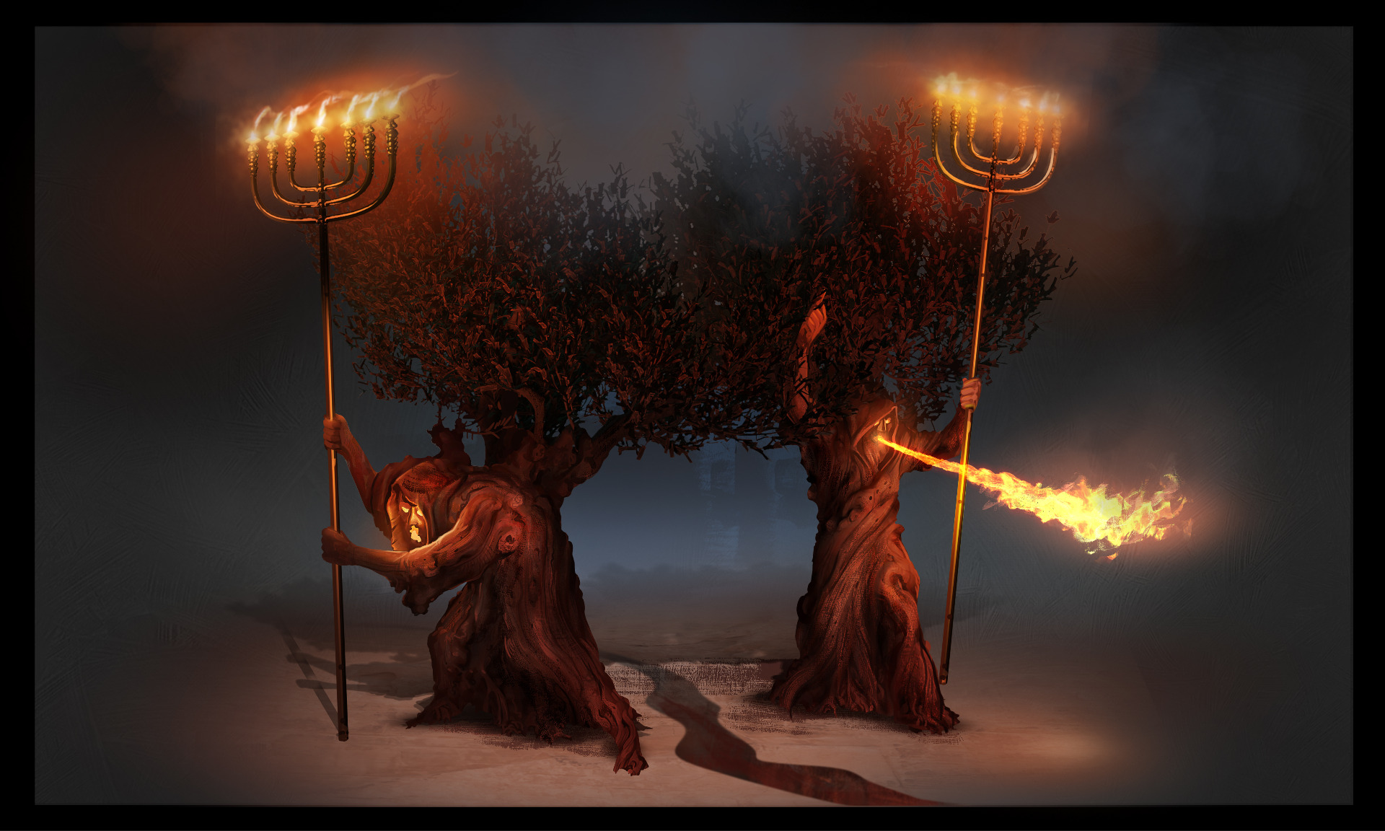
The Revelation
For Sunday (4/23)
14. Authority to my two witnesses

