Slide 1
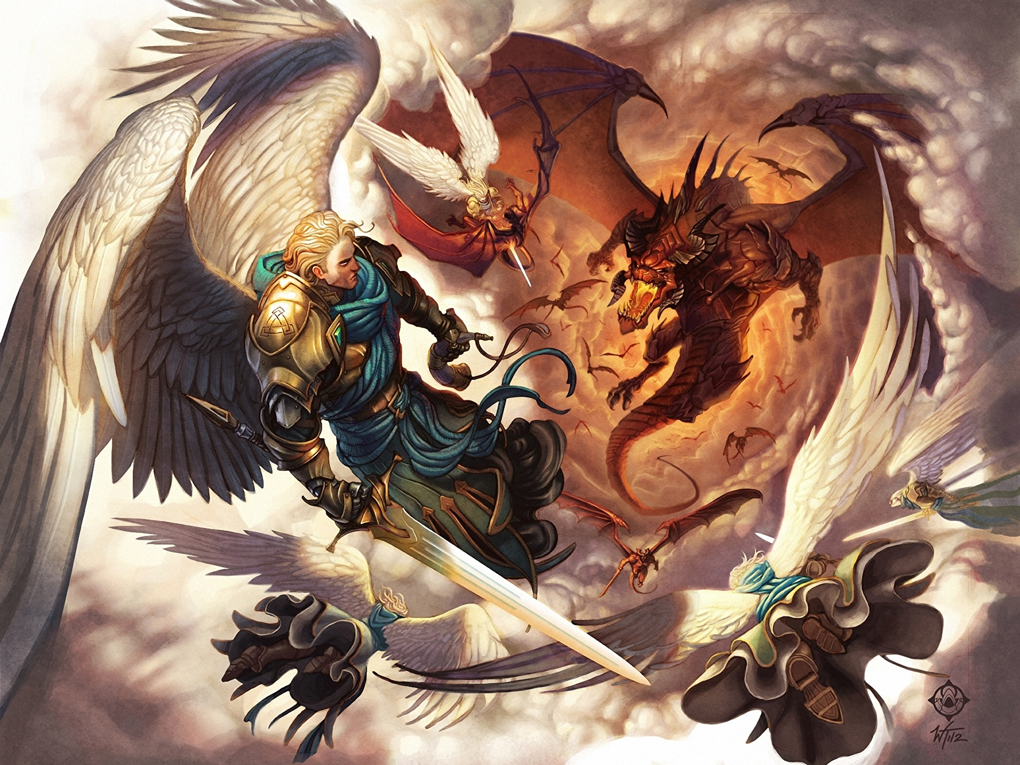
The Revelation
15. Now war arose in heaven
chapter 12

Slide 2
Overview: Revelation 1-11
Introduction to the vision (1-3)
Glorified Son of Man among the lampstands (1)
7 churches charged to “hear” & “conquer” (2-3)
Act I of the vision (4-11)
God on throne, praised by His heavenly court (4)
Slain Lamb is worthy to open the scroll (5)
6 seals – heaven’s judgments on earth (6)
Interlude: God’s people sealed (7)
7th seal – silence in heaven → trumpets (8)
6 trumpets – God’s wrath on earth (8-9)
Interlude: John’s call, church’s witness (10-11)
7th trumpet – eternal kingdom come (11)

Slide 3
Revelation 12
Read (listen to) the chapter.
See the drama play out and get the basic storyline.

Slide 4
Making sense of Revelation 12
Identify key points – anchors in this text
Which figures are identified clearly?
Dragon = the devil (12:9)
Male child = Jesus (12:5; Psalm 2:9)
Michael & his angels (12:7)
“our brothers” (12:10-11)
What are the clear plot points of the drama?
What is the dragon’s first aim? (12:1-6)
Who conquers the dragon? (12:7-12)
What is his response? (12:13-17)

Slide 5
Making sense of Revelation 12
See biblical patterns – from OT and NT
What images/elements from this story remind you of a previous Bible story?
Woman vs. Snake (Genesis 3:15)
Protection and nourishment in the wilderness (Exodus; also Hagar)
Fall of the satan (Luke 10:18)
Accusing before our God (Zechariah 3)
Conquering of the slain Lamb (ch.5)
1,260 days / time, times, half a time (3.5, ”not forever,” see 11:2-3; Daniel 12:7,11)

Slide 6
Making sense of Revelation 12
Put it in context – of the Revelation
What themes from Revelation 1-11 are being sounded again in chapter 12?
Heavenly reality → Earthly reality
The evil one at work (9:1-11)
God (the Lamb) ultimately victorious
Paradox of conquering thru suffering
Consider audience – 1st century Asia
What would this mean for the persecuted church? Compromising church? Apathetic?

Slide 7
War in Heaven & Earth (Rev 12)
Woman v. Dragon (1-6)
Woman = Humanity (perhaps also Israel)
Devil tries to thwart God’s plan; Christ overcomes (death, resurrection, ascension)
Michael v. Dragon (7-12)
Christ victory deals mortal blow to devil
Those who follow Lamb conquer with Him
Dragon v. Offspring (13-17)
Devil rages because he’s been defeated
God protects & provides His people as the devil makes war against them

Slide 8
Reflections on Revelation 12
What changes when we understand that Revelation 12 tells the story of our reality?

Slide 9
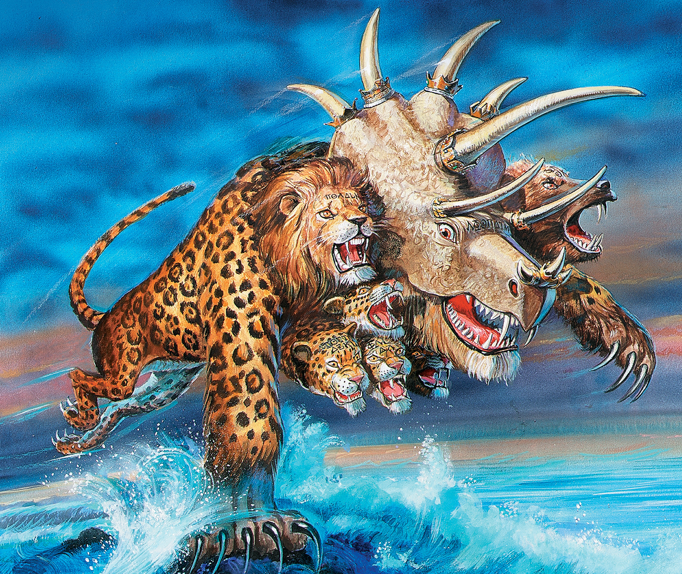
The Revelation
For Sunday (4/30)
16. A beast rising from the sea

